Slide 1
Royal Canadian Air Force
RUCTOP
LGen E.J. Kenny, Comd RCAF
CWO R.J. Hansen, Command CWO RCAF
9 September 2024

Slide 2
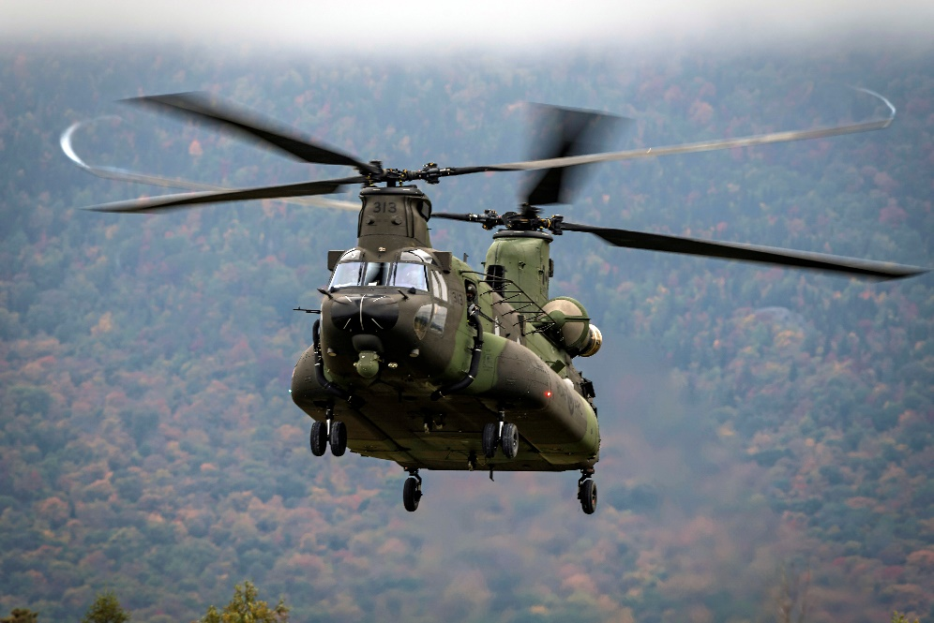
Outline
Current & Future Security Environment
Mission & Vision
Our People
RCAF Strategy
Strategic Objectives
RCAF 2024
Expectations / Perspectives

Slide 3
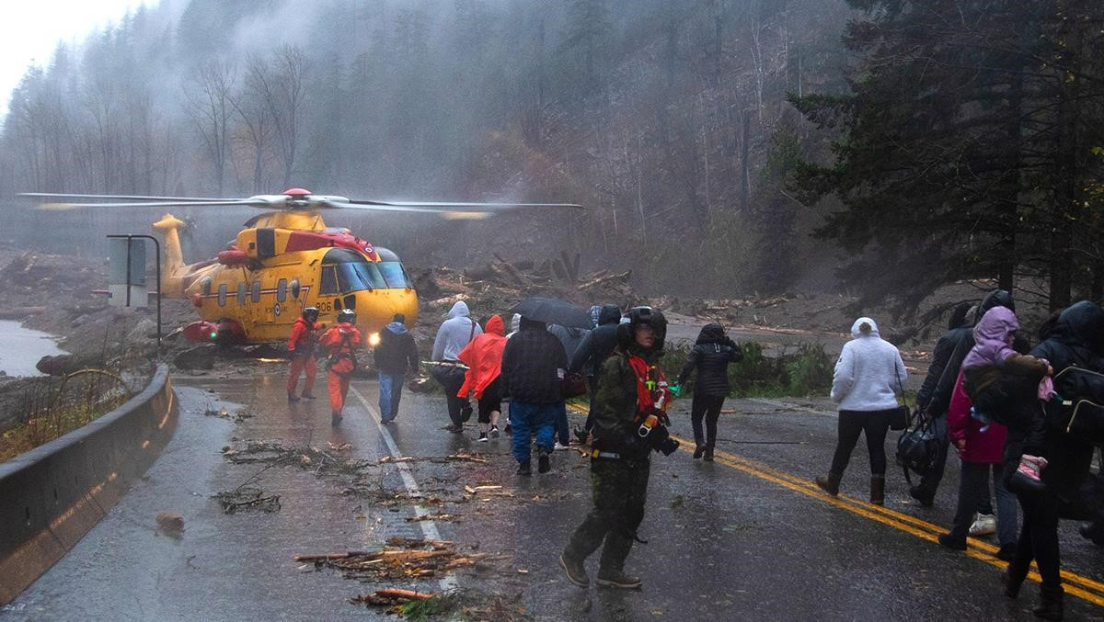
Current and Future Security Concerns
Geostrategic concerns
Emerging and disruptive technologies
Cyber and EM threats and resilience
Personnel challenges
Climate change
Space capabilities

Slide 4

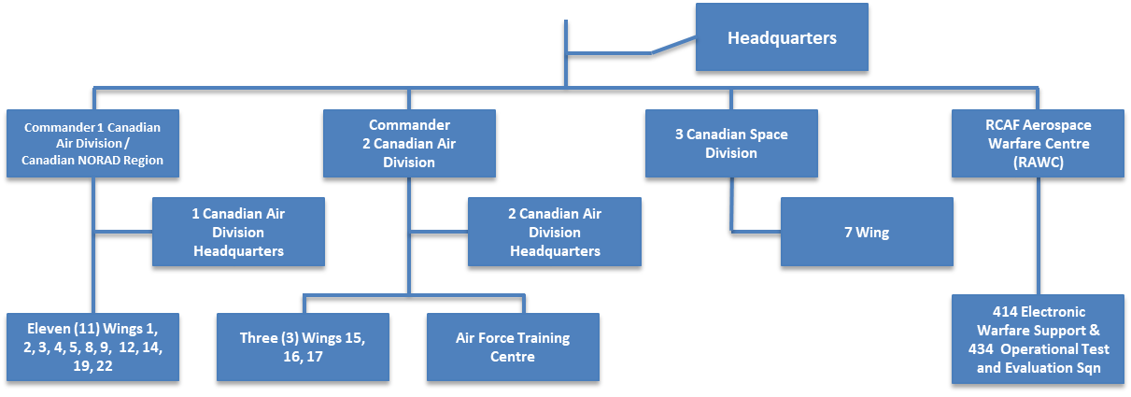
Mission
Generate relevant, responsive and effective
air and space power at home and abroad
Vision
Achieve operational advantage as an agile,
integrated and inclusive air and space force
Our People
 | Regular Force | Reserve Force | Public Service (Indeterminate) | Total
People | 11,656 | 2063 | 1372 | 15,091
Positions | 13,439 | 3274 | 2155 | 18,868
4

Slide 5
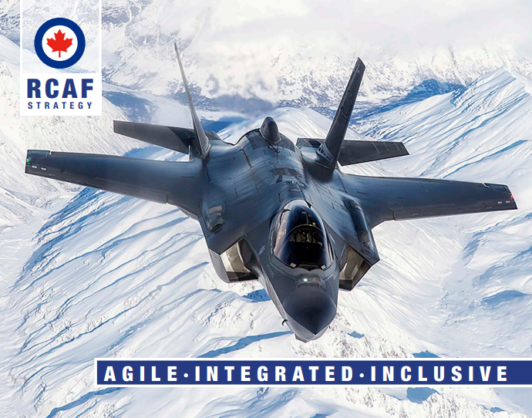

RCAF Strategy

Slide 6
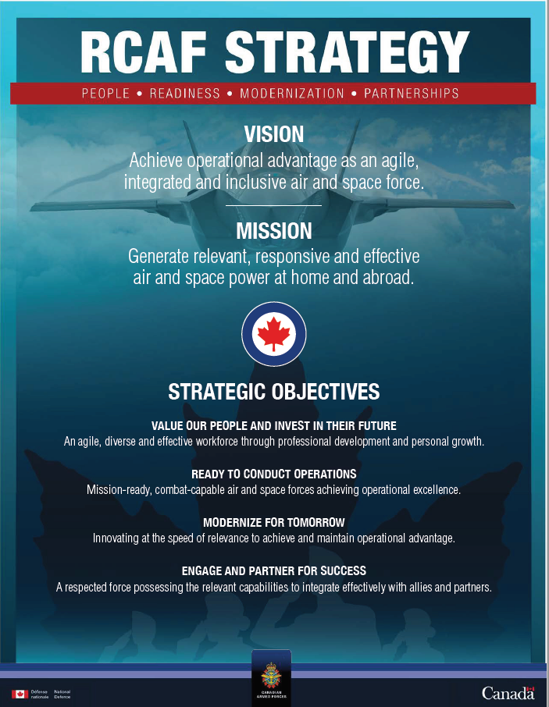
Notes:
Discussion slide

Slide 7
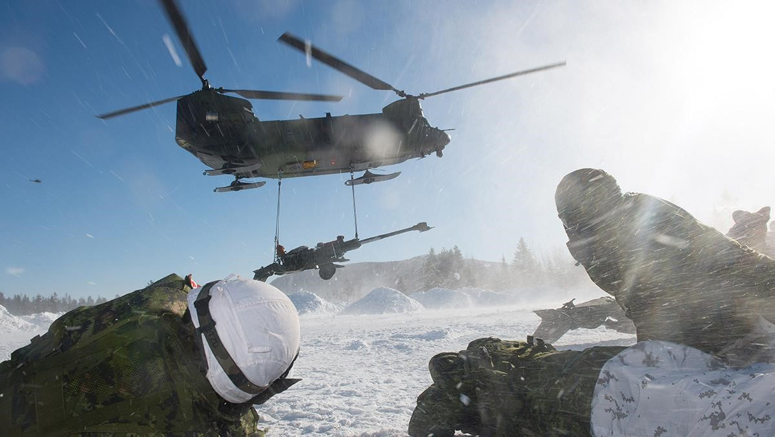
Strategic Objectives
Value our people and invest in their future
Ready to conduct operations
Modernize for tomorrow
Engage and partner for success

Slide 8
Comd Expectations
Mission / Vision / Values
Priorities
Two approaches: Set in advance, or work collaboratively
Develop your narrative
Consistently communicate – up / down / lateral
Work being done not aligned with priorities – question why it is being done using a risk mindset (output & process)
Review, understand, modify if needed
Alignment
Focus of the Sqn/Unit
Taking Care of People
Reflections
Inclusion / Respectful Environment
Get to know your people
  Strengths / areas for improvement
Empower your people
Mentor your people
Develop our replacements
Be approachable / authentic
Make / own decisions
Unit command team has biggest impact on people
Limited feedback
Work-life balance
Command team approach

Slide 9
CCWO perspective
Welcome to the CWO Corps
Own your role as an advisor
Accountability
Immerse yourself
Unit Culture
Role of the Critical Sensor
Messaging
Work/Life balance
What does the future hold?

Slide 10

Discussion

