Slide 1
Sustained Operational Excellence
Notes:
Does anyone here think that this is an unreasonable goal for our institution?
Next question, what is Excellence? Is it the right balance between efficiency and effectiveness in delivering on our mandate? How do we get there?
We are aiming at improving how we currently move in this direction. There is a lot that we do well as individuals and as an organization. A key question that we can continuously ask is “What can I/We do better?”

Slide 2
Reflection
Broad view of how we do business
Mindset
Character

Slide 3
Reflection
Notes:
Before we begin our journey,
I joined the CAF because…
I would like to ask you to take out your handout. The first question is “Why did you join the CAF?”
Think back and really try to put yourself back in the place you were when you made the decision to go to the recruiting office. Please take a few moments to write down 2 or 3 bullet points that answer this.
The next question is “Why do you stay?” I stay because…
please take another few moments and write out a few bullet points to answer this.

Slide 4
Something to Consider
What the Royal Canadian Air Force does?
Responsible for training, generating and maintaining combat capable, multi-purpose air forces to meet Canada's defence objectives.
Notes:
It is worth highlighting and always remembering that combat capable and other activities are what we mean when we describe our overarching goal of sustained operational Excellence.
This is one of the mandates for the Comd of the RCAF.
None of what we are about to discuss in pursuit of our goal is meant to soften our resolve or our response. In fact, we are trying to elevate our ability to deliver our capabilities as ordered by our government on behalf of the people we have sworn to protect.

Slide 5
How to Win in Operations?
Multiple schools of thought:
Equipment Wins –
“More/better sensors, more communications, more and better computers, more and better display devices, more satellites, more and better fusion centers, etc.—all tied into one giant fully informed, fully capable C2 system. This way of thinking emphasizes hardware as the solution.”
People Win –
“Need Insight and Vision to unveil adversary plans/actions and to “foresee” own goals and appropriate plans and actions
Need Focus and Direction, to achieve some goal or aim
Need Adaptability, to cope with uncertain and ever-changing circumstances
Need Security, to remain unpredictable”
Which version can you positively impact every day?
John Boyd, Organic Design for Command and Control
Notes:
The objective here is to describe the two schools of thought regarding the question at the top. Explain the points on the slide paraphrasing and then ask the students the question in red at the bottom. This should generate a brief discussion
Ref: http://www.projectwhitehorse.com/pdfs/boyd/organic_design.pdf
Need insight and vision, to unveil adversary plans and actions as well as “foresee” own goals and appropriate plans and actions. •
Need focus and direction, to achieve some goal or aim. •
Need adaptability, to cope with uncertain and ever-changing circumstances.
Need security, to remain unpredictable.

Slide 6
How to Win in Operations? How We Think
How do we convince others to stop fighting for their way of life?
This drives the bulk of the CAF’s purpose. Things we can do include:
Take Territory
Kill combatants
Destroy C2 (or C3/C4/C5) structures
We can pay money
We can give jobs
We can patrol endlessly
Support some rebuilding
But the Taliban, the Viet Kong, the Cartels, the US Revolutionaries and scores more kept fighting.
If our goal is to Win, then this can be like a game. We can thus Think in “Game” terms.
John Boyd, Organic Design for Command and Control
Notes:
Game terms a zero sum game in order for me to win you must loose.
The Infinite Game, by Simon Sinek
Military leaders are beginning to recognize this. A Comd with the sole drive of performance will look good on the short term they can drive their people into the ground and leave after two years looking like a top performer. Of course, the person coming in behind them is going to look like crap trying to pick up the pieces and rebuild the organization.

Slide 7
How to Win in Operations? How We Play
When have you lost a game and decided to never play against that person again…ever?
If you are so outmatched that you don’t think you could ever win, most people stop…unless…
The stakes are so high that it’s worth the rest of your life to find a way to win.
Need two parts:
A way to outmatch such that they could never win; and
To lower the stakes so that losing isn’t so bad.
John Boyd, Organic Design for Command and Control
Notes:
Ref: https://soundcloud.com/youllneverwin
Example for point 1 – I tried to learn how to play hockey at the age of 13. I quickly realized just how far behind everyone else I was and immediately decided hockey was not for me.
Example to use for Point 2 - How did Genghis Khan win wars? Not only did he have superior weapons and tactics, but.
If you resisted them they would, possibly Kill all your men, kill or sell as slaves all your children and animals, burn your city to the ground, and scatter the ashes!
Obviously, Not A Good Idea to Resist!!!
If you surrendered, they would demand 10% of everything you had of value, then incorporate you into their empire including protection from others and incorporating you into their many successful economic systems like their Mail system and The Silk Road (a highly profitable and secure trading road between Europe and China.
The Mongols were very open about incorporating other religions (allowing Christian, Muslim, Buddhist, Jewish, Hindu, Taoists, and many others) to be practiced. The royal family had many believers of all these.
They also had women in many high-ranking positions.
This all at a time when religious persecution and woman having no rights prevailed!

Slide 8
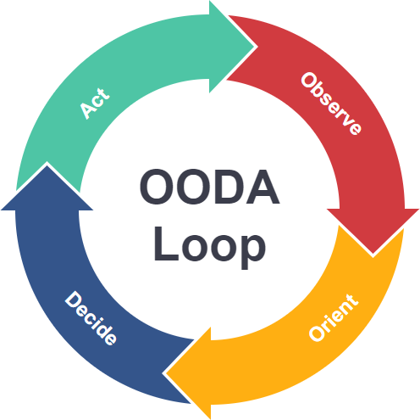
How We ALWAYS Win
Faster information processing on everything at every stage creates confusion, disorder, and chaos for the adversary¹
USAF Col (Ret’d) John Boyd suggested the OODA loop²:
Observe
Orient
Decide
Act
Equipment can help, but OODA loop is an information/decision processing loop managed by people.
To process faster/better, we need people working as superior Teams.
John Boyd, Organic Design for Command and Control
Notes:
– Introduce the concept of the OODA Loop using the points on the slide.
This model can help with judgement
Observe
What is the current situation? What is the reason you want to change? How bad do you want to change?
Orient
Where are you currently at relative to where you want to go? How far is it to your destination?
Decide
What is the exact path you are going to take? How are you going to handle challenges and setbacks?
Act
What’s the approach and methods you will take to implement the decisions? What is your action plan?
This is a loop because once you take action you should be carefully observing what the outcome is or is likely to be and adjust accordingly.
So to the last point – building better teams is where we can make strides to improve.
Refs:
http://www.projectwhitehorse.com/pdfs/boyd/organic_design.pdf
https://online.visual-paradigm.com/knowledge/decision-analysis/what-is-ooda-loop/

Slide 9
Character and Competence
“Trusted to Serve” has put us on the path to elevate character alongside competence.
High character organizations tend towards success and do so consistently over time.
Ivey Business School, Western University
Notes:
Trusted to Serve has laid out the idea that we can be a better organization by elevating our character in-line with our competence.
Find one person in the front and ask if they agree with this idea?
Character and Competence are two key themes in pursuit of sustained operational excellence.
In the interest of sustained operational excellence, we are going to weave together the ideas of an Infinite Mindset and Character Based Leadership to guide our success.
Let’s discuss the “consistently over time” part of that statement.

Slide 10
What kind of game are we playing and why?
Finite Game | Infinite Game
Known players | Known/Unknown players
Clear end point | No end point
Clear winner | No winner
Fixed rules | No fixed rules
Simon Sinek, Infinite Game, The INFINITE GAME Book | Go Beyond Reading - Simon Sinek
Notes:
With our goal in mind, we will explore an idea about different types of games. This is not meant to trivialize our mission. It is a way to conceptualize how we approach it.
Do we always know the players in our game?
When does our game end? – Here we want to think about extending the game. Making decisions on how best to position your unit to succeed into the future.
Are we able to know if we won?
Do the rules change over time?
How does being part of an organization that is in an infinite game change the way you view the organization?
How does it change the way you view yourself within it?
How about others?
What about decision making in this context?
Is thinking about it in this context useful as we strive for Sustained Operational Effectiveness?

Slide 11
Shifting to an Infinite mindset
Focus on sustaining the game. Seek to get better and build something that will outlast them.
Aim for resilience. Embrace unexpected challenges to learn and grow
Create cultures of unity and belonging improve trust cooperation and innovation
Seek to improve everyone’s lives
Simon Sinek, Infinite Game, The INFINITE GAME Book | Go Beyond Reading - Simon Sinek
Notes:
Discuss each of these points.
I recently recall remarks about a squadron being the best of all the squadrons within a specific fleet. While we can benefit from friendly competition we also want to ensure that we are focused on sustaining the game. How did this squadron through its success contribute to the betterment of the other squadrons in its fleet? How did it position itself and its fleet for success in the future? These are more infinite minded questions that would be inspirational to RCAF personnel.
The Military is always going to be a bridge for the National Government between a Finite and Infinite mindset in global politics. Our tactical tasks are often finite in the moment, we have to move people and equipment using Air Transport, the processes for that day-to-day are typically finite. But there’s also the infinite game in the background. Why do we only use the C17 on certain resupply missions. When do we contract out airlift? How do we manage our mobile repair parties and parts hubs? We can absolutely focus on the Finite only, however the Infinite is always there ready to be tapped into for increased resilience, unity, and belonging. Are we an Air Force that does stuff? Or are we an Air Force that Supports and Defends Canada and Canadians? Stuff is finite, Canada and Canadians are infinite.
In the Vietnam war the US won every battle but lost the war why?
North Vietnam was playing the infinite game. Their goal was to outlast the US not defeat it.
Cultures of unity and belonging and the improvement of lives will be discussed more as we explore character-based leadership and understanding people.

Slide 12
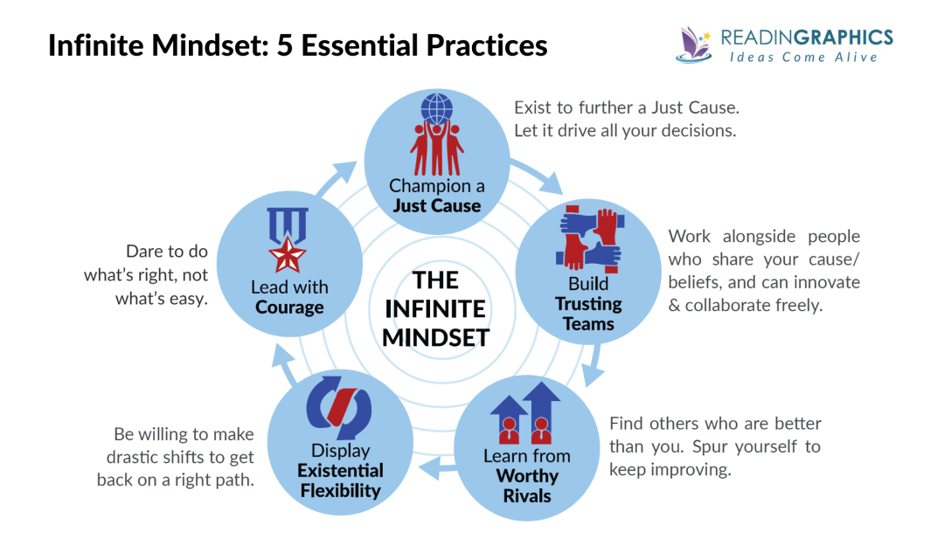
Simon Sinek, Infinite Game, The INFINITE GAME Book | Go Beyond Reading - Simon Sinek
Notes:
This is the model that is used to shift into an Infinite mindset. We will discuss how each one can apply to our organization and your units in the coming slides.
Note: highlight each of the titles of the essential practices.
The best companies foster a sense of trust between employees so they can focus on achieving goals together, rather than fighting internal politics. The only way leaders can build a "circle of safety" is by protecting employees.

Slide 13
Practice #1: Advancing a Just Cause
Infinite-minded leaders are driven by a Just Cause.
They are compelled by the potential of the future that drives all their decisions.
A Just Cause must fulfill 5 criteria:
Standing for something meaningful;
Idealistic.
Inclusive;
Resilient; and
Service-oriented;
RCAF Mission/Vision – does this give you a just cause to champion?
Simon Sinek, Infinite Game, The INFINITE GAME Book | Go Beyond Reading - Simon Sinek
Notes:
What do we mean by a “just cause”?
Just Cause has five elements:
It stands for something, not against something: It’s optimistic and hopeful.
It’s idealistic: It’s inspiring, bold, and ultimately unachievable.
It’s inclusive: It invites and inspires others to join.
It’s resilient: It can endure technological, cultural, political, and industry changes.
It’s service-oriented: It’s aimed at the benefit of others.
You as Leaders/Command Teams must serve as the custodians of the Cause in service to the overall objective of “Sustained Operational Excellence”
• Focus on serving a greater purpose that gives people a sense of belonging and meaning; • Operate in a way that protects people, As Leaders you provide the circle of safety to your units; and • Manage resources to keep serving the 2 responsibilities above.
Note: below is the description from the resource.
Practice #1: Champion a Just Cause (Discussed purpose of RCAF – does this give you a just cause to champion?)
Infinite-minded leaders are driven by a Just Cause, i.e. a compelling vision of a future that doesn’t yet exist. This drives all their decisions.
A Just Cause must fulfill 5 criteria: standing for something meaningful, inclusive, service-oriented, resilient, and idealistic.

Slide 14
RCAF
Our mission
Generate relevant, responsive, and effective air and space power at home and abroad.
Our vision
Achieve operational advantage as an agile, integrated and inclusive air and space force.
Notes:
Does the RCAF Mission/Vision statement resonate with you? Does it resonate with the average Aviator/2Lt?
How does your unit fit into these statements?
Does this meet the 5 criteria? (standing for something meaningful, inclusive, service-oriented, resilient, and idealistic.)
Talk through each of the 5 criteria one at a time with the students and see if this vision is sufficient, or what might need to change.

Slide 15
1 CAD and 2 CAD
1 CAD
Mission: Generate and employ world class air power at home and abroad.
Vision: An agile, integrated, mission-ready air force, responsive to CAF priorities.
2 CAD
Mission: 2 Cdn Air Div generates and develops personnel as Training Authority for the RCAF.
Vision: 2 Cdn Air Div will deliver advanced aerospace knowledge and leading-edge training through a responsive, innovative and effect-based methodology to achieve maximum training effectiveness for the RCAF.
Notes:
How about these?

Slide 16
Tactical Level
Mission:
?????
Vision:
?????
Notes:
What is your Mission/Vision statement? Is it a “Just Cause” that inspires you and your team?
Does it align with the operational and strategic mission/vision statements?
If you are going to update your units Mission/Vision statements it might be useful to get your people involved. This will help build buy-in. Over the last year we have been training personnel on AFOD 5 with facilitation skills that lends itself very well to this task.
Does this meet the 5 criteria? (standing for something meaningful, inclusive, service-oriented, resilient, and idealistic.)
Talk through each of the 5 criteria one at a time with the students and see if this vision is sufficient, or what might need to change.

Slide 17
Practice #2: Build Trusting Teams
Alignment of people and decisions with the Cause. Build trusting teams where people share the same purpose/beliefs and can collaborate and innovate freely.
High-performing teams require 2 ingredients:
Performance (which is about technical competence); and
Trust (which is about personal character–the ability to trust others and be trusted).
Infinite-minded leaders develop both elements in their teams by:
creating a safe environment where people can voice their fears/concerns and address issues, encouraging actions that build trust and optimal performance; and
developing their team members.
Simon Sinek, Infinite Game, The INFINITE GAME Book | Go Beyond Reading - Simon Sinek
Notes:
Practice #2: Build Trusting Teams
Having a Just Cause isn’t enough. You must also align people and decisions with the Cause. Build trusting teams where people share the same purpose/beliefs and can collaborate and innovate freely.
Specifically, high-performing teams require 2 ingredients: performance (which is about technical competence) and trust (which is about personal character–the ability to trust others and be trusted). Infinite-minded leaders develop both elements in their teams by: creating a safe environment where people can voice their fears/concerns and address issues, encouraging actions that build trust and optimal performance, and developing their team members.
How do you align people and decisions with the cause? Good leadership – How do you walk into a room full of strangers and in 60-90 minutes develop a high performing trusting team?

Slide 18
Practice #3-a: Learn from Worthy Rivals/Mentors
A Worthy Rival/Mentor is an infinite-minded player who’s worth learning from because they’re better than you in some way(s). It can be:
Inside your unit;
Inside your Trade Group;
Global Adversaries;
Present Allies;
Historical Groups/People…
Find people better than you to help spur yourself to keep improving.
Simon Sinek, Infinite Game, The INFINITE GAME Book | Go Beyond Reading - Simon Sinek
Notes:
This is why you are here. You will learn from and build a network here with people that have different technical and people skills. The same with the people in your units.
You may also do this outside the organization through Honorary Colonels, other business leaders, or through books.
Practice #3: Learn from Worthy Rivals
A Worthy Rival is an infinite-minded player who’s worth learning from. It can be inside or outside your industry, and must be superior than you in some way(s).
Not necessarily superior in rank. Maybe they have a higher level of education, different life experiences, different outlook or worldview.

Slide 19
Practice #3-b: Be a Worthy Rival/Mentor
Your knowledge and experience is vital to the organization and the people within it.
How will you share this knowledge and experience with others
Simon Sinek, Infinite Game, The INFINITE GAME Book | Go Beyond Reading - Simon Sinek
Notes:
This one isn’t about you but your team. How will you make your team better? Given the issues we face with recruiting and retention, it is incumbent on you as leaders to share as much of your knowledge and experience as possible.
What level of vulnerability/transparency will you require to accomplish this?

Slide 20
Practice #4: Display Existential Flexibility
If your organization’s direction no longer aligns with its Just Cause, be willing to make drastic, fundamental shifts to get back on a right path.
Simon Sinek, Infinite Game, The INFINITE GAME Book | Go Beyond Reading - Simon Sinek
Notes:
How would you do this?
This will be driven in part by the context of the situation. If your unit is functioning well then you operate more as a caretaker. If not, then you need to operate as a change agent.

Slide 21
Practice #5: Lead with Courage
It takes courage not only to take risky actions, but also to admit to mistakes, shift your perspective, and stay true to your Just Cause in the face of internal and external pressures.
Infinite-minded leaders have the courage to do what’s right instead of what’s easy.
What are your experiences thus far of being “the person in charge”? Enjoyed it? Not Enjoyed it? Why?
Simon Sinek, Infinite Game, The INFINITE GAME Book | Go Beyond Reading - Simon Sinek
Notes:
The first point can be related to a few of the dimensions of character for example, accountability, transcendence, courage, and integrity. We will take you through a deeper understanding of character shortly.
Practice #5: Lead with Courage
To play the infinite game, you need courage not only to take risky actions, but also to admit to mistakes, shift your perspective, and stay true to your Just Cause in the face of internal and external pressures. Infinite-minded leaders have the courage to do what’s right instead of what’s easy.

Slide 22
Why did you join?
Why do you stay?
Simon Sinek, Infinite Game, The INFINITE GAME Book | Go Beyond Reading - Simon Sinek
Notes:
We do an exercise on AFOD 5 that asks the students to describe the purpose of the RCAF and then identify what’s wrong with it. This typically lowers the morale of the room temporarily.
We then use these two questions, which brings them back up and gives them something to strive for. It’s quite remarkable to witness.
Your people are here and stay for the same or similar reasons that you do. Using the infinite mindset framework will help us get where we want to go.

Slide 23
Break
Notes:
Please take a 10-minute break. We will begin with the next portion at ZZZZ.

Slide 24
Character

Slide 25
Who am I becoming while I am busy doing?
Notes:
This is an amazing reflective question to keep at the forefront of your mind as you move through your career and life journeys.

Slide 26
The Effective Leader
Competencies
Intellect
People Competencies
Business Competencies
Strategic Competencies
Organizational Competencies
Character
Commitment
Traits
Values
Virtues
Aspiration
Engagement
Sacrifice
Ivey Business School, Western University
Notes:
Brene Brown in her book Dare to Lead defines a leader as: “anyone who takes responsibility for finding the potential in people (including oneself) and processes, and who has the courage to develop that potential.”
Yes, or No? Show of hands for yes. We are a highly Competent organization. There are many metrics we use when evaluating most of the competencies in this model. For example, Aircrew certifications, the checkride – perform a series of tasks in the proper time and sequence, FORCE Eval, Basic training, etc…
We are not great yet at measuring character. However, we are headed in that direction. Not with a perfect system but with an evolving and improving one. Some of that progress starts right here with you and continues across the CAF and RCAF.
Commitment is somewhat unique but no less important in the main objective of sustained operational excellence. The most useful questions we can ask about commitment are: “Why did you join?” and “Why do you stay?” Commitment will wax and wane throughout a career. As we are seeing with the CAFRA interview data, retention of members is affected by their perception of supervisors and leaders and “poor culture”.

Slide 27
What is Character?
Character is a combination of virtues, personality traits and values that enables sustained high performance.
Notes:
What are your thoughts on this definition. Do you agree or disagree?
Whether you fully agree or not, can we all accept this as our common definition?

Slide 28
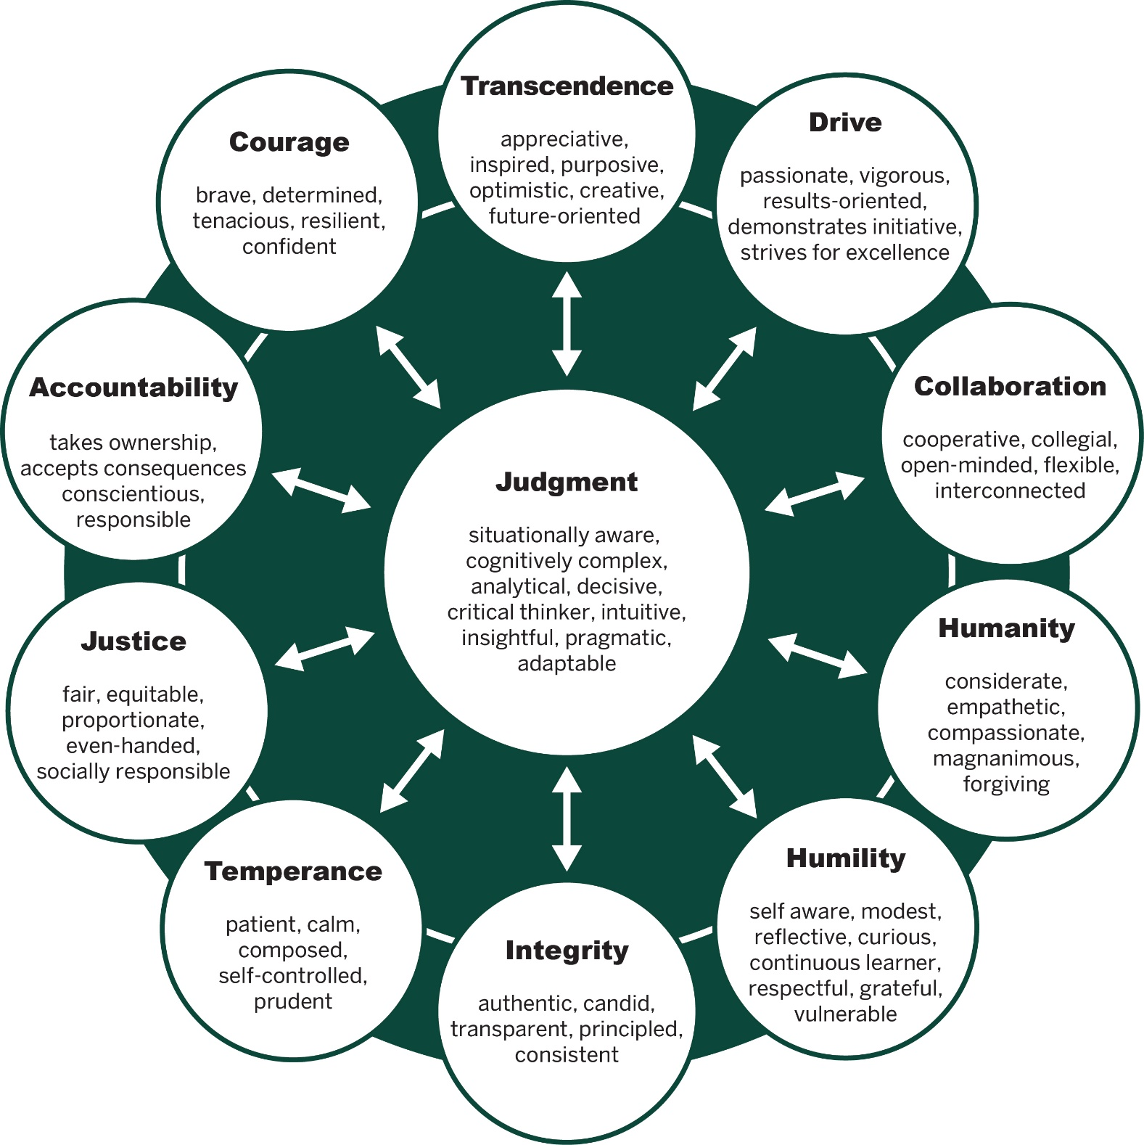
Dimensions of Character
Elements: Observable behaviours supporting the Dimension
Crossan, M.; Byrne, A.; Seijts, G. Reno, M.; Monzani, L., Gandz, J.: “Toward a Framework of Leader Character in Organizations” Journal of Management Studies, 2017
Notes:
Who is familiar with this model? Has anyone used it? How?
The model will be the starting point. A key to remember throughout this process is that we are still very much in the beginning stages of elevating character in-line with competence which is laid out in “Trusted to Serve”.
I will make a bold assumption because I was not at kitty hawk when Wilbur and Orville took flight. However, I will say with some certainty that the language of air power today was not the language they were using in 1903.
So this is where we will start. Fortunately, we have also been given formal direction on this, which I am sure you are all intimately familiar - RCAF PERFORMANCE AND COMPETENCY EVALUATION (PACE) ADMINISTRATIVE INSTRUCTIONS - 2023/2024; Annex F - Planning and Administering an HLRR Board; Appendix B to Annex F - Make Leader Character Your Competitive Edge
Appendix C to Annex F - Character Matters - Organization Dynamics
Appendix D to Annex F - Virtues & Vices Index
The main objective here is to get us all speaking the same language of character. Then we can begin to evaluate it. We are moving towards discussions that are based on Leader Character which supports elevating character alongside competence which will lead us to Sustained Operational Excellence.
Two points of emphasis – Dimensions of character are defined by their elements. Elements are the “observable behaviours” that support the Dimensions.

Slide 29
High Levels – Integrity, Drive, Accountability
Low Levels – Humility, Humanity, Collaboration
Crossan, M.; Byrne, A.; Seijts, G. Reno, M.; Monzani, L., Gandz, J.: “Toward a Framework of Leader Character in Organizations” Journal of Management Studies, 2017
Notes:
When we consider the individual leader, with unbalanced character, what type of person do you see? Have you ever experienced someone like this before?
These leaders are often promoted – although they lack judgement
Dangerous place to be - hard leader to reign in – no psychological safety to raise issues
Not a leader who fosters a safe environment – nobody wants to raise issues
Dismiss ideas, arrogant, not considerate – leaves organizations in vulnerable state – risk in organization
Why do people quit their jobs?
The character strength of our leaders will decide the future of our CAF.

Slide 30
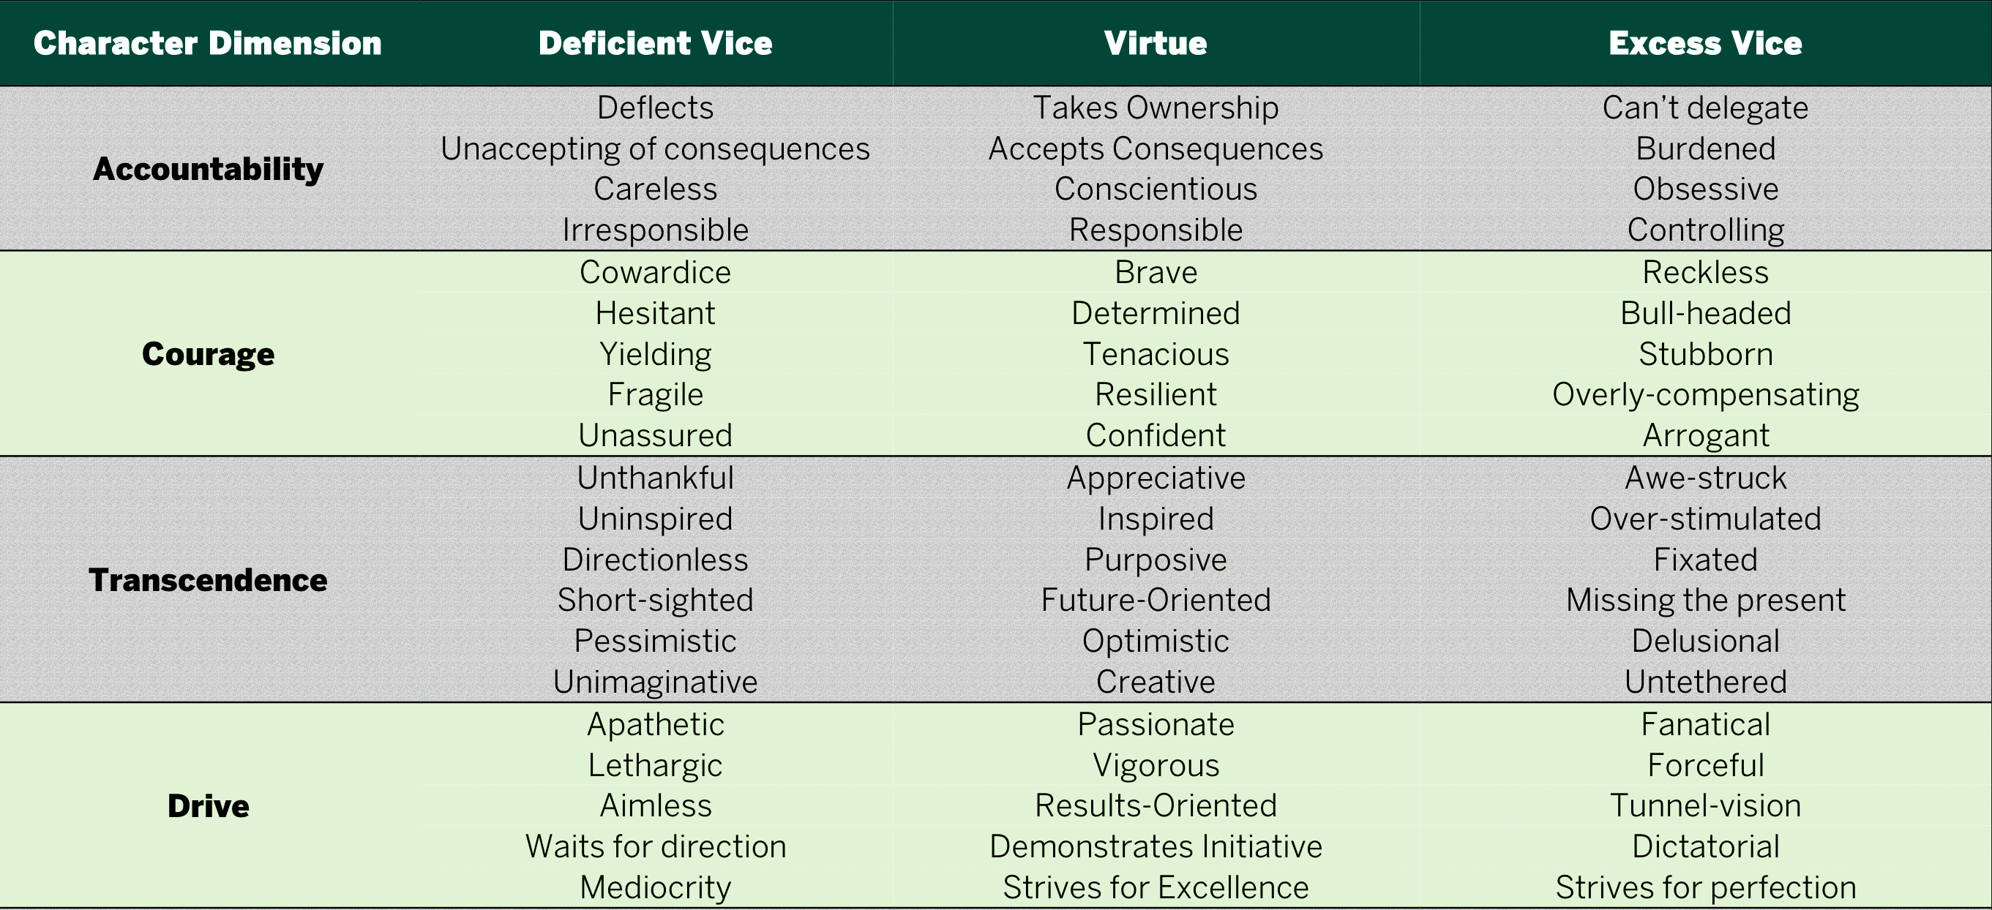
Virtues and Vices Index
Notes:
When going through these you may start to recognize elements where you are deficient or elements where you operate in excess.
If we look at the first dimension here Accountability we have a person who deflect responsibility, when in a virtuous state you take ownership, but when in excess you have the inability to delegate. Has anyone here ever had a hard time letting go and delegating?
There are two main uses for this document. The first is as a development tool.
Think of it like the word picture book from CFPAS. When you write a FN you can use this in your description and outcome statements.
The second is as a decision-making tool. When making decisions you can ask yourself where you stand on the dimensions.
For example, the W/Comd hands you a task. You immediately think you have an answer but if you seek collaboration you will at least get some other opinions to help generate thought around the correct response ultimately leading to a better response and buy-in from your team by being sought out for their thoughts.

Slide 31
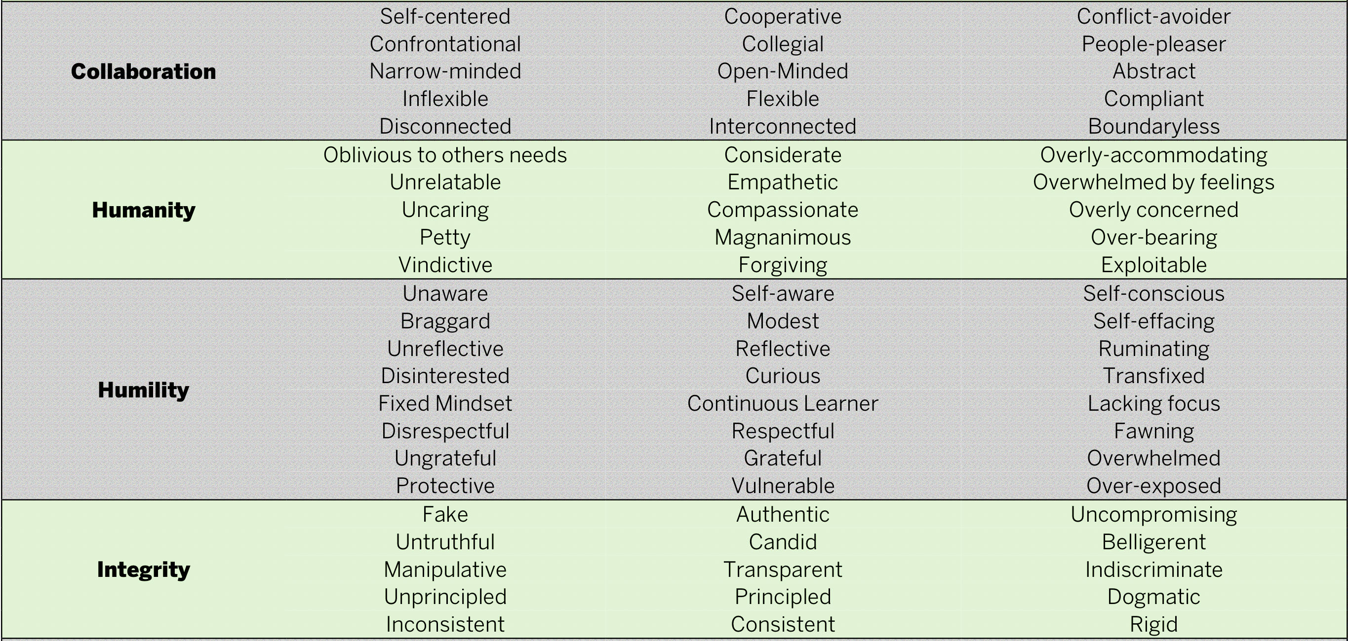
Virtues and Vices Index

Slide 32
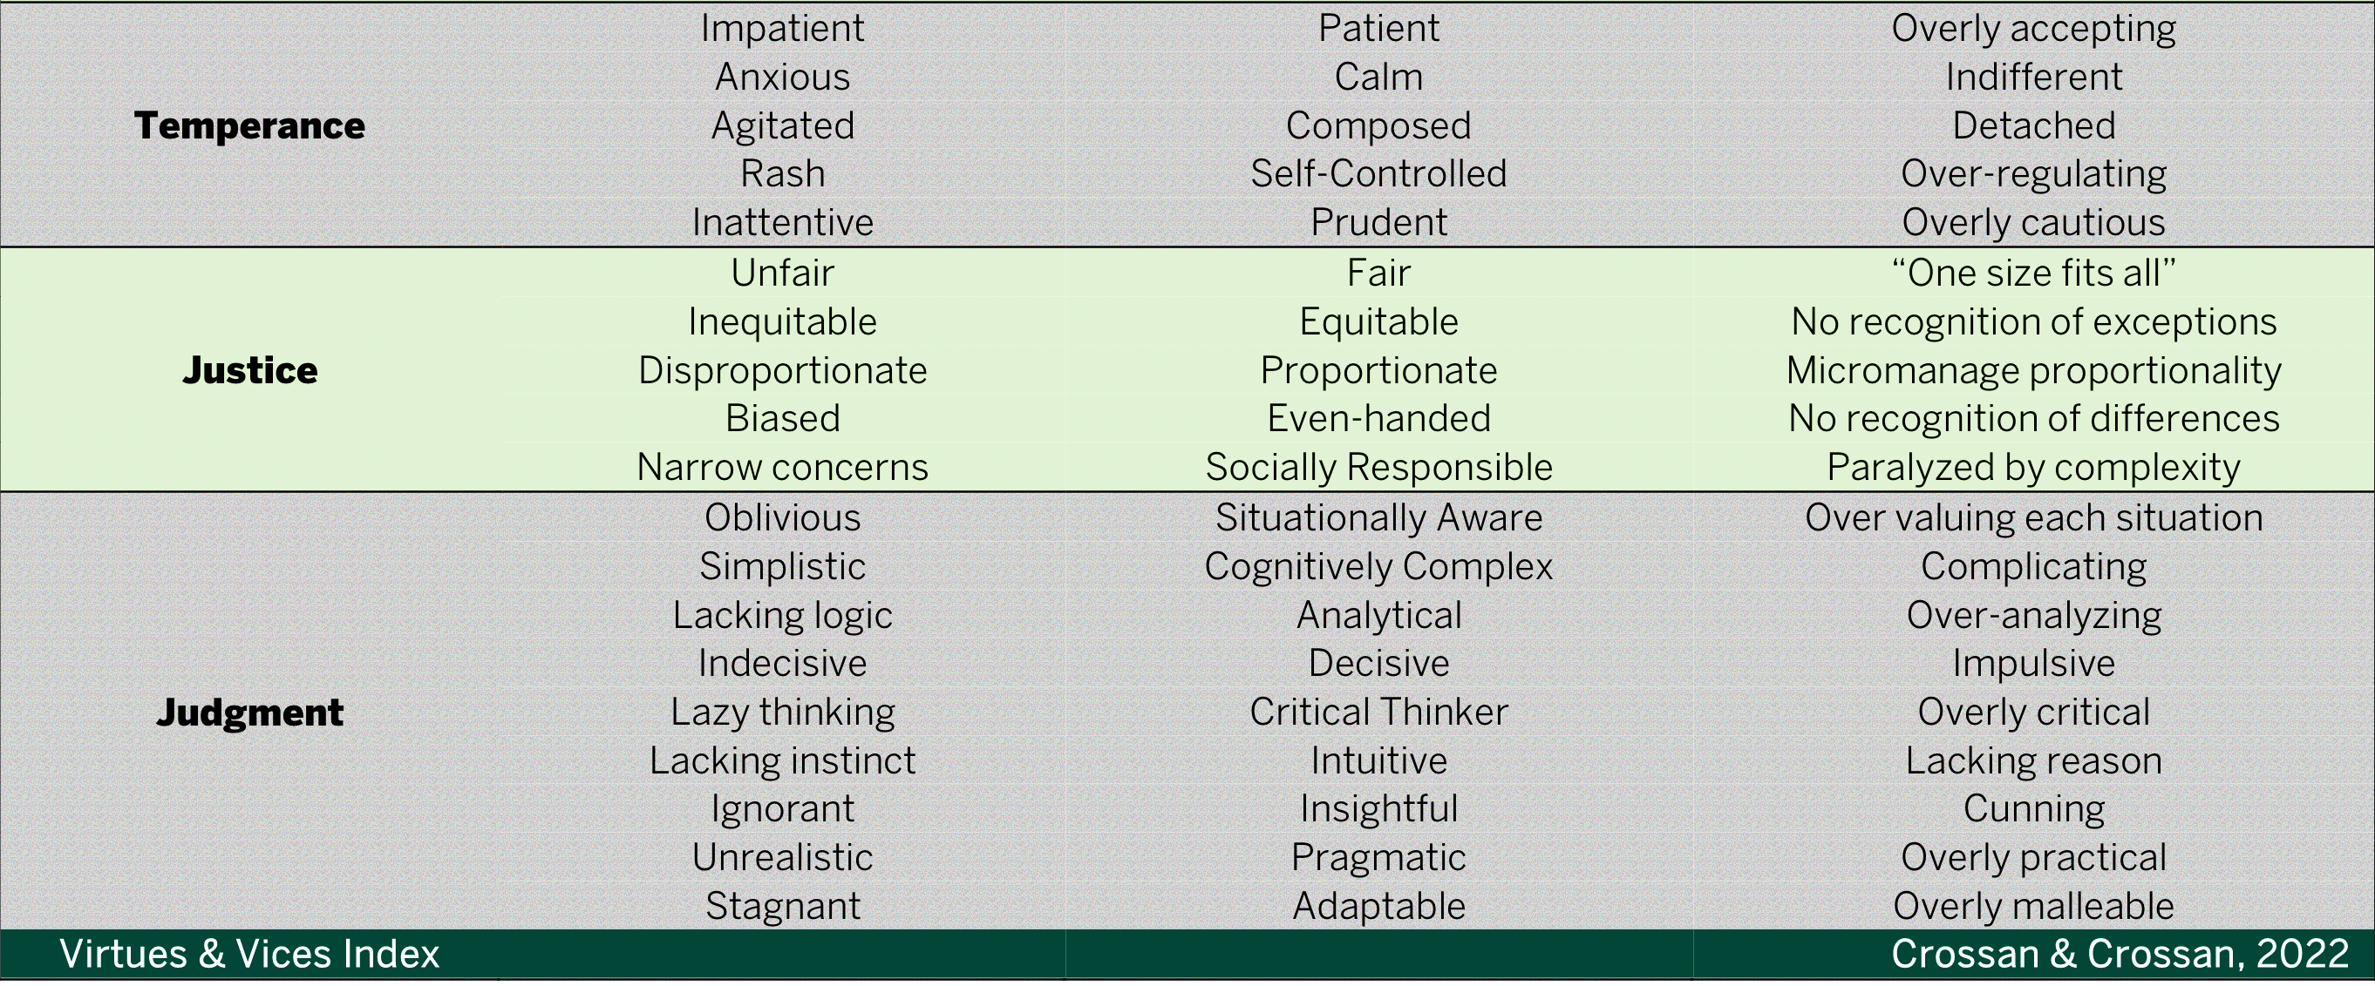
Virtues and Vices Index

Slide 33
Why is it so important?
Strength
of
character
JUDGMENT
CONTEXT
Time Pressure
Money Priming
Bystander Effect
Social Conformity
Notes:
Strength of character is particularly important because we do not make our decisions in a vacuum. Each choice that we make is made in a particular context. Without strength of character our choices end up being dictated much more strongly by our context than our values and beliefs.
This is by no means an exhaustive list but things like the bystander effect, time pressure and money priming can all influence our choices.
In an organization like the CAF that has such a strong culture and in particular in a unique environment like RMC social conformity can strongly influence our behaviour if we do not have strength of character. Keeping in mind when we say strength of character we are talking about a balanced character where no one dimension is running the show.

Slide 34
“Between stimulus and response there is a space. In that space is our power to choose our response. In our response lies our growth and our freedom.”
Viktor Frankl
Notes:
Emphasis in this quote is placed on the space and in the next slide how strength of character can increase that space or improve our judgement when the space is limited.

Slide 35
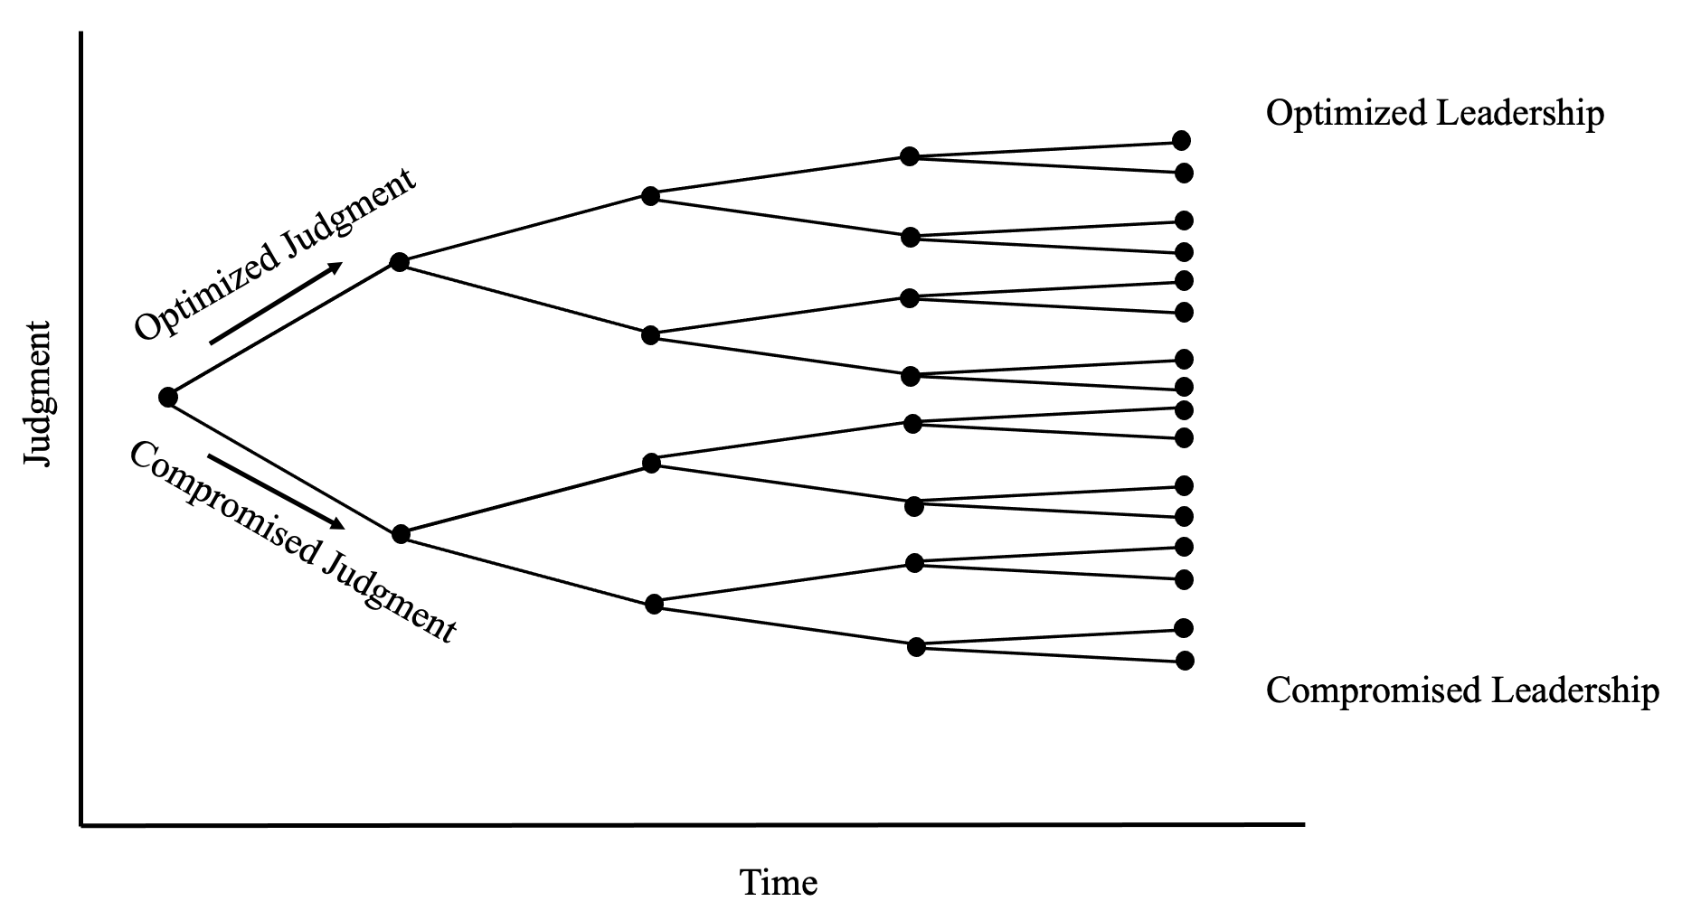
Character/Competence Judgment
*Slide taken from Ivey Institute for Leadership: Leader Character Practitioner Course (2022)
Notes:
The image here depicts how our judgement can impact our ability to lead over time. Each dot represents a decision we make where we can exercise strength of character. The more decisions we make using this strength, creating the space between stimulus and response, the more likely it will be an optimal decision. The more consistent we are within our decision making, the more likely we will lead to optimized leadership for ourselves and in turn, our organization.

Slide 36
How Do We Improve Character and Culture?
Awareness – acknowledge the problems, and have discourse in a common context
Embed the language of character within all aspects of training / operations / education
Assessment and Development – PaCE, FN, JD, Unit discussions, etc…
All of these will bring systemic change to our organization
Notes:
How can we improve character and culture? It starts with awareness, acknowledging that problems do exist, and having conversations in a common context with a common language. This is what we have been doing on this course. Next is that we need to assess the need to change the way we do things and develop new ways. We need to individualize training and the knowledge gained to make systemic change. Within the AFOD program we assessed the requirement to include discussions on character and mindset. We then developed this training and embedded it within the program to make it a systemic change. You can do this as well. Lastly, we need to embed the language of character and an open mindset within all aspects of training / operations / education. Make it a common language, discuss it continuously, by making it a habit, we start adjusting our behavior and start changing our culture.

Slide 37
Character Strength Varies
The strength of character varies, however all dimensions can be developed
Four archetypes:
Strong character – high on all dimensions
Weak character – low on all dimensions
Unbalanced character – high on some dimensions and low on others but self-aware and actively working to develop weaker character dimensions
Compromised character - high on some dimensions and low on others but lacking understanding and/or willingness to develop weaker dimensions. Leads to rigidity of imbalances.
Strong character (along with strong competence) brings strong judgment
Weak character allows context to dictate individual actions
Unbalanced character compromises judgment – risk factor
Compromised character not only comprises judgment but also perpetuates imbalances in others and possibly the organization – becomes systemic.
Crossan, M.; Byrne, A.; Seijts, G. Reno, M.; Monzani, L., Gandz, J.: “Toward a Framework of Leader Character in Organizations” Journal of Management Studies, 2017
Notes:
Bring back the question of “Who am I becoming while I am busy doing?”
Discuss each archetype.

Slide 38
Now What?
What can you do to improve your own character?
What can you do to improve the culture within your Unit? Wing? RCAF? CAF?
This has been done in other institutions (CRA, CBSA…).
WE have an opportunity.
Notes:
So now what? [Discuss each question for several minutes]
- What can you do to improve your own character?
What can you do to improve the culture within your section?
What can you do to improve the culture within the RCAF?

Slide 39
Character/Competence Judgment
*Slide taken from Ivey Institute for Leadership: Leader Character Practitioner Course (2022)
Notes:
What do we do with this person? How many compromised character decisions are acceptable?
There isn’t likely an answer, but we have a significant support system that allows us to manage these kinds of situations.

Slide 40
Thank you

