Slide 1

Interpersonal Conflict and Accountability
Notes:
This lesson is designed to discuss conflict, personality traits, conflict resolution, and accountability.
This series of slides closes out the main idea of Sustained Operational Effectiveness. The “Why” of Trusted to Serve, Culture evolution, CBL, and Facilitation all come back to the goal of Sustained Operational Effectiveness. We are conducting this training as current and future leaders within our organization to recognize conflict and effectively deal with it. Character will be discussed further in other lessons. When thinking about conflict it’s useful to think on these two questions:
Why is this important?
How can we continue to be effective despite conflict?
Why is this important?
How can we continue to be effective despite conflict?

Slide 2

Places of Conflict
Conflict can take place:
within ourselves;
with another;
within our groups; and/or
between groups.
Recognizing these places of conflict can help us identify what is contributing to the conflict. This makes it easier to decide how to best approach the issue(s).
Notes:
“When and where does interpersonal conflict occur?” solicit the students for answers to this before bringing up the individual and team definitions. Some questions to use to enhance the conversation are:
Why is this important? What does this mean to you? How do you feel about this? Are we an organization built on trusting teams?
Is there such a thing as good conflict?

Slide 3
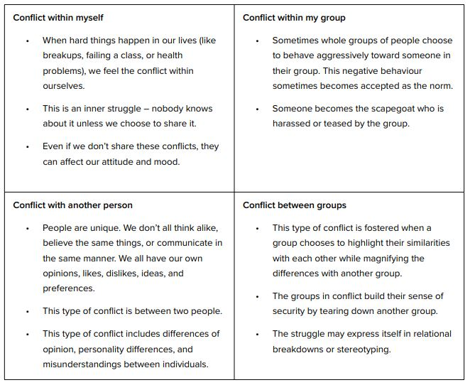
Notes:
Ask students for an example of each. Add to the discussion by displaying some vulnerability and share some examples if you feel comfortable doing so. If not the following generic examples can be used.
Self – I have been moved to a new unit and the job is not familiar to me. I struggle internally with having to learn something new and perhaps not be very good at it.
Another – I place expectation on others that I have for myself. This may not be realistic, and I may not be considering their current life/work circumstances
Within my group – Without realizing it our groups attitudes and behaviours make it difficult for new people to integrate into our group.
Between groups – Maintainers and operators are ultimately working towards the same goal but think differently about how to get there because of their different experiences/training.
Is there such a thing as good conflict?

Slide 4
Task versus Relationship Conflict
Researcher/Author Adam Grant highlights two types of conflict:
Task conflicts are disagreement between people about the conduct of the specific task on which they are working.
For example, I think there’s a better way to tie the knot.
Relationship conflicts are not related to the specific task.
For example, I think you are just a bad person.
In an ideal team, all conflict is Task conflict.
In reality, most conflict is Relationship conflict…but does not need to be.
Relationship conflict engages Personality and Character.
Notes:
Task Conflict Task conflict is encouraged as it promotes creativity, critical thinking and innovation. Some examples of task conflicts are: differing opinions on how to design the user experience for a particular product, or the technical architecture for implementing a system. By having diverse opinions and having team members debate various options, we get an exploration of ideas and solutions. Task conflict often stimulates healthy debate and increases team motivation, as team members feel that their input is valued. Grant states that some organizations build challenge networks (groups of thoughtful critics) into their cultures to stir up task conflict. If your team does not have task conflicts, it might be a sign of lack of trust or other underlying issues. While task conflict is beneficial, it is important to manage it properly.
Here are a few tips for dealing with relationship conflicts:
Set ground rules on how team members should conduct themselves, which includes acceptable behavior and procedures for handling conflict. You can add them as part of your program charter. Similar to how open communication and active listening is important for resolving task conflicts, it is important to resolve relationship conflicts as well. Identify the root cause of the conflict by talking to the team members involved in the conflict in a one-on-one setting. Avoid taking sides or showing favoritism. Resolving relationship conflicts requires handling people’s emotions. Sometimes this results in heated arguments and personal attacks. If you are comfortable facilitating discussions to resolve relationship conflict, go for it. I personally do not try to get into solving team member’s relationship conflicts, as these need to be handled sensitively and might require manager or HR intervention.

Slide 5
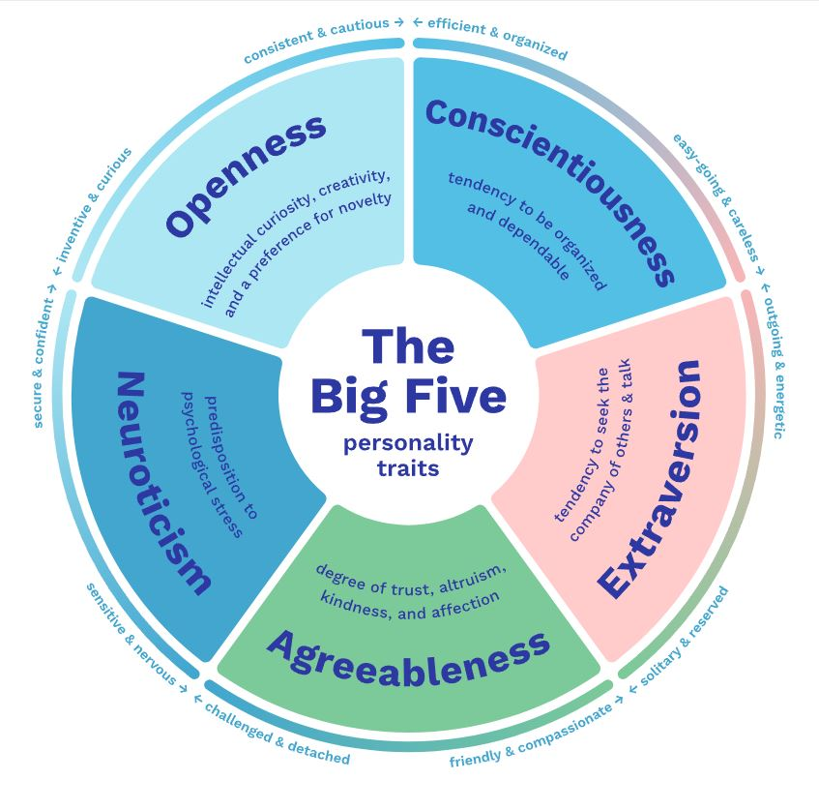
Notes:
The Big Five Personality Traits: The 5 Factor Model of Personality - OCEAN or CANOE, are a psychological model that describes five broad dimensions of personality: Openness, Conscientiousness, Extraversion, Agreeableness, and Neuroticism. These traits are believed to be relatively stable throughout an individual's lifetime.
In general people are normally distributed on this model. However, there are some differences between men and women. Women are typically higher on Neuroticism and Agreeableness. At the far end of the distributions there are significantly more differences between men and women. For example, almost all, of the most disagreeable people are men.
The purpose of learning this model is to better understand yourself and others by your similarities and differences in each of these categories.

Slide 6
Openness
Intellect
Quick to understand things
Understand abstract ideas
Can handle a lot of information
Like to solve complex problems
Find interest in philosophical discussion
Like difficult reading material
Have a rich vocabulary
Think quickly
Learn things quickly
Formulate clear ideas
Openness
Enjoy the beauty of nature
Believe in the importance of art
Love to reflect on things
Get deeply immersed in music
Like poetry
Seldom mention the emotional aspects of paintings and pictures
Need a creative outlet
Tend to get lost in thought
Daydream frequently
See the beauty in things that others might not notice
Notes:
Allow students to read the slide then ask if any points stand out to them.
???Creativity is the ability to generate a broad range of original and practical ideas. One exercise is to have everyone in the room come up with as many different uses for a brick in one minute. Then differentiate those who had original ideas that no one else had. ????
Intellect is a direct reflection of IQ which is the most reliable measure of intelligence or a person’s capacity to learn.
Louis Pasteur – Milk pasteurization
Picasso – 13,500 paintings; 100,000 graphic prints or engravings; 34,000 book illustrations; 300 sculptures and ceramics

Slide 7
Conscientiousness
Industrious
Carry out my plans
Don’t waste time
Don’t find it difficult to get down to work
Finish what I start
Get things done quickly (don’t postpone)
Always know what I’m doing
Not easily distracted
Orderly
Tidy
Like order
Bothered by messy people
Want everything to be just right
Bothered by disorder
Like routine
See that rules are observed
Want every detail taken care of
Notes:
Allow students to read the slide then ask if any points stand out to them.
Orderliness is associated with sensitivity to disgust
High conscientiousness and high IQ predict managerial and administrative success.
The Longevity Project study stated that Conscientiousness was a key predictor for a long life. The more conscientious and goal-oriented an individual was, the longer they tended to live.
Political affiliation is correlated with personality: Conservatives are higher in Conscientiousness Liberals are higher in openness.
Abraham Lincoln, Theodore Roosevelt

Slide 8
Extraversion
Enthusiasm
Makes friends easily
Reveal everything about myself
Warm up quickly to others
Show my feelings when I’m happy
Have a lot of fun
Laugh often
Assertiveness
Take charge
Have a strong personality
Talent for influencing people
Know how to captivate people
See myself as a good leader
Can talk others into doing things.
The first to act
Notes:
Allow students to read the slide then ask if any points stand out to them.
Extraverts tend to value the present; Introverts tend to value the future.
Positive emotions move people forward towards desired goals, negative emotions will stop or move people backward.

Slide 9
Agreeableness
Compassion
Feel others’ emotions
Inquire about others’ well-being
Sympathize with others’ feelings
Not indifferent to the feelings of others.
Take time for others.
Take an interest in other people’s lives
Have a soft side
Like to do things for others
Interested in other people’s problems
Politeness
Respect authority
Don’t believe I am better than others
Hate to seem pushy
Don’t take advantage of others
Avoid imposing will on others
Rarely put people under pressure
Avoid insulting people
Avoid conflict
Not out for personal gain
Notes:
Allow students to read the slide then ask if any points stand out to them.
Agreeableness is linked to the idea of how much we should value our own interests compared to others.
Agreeable behaviour is an adaptation of maternal care
Disagreeable behaviour is an adaptation of predatory aggression
Research has shown that disagreeable people are less likely to be used by other people, are often paid more for the same work, and do not become resentful
Agreeable people can become more resentful or passive aggressive over time under certain conditions.

Slide 10
Neuroticism
Withdrawal
Often feel blue
Filled with doubts about things
Feel threatened easily
Feel depressed
Worry about things
Easily discouraged
Become overwhelmed by events
Afraid of many things
Volatility
Associated with defensive or predatory aggression
Get angry easily
Get upset easily
Can’t keep emotions under control
Change mood frequently
Moods go up and down easily
Easily annoyed
Getting easily agitated
Can be stirred up easily
Hyper-reactive to frustration, disappointment, and pain
Notes:
Allow students to read the slide then ask if any points stand out to them.
Anxiety is an indicator of pain, pain is an indicator of damage. Anxiety is experienced before pain as a defense mechanism (not just physical pain, emotional, psychological)
Actively exploring what you are afraid of or anxious about reduces the fear/anxiety. Must be done carefully.

Slide 11

Break

Slide 12

Conflict (Relationship)
What are signs that Conflict has shifted to Relationship Conflict?
Notes:
Now that we’ve defined some terms for Personality characteristics, how does personality come back into Relationship conflicts?
Blame is a good indication that it is now a Relationship conflict.
Things like who is right, smart, moral, caring, competent…
Once the class settles out with what can indicate the transition to relationship conflict, move on to the next slide.

Slide 13
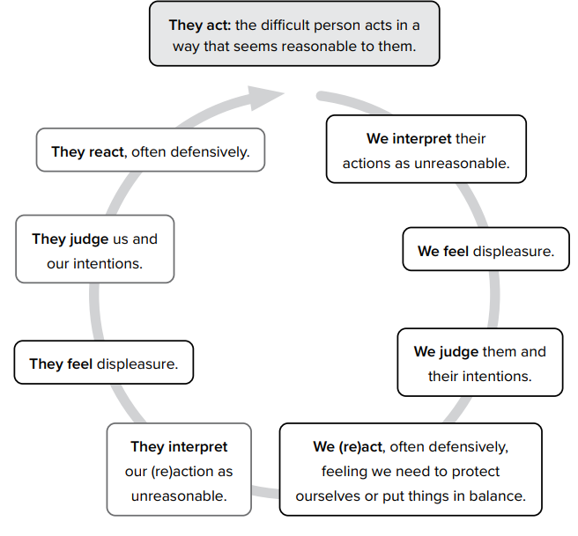
© Crisis & Trauma Resource Institute (CTRI) – www.ctrinstitute.com
Notes:
There’s an idea that goes along with this about being in a box. I can only see from inside my box. I need to get outside my box to see the way others view the situation.

Slide 14
Collusion (How it Builds)
Why keep the Conflict to ourselves? Sharing is Caring…
Gathering Allies
How long are we willing to wait someone out?
© 2021 Arbinger Institute LLC
Notes:
Have you ever disagreed with someone and told everyone else in your life about how wrong they are?
Ideally the Instructor tells a story about a conflict where they gathered allies and how that made them feel.
See if any students want to tell a story about gathering allies to a conflict.

Slide 15
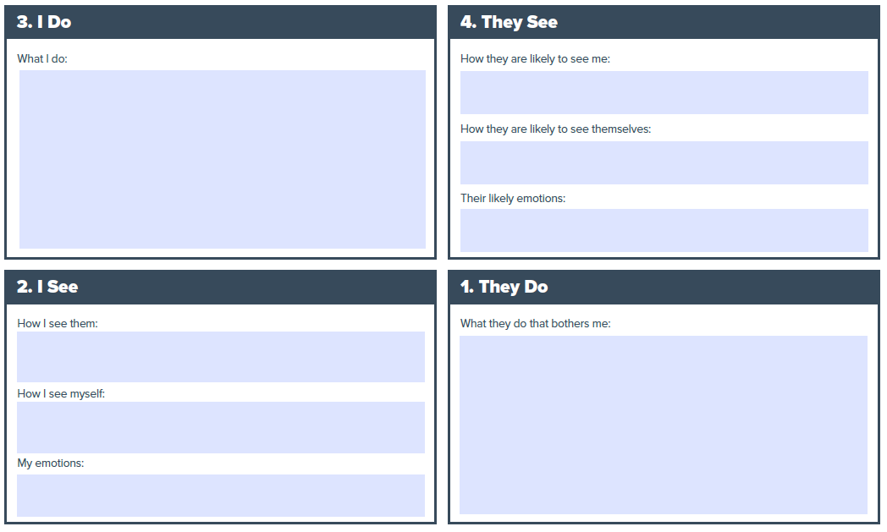
Resolving Collusion
© 2021 Arbinger Institute LLC
Notes:
Ref: https://arbinger.com/diomtools/
How do we get off the train?
Diagram your conflict by filling out quadrants 1 through 4.
Then: (click)

Slide 16
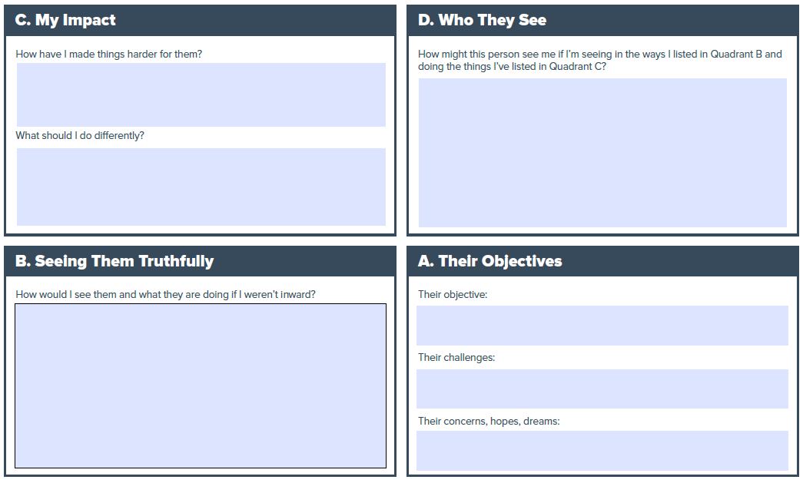
Resolving Collusion
© 2021 Arbinger Institute LLC
Notes:
Ref: https://arbinger.com/diomtools/
Completing quadrants A through D. Then take the next step by implementing what you wrote in the bottom half of quadrant C.

Slide 17
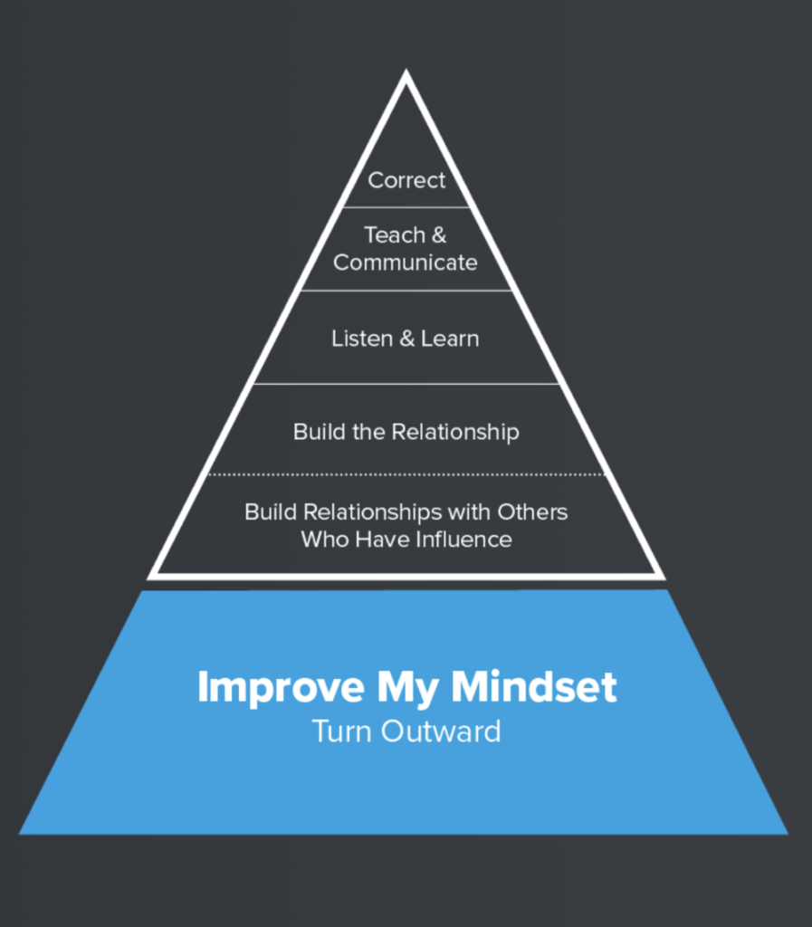
Work bottom up
Most time and effort should be spent at the lower levels of the pyramid
When stuck, go lower
The solution to a problem at one level of the pyramid is always below that level
Mindset matters most
Ultimately, my effectiveness at each level of the pyramid depends on the lowest level of the pyramid – my mindset
© 2021 Arbinger Institute LLC
Notes:
Now that we have a tool to “de-blame a collusion” and remove ourselves and others from a Relationship conflict, how do we build this out into a better performing team?
How do we keep out of Relationship Conflicts and stay in Task Conflicts?
As with most things, it’s a process, and we can model it with a pyramid.
Describe the above slide.

Slide 18
Mindset Matters Most
The Influence Pyramid is a tool for you to determine how to help others change for the better
The largest part of the pyramid is the base, which is about your own mindset
If you cannot convince others to change, move down the pyramid and find the weak layer in your pyramid with that person. The 3A+ process helps the evaluation here to show Capability, Impact, and Effort
© 2021 Arbinger Institute LLC

Slide 19
Key to Positive Change?
“Someone has to start. Other people might not be cooperative, but that is not connected to you. My advice is this: You should start. With no regard to whether others are cooperative or not.” –Alfred Adler
Points to Remember
You can make positive change
Positive Change means Positively Changing other people
Changing other people means owning and improving your own mindset
5 of the 6 layers of the pyramid are you improving you first
Questions to Ask
How am I getting better?
For What am I responsible?
How can I help?
Key to Positive Change?
Your personal accountability
Not just your own actions, but your impact on others to be better
Notes:
Adler quotation – The Courage to be Disliked by Ichiro Kishimi and Fumitake Koga
Points to Remember
You can make positive change
Positive Change means Positively Changing other people
Changing other people means owning and improving your own mindset
5 of the 6 layers of the pyramid are you improving you first
Questions to Ask
How am I getting better?
For What am I responsible?
How can I help?
Key to Positive Change?
Your personal accountability
Not just your own actions, but your impact on others to be better
As with the title of this lecture, we are speaking of Accountability.

Slide 20
Extreme Ownership - Overview
By Jocko Willink and Leif Babin (Navy Seals)
Without a Team there can be no Leadership
Leaders are either Effective or Ineffective
The accomplishments of the team define the effectiveness of the leader
Best leaders not driven by ego or personal agendas, simply focused on the mission and how best to accomplish it
Most failures are due to poor communication
The Leader is truly and ultimately responsible for everything
© 2017 Extreme Ownership (Willink and Babin)
Notes:
The premise of Jocko Willink’s Extreme Ownership is that the Leader is responsible for everything.
This does not mean a “yes but…” this means a “yes (period).”
If you are the leader of whatever team/sub-team/working group/whatever, then you are responsible for everything.
Acknowledge the mistakes and admit failures, then develop the plan to move forward and win.
Communication is two parts, what you say/message, and what the team understands. What do you do when the team will not accept your message?
Ultimately the team’s failure is the Leader’s responsibility.
Which means if the team will not accept your message you need to keep adapting. [Continues on next slide]

Slide 21
Extreme Ownership – What does it Mean?
Subordinates not doing what they should?
Try the Arbinger Pyramid, what layer is not yet working?
What about the edge cases?
Navy Seals get to select from the best of the best, do you get the same option? How do you fix this problem?
What does this mean for unit/section climate?
You are always alone in ownership of the problem.
You are always part of a team when solving a problem.
Believe
© 2017 Extreme Ownership (Willink and Babin)
Notes:
The systemic way to select out those that cannot do their job is through training, discipline and remedial measures. Not everyone is going to be a great Navy Seal, but are they going to be suitable in a different role? What role? How do you get them there?
What about the people who are not good in any team that you can think of? Is the extreme ownership plan applicable? Do the work to process them out of the CAF. This includes uncomfortable conversations, potential for blowback (as harassment or grievances) and a metric tonne of paperwork. The team is the thing the leader builds and protects to complete the mission. Mission failure is on the leader. This includes a team that can’t sustain themselves in the infinite game discussed previously.
You as the leader set the tone for the climate in the unit/section. If you don’t like the climate, then it’s your fault, admit it, own it, then find a plan to fix it.
Believe.
Believe in yourself that you can make a difference.
Believe in your team, they want to help and know how to help, you need to empower them in the mission and vision.
Believe in your purpose, there is a purpose to the RCAF.

Slide 22
Appreciation and Leadership
Appreciation means:
“Provide assessment of what is being done in a clear unambiguous way”
“Appreciation must not interact nor interfere with [the] system but must discern (not shape) the character/nature of what is being done or about to be done”
Observe and Orient
Leadership means:
“Give direction in terms of what is to be done also in a clear unambiguous way”
“Leadership must interact with [the] system to shape the character or nature of that system in order to realize what is to be done”
Decide and Act
© Project Whitehorse (Boyd)
Notes:
Let students read slide
Ref: http://www.projectwhitehorse.com/pdfs/boyd/organic_design.pdf
Appreciation means:
“Provide assessment of what is being done in a clear unambiguous way”
“Appreciation must not interact nor interfere with [the] system but must discern (not shape) the character/nature of what is being done or about to be done”
Observe and Orient
Leadership means:
Give direction in terms of what is to be done also in a clear unambiguous way”
“Leadership must interact with [the] system to shape the character or nature of that system in order to realize what is to be done”
Decide and Act

Slide 23
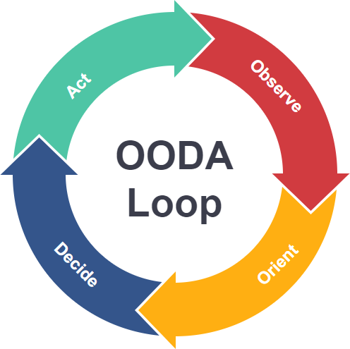
Leadership Cycle
Leadership, Operations, Training all involve the same cycle
Your decisions and actions in a team are weighted based on the trust your team has for you
Your personality sets the baseline but your character (changeable) defines the trust your team will have for you
John Boyd, Organic Design for Command and Control
Notes:
Let students read slide.
Ref: http://www.projectwhitehorse.com/pdfs/boyd/organic_design.pdf

Slide 24

CAF Leadership Doctrine
None of these principles are new to the CAF
Leadership in the Canadian Forces – Doctrine from 2005
Key Principle includes Values-based Leadership
Key Supporting Condition includes Open Culture
Importance of Trust Highlighted in Chap 1
What’s new is the Focus, the Tools, and the Details
Your own personal mindset is the base of the pyramid that builds to a peak of us collectively defending Canada and Canadians in an Infinite Game
The goal is “Sustained Operational Excellence”; the method is to build Trusting Teams starting with Personal Character
Notes:
Ref: https://publications.gc.ca/collections/collection_2013/dn-nd/D2-313-2-2005-eng.pdf

Slide 25
Questions?

