Slide 1

RUCTOP LEADERSHIP, RELATIONSHIPS and DNA Roles of the Command Team
13 Sept 2024
CWO Dan Campbell
Overall classification of the brief: UNCLASSIFIED

Slide 2
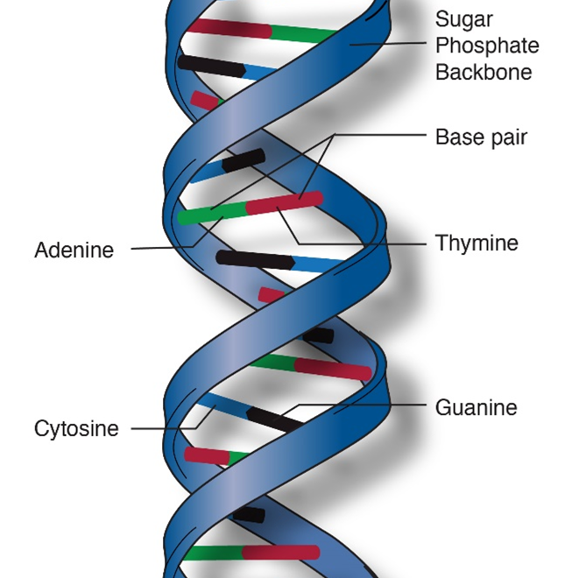

Expertise / compétence
EQ-I / IQE
Critical Thinking /pensée critique
Honesty /
honnêteté
Competence
Priorities / priorités
Change / changement
Continued Learning/ apprentissage continu
Forward Looking /
regardant vers l'avenir
LEADERSHIP DNA
ADN de LEADERSHIP
Relationships /relations
Growing Leaders/ former des leaders
Commitment
Aspiration
Sacrifice
Integrity/ intégrité
Vulnerability /
vulnérabilité
Communication
Character
Trust / confiance
Empathy / empathie
Humility/ humilité
Reflection / la réflexion
Values / valeurs
Inspiring / inspirant

Slide 3
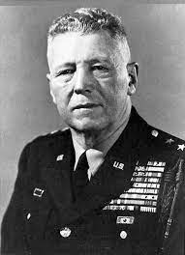
We Own The Problem
When things go wrong in your command, start searching for the reason in increasingly larger concentric circles around your own desk.
~Gen Bruce C. Clark, Commander in Chief of the US Army in Europe, 1960-1962
Lorsque les choses tournent mal dans votre commande, commencez à chercher la raison dans des cercles concentriques de plus en plus grands autour de votre propre bureau.

Slide 4
