Slide 1
RUCTOP
NOK and Reverse Notification Presentation
LCol Hope Winfield
Canadian Air Divisions and Canadian NORAD Region Senior Chaplain

Slide 2

CAF Chaplain Area of Responsibility
Who are the Chaplains and what do they do?
QR&O 33
33.06 - RELIGIOUS, SPIRITUAL AND MORAL WELL-BEING
Commanding officers and officers commanding commands or formations shall provide for the religious, spiritual and moral well-being of the officers and non-commissioned members under their command and the families of those officers and non-commissioned members.
CANFORGEN 131 22 CMP 063 22
CHAPLAIN S ROLES, RESPONSABILITIES AND EXPECTATIONS TO CARE FOR ALL.
Notes:
As a Commander, the relationship with chaplains at your base has shifted. QR&O 33 states clearly the advisory role chaplains have and what they do, they carry out because it is a command responsibility to provide Spiritual and Religious Care for members and their family. “Shall” – imperative
When it comes to a death of a member (NOK) or relaying a death of a family member (reverse NOK) IOT care for all we may need due to cultural, language, location or Spiritual/Religious background engage other chaplain colleagues. In these instances, we will need the support of the Chain of Command to connect across commands to ensure chaplains can carry out the full services required: NOK, assisting the DA, or taskings for BOIs.

Slide 3
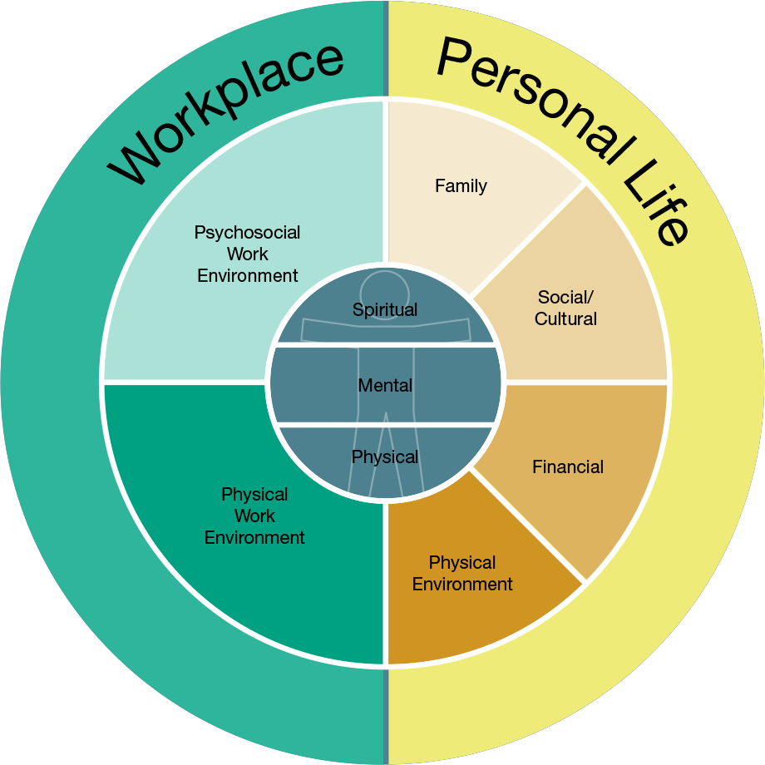
Total Health and Wellness
Notes:
Every human being has a Spiritual core. World Health Organization
The topics we will discuss today will be hard stories to tell and hard stories to hear.
The hours which you will be called upon to stand up a NOK Team, how close the relationship you have with the family and deceased, and influencers internal and external.
News will impact all aspects of the human being from physical, mental and spiritual. Each person will react different. Today we will cover approaches and best practices but know the plan will not survive first contact as human beings (not machines) are involved.

Slide 4
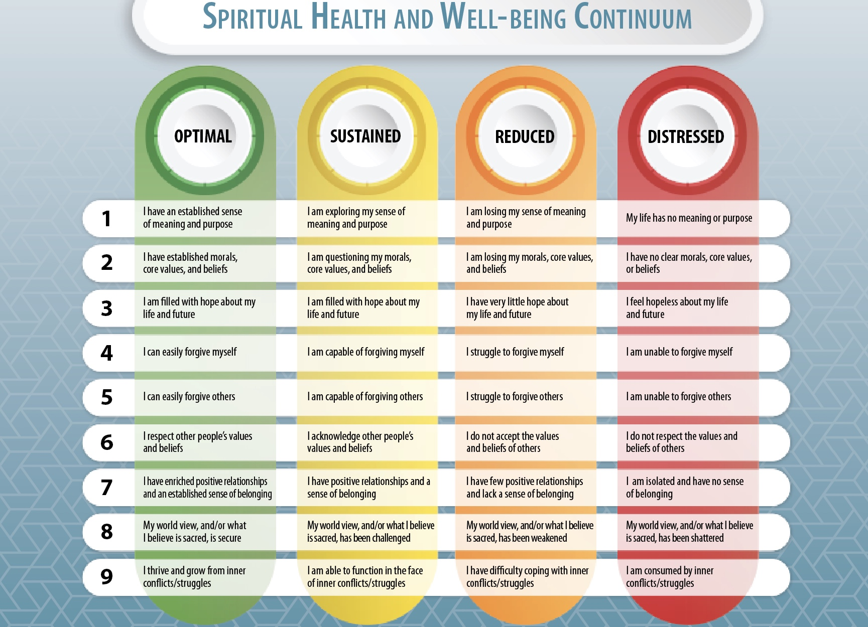
Notes:
Every human being has a Spiritual core. World Health Organization.
The person giving the information or receiving the information could be anywhere on this Spiritual Continuum.
Theorists have posited that individuals motivated by a strong human spirit experience a number of benefits including better able to accept the reality of a situation, develop creative coping strategies, find meaning in trauma, maintain an optimistic view of the future, access their social support network, generate the motivation to persevere, grow from adversity.

Slide 5
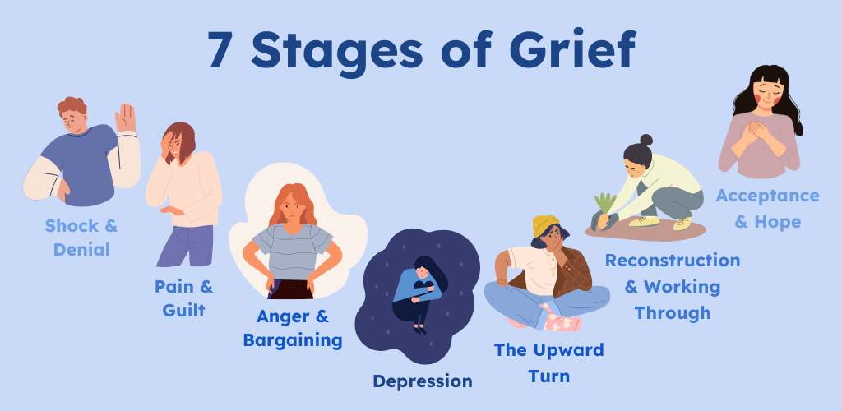
Notes:
Shock
Grief can be a difficult and messy process. When a loss occurs, one of the first things you may experience is shock. Even when you anticipate a loss—like the death of a loved one with a terminal illness—it can still be surprising and distressing. That's because no one can ever be truly prepared for a loss so significant.
Consequently, when you are in shock after a loss, you may behave normally or as if nothing has happened. Most of the time, this is because your body has not processed the loss yet. You may feel like the situation hasn't "sunk in" just yet. You might also experience numbness or a sense of detachment from what has happened. These feelings and experiences are self-protective mechanisms that act as a buffer so that you are not overwhelmed all at once.²
Denial
Because the death of a loved one can have such a significant impact on you, you might experience denial. During this stage of grief, it is simply too hard for your brain to comprehend that your family member, friend, or other loved one is gone.
Denial is your brain's way of spacing out your feelings of grief, allowing you to acknowledge and experience only what you can handle in that moment. As you slowly begin to accept the loss and what it means for your life now, your denial will begin to diminish. You may have a broader range of feelings and emotions when denial wears off.²
Until then, you may have periods when you feel distressed, which can be triggered by reminders of your loved one. You also may feel emotionally "shut off" from the people around you. In some cases, it's a normal feeling to want to avoid others so that you do not have to acknowledge or discuss your loss.⁵ Sometimes, you feel forgetful, get easily distracted, or procrastinate during this stage of grief. You may also try to stay busy all the time or shut down emotionally.⁴
The main takeaway is that denial can affect your behavior in several ways, and you don't really know how the situation will play out until you're in it. But it's important to remember that however you feel after a loss is valid and OK.
Anger
While it is completely normal to feel angry after the death of a loved one or the loss of something important to you, you may feel confused or even embarrassed by these feelings. In these cases, it will be tempting to squash, internalize, or even ignore your angry feelings—but they still exist and will likely manifest themselves in some way.⁶
You also may be surprised to learn that you direct your anger at the person or thing that was lost. In certain situations, you could also feel angry with the healthcare providers, your friends, family members, God, or any other spiritual being(s) you believe in. But under all that anger is your pain. While it may be uncomfortable to deal with, it provides more structure to your grieving than remaining numb.²
Bargaining
If you are having feelings of guilt, shame, or blame, your experience may fit into the bargaining stage of grief. During this stage, people often feel helpless and hopeless and ask themselves "what if" questions. You may feel guilty for not doing more to keep the loss from happening or for not spending more time with the person you lost.²
During the bargaining stage, it's common to wonder or say, "I should have done this..." or "If I had only done that..."⁴ While these types of doubts are normal, they are not where you want your thought process to remain. It is impossible to go back and behave differently or change the circumstances surrounding your loss.
Instead, try thinking about any good memories you have with them.
Depression
One way to distinguish between the depression that is part of the grief process and clinical depression is to understand your symptoms and how often you are experiencing them. When you are grieving, you might have a depressed mood for a few days and then feel better the next. But with clinical depression, your depressed mood is ongoing, persistent, and accompanied by feelings of hopelessness and worthlessness.⁸
During grief, the sadness may also cause you to lose your appetite or be unable to sleep. If you find that you are not only experiencing these things but also no longer feeling a sense of joy, have decreased energy, and have thoughts of death or suicide, it is important to talk to a mental health professional for support.⁹
Testing
The testing stage of the grieving process often involves trying out different things that help you move forward. In this stage, you are starting to build your new normal as well as processing your feelings and emotions created by the loss.
Acceptance
Reaching the acceptance phase does not mean you are OK with what happened. Instead, this part of the grieving process is more about accepting what your life looks like now. You will still need to listen to your feelings and adjust, but you will start to feel more whole—even if it looks different than it did before.²

Slide 6

Emotional Intelligence
Notes:
NOK Notification training is not just a “how to” course – it requires participants to engage their emotional intelligence. The more aware you become now of what will likely go on inside you and the people whom you notify, the more effective and compassionate you will be when the time comes to encounter a military family on the worst day of their lives.
A Manual accompanies this training and includes far more information than is included in the training available at your Wings through our RCAF Chaplain NOK Trainers.
You may wish to begin with a story of a time you were part of a notification team. If you have not, invite someone who has. It may have gone well or not. Be sure to emphasize the actual experience, including the emotions you experienced from the moment the call came in until the conduct of the notification itself.

Slide 7
Next of Kin (NOK) and Reverse Notification
“Wavetops” Presentation
Based on training offered during the Command Team Course
at the Canadian Army Command and Staff College

Slide 8
Overview and History
News from the battlefield from survivors or messengers.
Telegrams and lists posted during world wars became more personalized.
Mothers Against Drunk Driving (MADD) received a grant from the Department of Justice in 1988 to train police officers in death notification.
CAF have been trained by MADD-qualified Police trainers, ad hoc, as needed.
The need for more military specific process has been talked about for years.
Conversation with CACSC deans about command courses not having NOK training for CO’s.
Permission to adapt MADD curriculum.
Piloted Feb 2021 at the staff college command course and sought and incorporated input from all elements.
Input from chaplains, command team members and military families who have lost loved ones.
End state – a comprehensive training pack for all CAF
Notes:
The Next of Kin Notification and Reverse Notification training package is a three-hour, intensive course offered during the Unit Command Team Course (Reg F and Res F) at the Canadian Army Command and Staff College. It was developed by the chaplains of the Canadian Army and Doctrine Training Centre in Kingston. It is based on training created by Mothers Against Drunk Driving (MADD) for Police Officers, uniquely adapted for the military context, including the many policies and procedures we have concerning casualty care. It has quickly become the standard for Notifications, something that has been lacking in the CAF. Due to the high demand for this training, several chaplains have participated in a Train the Trainer event, equipping them to deliver a Professional Development session, covering essentially the same material, in a 60-to-90-minute session. Today’s “wavetops” presentation is little more than an introduction of the concepts from the CACSC course and the PD.

Slide 9
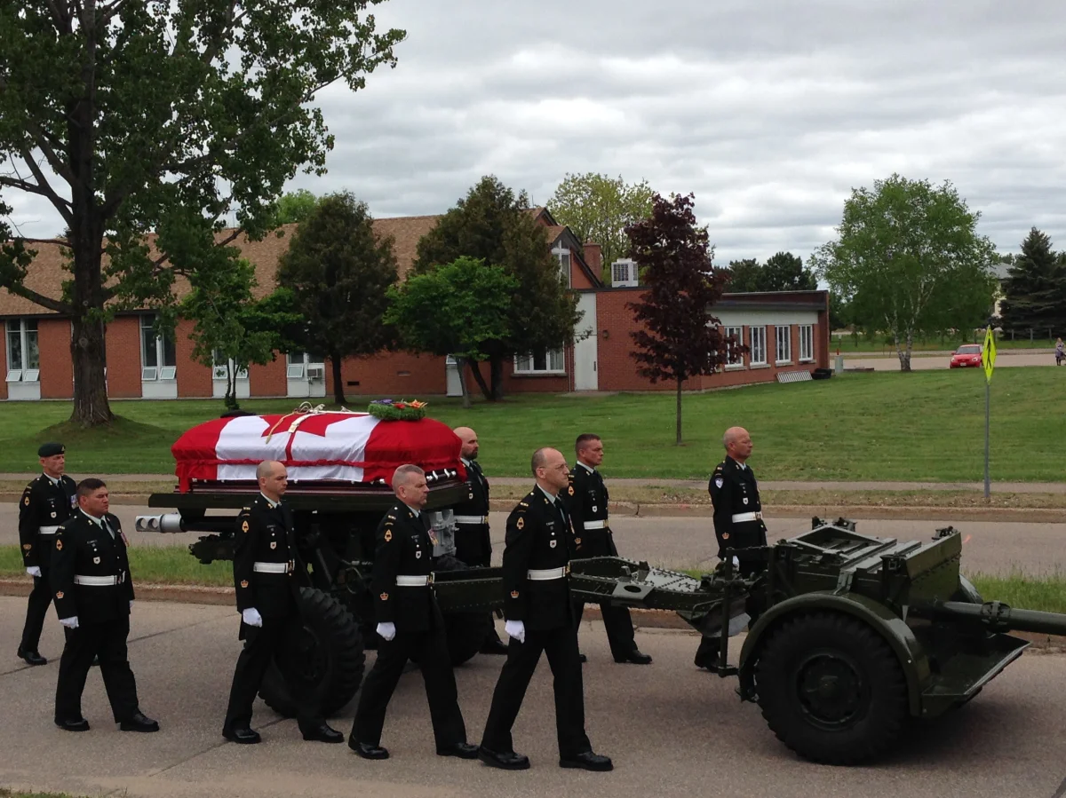
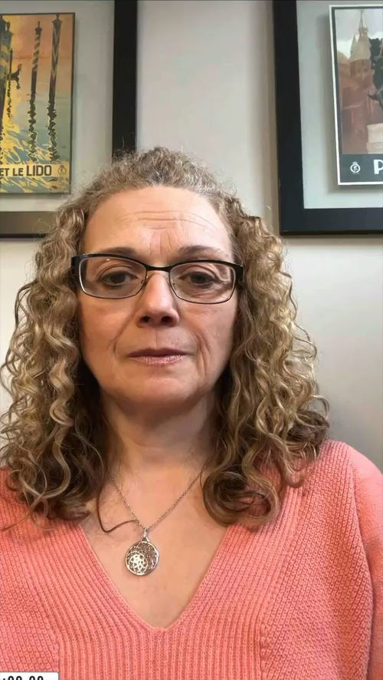
Monica Bobbitt
Notes:
Monica Bobbitt is the widow of LCol Daniel Bobbit, who was killed in LAV rollover during EX Maple Resolve in Wainwright, in 2014.
Reactions?
- No perfect way to notify: is this good news or bad news?
- What stuck with her: care, compassion.
- Notification did not take place inside the house.
- Attention to children (will take up this point later).
- The notification was a turning point in her life.

Slide 10
Guiding Principles for Notifications
Safety – notifications will always be done in a way that protects the safety of the NOK and the notification team.
Compassion – notifications will be delivered with compassion and care for the NOK as well as others who may be party to the situation.
Truth – notification teams will be truthful in the information they share.
Respect – notification teams will treat the NOK and the deceased with utmost respect and dignity.
Timeliness – notifications will be done as quickly and efficiently as possible without compromising the other values.
Professionalism – NOK teams represent the CAF and because of the nature of an NOK Notification should adhere to the highest standards of professional conduct.
Public acceptability – all decisions and actions will be taken with the confident knowledge that it will be deemed right under public social scrutiny. (i.e., Globe and Mail test)
Notes:
Guiding Principles for Nonstandard Notifications
Sometimes notification may need to be done in a context that falls outside of the norms of this guideline. (i.e. - mass casualties, remote locations or with NOK of different languages and backgrounds). In these cases when the process needs to be varied, the following Guiding Principles should be used as a filter for deciding if protocol variations are acceptable.
- These guidelines go beyond what is taught in the MADD course and are based on common questions asked by command teams.
All notifications must be completed embracing the following Guiding Principles:
Safety – notifications will always be done in a way that protects the safety of the NOK and the notification team. In person and seated is always best as it minimizes risk of injury from fainting and allows the notification team to respond to reactions of the NOK. Get in the house and get people sitting down.
Compassion – notifications will be delivered with compassion and care for the NOK of the deceased. Any deviations from protocol arise from the compassion principle.
Truth – notification teams will be truthful in the information they share. Lying even for a “good reason” is still a lie and will erode trust. Some very sensitive information may be better not shared or at a later time however falsehoods should never be substituted to avoid difficult situations. Be accurate. Be clear. Use words like “dead,” ”died,” “killed” instead of phrases that could be misunderstood, like “lost.”
Respect – notification teams will treat the NOK and the deceased with utmost respect and dignity.
Timeliness – notifications will be done as quickly and efficiently as possible without compromising the other values. Important: quickly, but not in a rush.
Professionalism – NOK teams represent the CAF and because of the nature of an NOK, should adhere to the highest standards of professional conduct. Professional conduct also includes adherence to OPSEC requirements while sharing what can be shared with the family. You are the face of the CAF. How would you want to be treated if the situation were reversed?
Public acceptability – given the high-profile nature of a CAF death, all decisions and actions will be taken with the confident knowledge that it will be deemed right under public social scrutiny. (i.e. Globe and Mail test)

Slide 11
Eight Steps of the Death Notification
BE READY for the Call
RESEARCH
CHECK, Check and Recheck
REHEARSE
NOTIFY
SUPPORT
DEPART
DEFUSE/DEBRIEF
Notes:
In the actual course / PD, this slide is the bulk of the training (1-2 hours). The most important point here is: notifications must be done quickly, but not in a rush! You will be tempted to skip some of these steps just to get the job done. Note, for example, that the notification proper is step 5 out of the eight.
Details of the steps are as follows:
1. Be Ready
Create a notification kit which will include the Notification Manual, note pad and pens, and if possible, ECN forms of your deployed members.
Have your uniform ready to go at any time.
Understand the role of the DA.
Make sure you can get access to needed information in the middle of the night.
Have a family care plan in place.
Designate a trained backup when you are away. (For the command team as well as the chaplain!)
2. Research
Know name of the member and important facts. Including the RSM in the process will add great value and greater SA on the member.
Know circumstances of death as much as possible (where, when, how, Combat, IED, training accident, natural causes, etc.).
Know where the body of the deceased is (in theatre, field hospital, morgue, or other).
Know the condition of the body (caution and discretion should be exercised in giving too much detail to the family).
Know whom you will be notifying and their relationship to the deceased.
Know what support services are available to help and information about the DA being assigned.
3. Check
All original information for accuracy and relevance. Confirm the person is dead and not just injured.
Service number (SN), rank, name, military occupation and unit of the member or name, position, unit and location of the person who died.
Name, address and relationship of the person who will be notified.
In the case of:
Illness or injury, available information as to diagnosis, prognosis, location of patient, name of doctor and means of contact; and
Death, available information as to date, time and cause of death, location of remains.
That you have the correct address of the person to be notified and the relationship of the deceased, ill or injured person to the NOK.
Your notification partner (the Chaplain if you are the CO and CO if you are the Chaplain), has been trained to notify and willing to assist you.
4. Rehearse
Review all gathered information.
Create quick notes of how you will inform.
Prepare yourself by using the actual words (‘death,’ ‘dead,’ ‘died,’ ‘killed,’ etc.).
Rehearse the notification out loud.
Be open to critique from your notification partner.
Note – Showing sadness and/or emotion during the notification process indicates you are human
5. Notify
Have at least two people present to make notification.
Park several houses away if possible and walk to the house where the notification will take place.
Introduce yourself at the door, ask if the NOK identified on the ECN form is present, and ask to be admitted to the home.
Preface your notification with “I have some difficult/tragic news. Can we sit down?”
Be very straightforward and direct with the notification.
6. Support
LISTEN
The most effective assistance can be given in in the form of listening. In most cases, the bereaved person needs to talk and be heard. Let them show their emotion without judgment.
REASSURE
Give reassurance that you will do all you can to help them (phone calls, wait with them until others arrive, help them prioritize what needs to be done, etc.).
COMFORT
Do not initiate holding or embracing. If they initiate it, however, don’t back away. Physical comforting can be a powerful support tool when needed by the NOK.
ASSIST
Try to locate a relative, friend, neighbour, or clergy person who will stay with the bereaved once you leave.
Ask – is there anyone else I can help you notify who will be able to support you?
INFORM
Once the person/s have calmed and are able to listen, inform them of the next steps that will take place.
A person called a Designated Assistant should have already been assigned and will be contacting the family shortly. Their job is to walk with the family through the repatriation (if necessary) and facilitate their needs through this process.
Know the role of the DA and who that will be. There is value in the chaplain meeting and returning with the DA to help manage the grief and ‘people side’ of the process as the DA is likely doing this for the first time and may not have the skills or experience to navigate some of the emotional challenges.
REASSESS
Before leaving, make sure that the NOK is able to cope with the situation and will have the support needed after you are gone.
Do not leave the NOK alone when departing! Ensure the NOK has a physical person present to support them before departing.
7. Depart
One person (ideally the Chaplain to provide care) should be the POC until the DA is able to engage. Leave a business card, including name, office phone number, file number, and name and number of the appropriate support service’s information, such as names, addresses, phone numbers, and hours of operation.
If the DA is not yet present explain that the Chaplain will return with a DA who will help the family walk through all the steps in the process. (See role of the DA pg. 25) If the DA has already arrived, this is a natural opportunity for the CO/CWO to exit and allow the Chaplain to support the DA and family as they begin their process.
Once the notification team has left the family, the CO and Chaplain must notify their respective CoCs that the notification has been completed. If the notification is taking more time or the family wishes to have the team stay with them, then members of the team will need to separately excuse themselves for a few moments to inform their CoCs. In some cases, there may be other family members (e.g., divorced parents) who need to be notified. If a secondary notification is required, command must be advised ASAP and a second team may need to be launched. Once the Primary NOK have been notified, the notification process is complete, and information can be released by the CoC to the media.
8. Defuse / Debrief
Members of the notification team should meet as soon as possible, after the notification, to debrief the situation.
Double check as to who is responsible for any follow up tasks to ease pain and suffering of the survivor(s).
Review the notification: what went wrong, what went right, how could it be done better in the future.
Share personal feelings and emotions among the team. (Key to processing)
Be honest. Share your concerns with one another. Discuss any personal feelings that may have been triggered during the notification process.
Support one another.
Respect confidentiality.
* The course and PD also go into detail on notifications following a non-operational death (e.g., suicide) and procedures for the death / serious illness of civilian DND employees.

Slide 12
Notifying After a Suicide
Same basic steps as any other notification.
Always remember sensitivity.
    Notifying the emergency contact of a loved one’s suicide may be one of the most difficult tasks a command team will face in their careers. This is a complex and stressful experience for which it is difficult to prepare. The way the death of a person is communicated can have a profound impact on the bereavement process.
Notes:
Not every service member for whom you will have to perform an NOK notification will have died in combat or during a training accident. There is a possibility that you will have to notify NOK after a suicide.
Every sudden death is tragic, but suicide can be especially difficult to process, and reactions from the NOK may be much stronger.
Upon learning of a subordinate’s death by suicide, before taking any action, a leader will need to pause and prepare themselves mentally for the tasks ahead. The coming days will be busy and difficult. Take a breath, ground yourself and identify your feelings and reactions to this event. Ensure you have a fire-team partner with whom you can accomplish the tasks below, support one another and debrief.
The Suicide Prevention Resource Center defines postvention as an organized response in the aftermath of a suicide to accomplish any one or more of the following:
• To facilitate the healing of individuals from the grief and distress of suicide loss
• To mitigate other negative effects of exposure to suicide
• To prevent suicide among people who are at high risk after exposure to suicide
When speaking to your unit:
Avoid discussion of specific details of the suicide. There is no need to discuss the method, specific location of the death, whether or not a note was left or why the service member may have died by suicide. These types of details can increase suicide risk in others. In addition, this information would be considered subject to the Privacy Act and can only be shared in accordance with the Act.
Avoid simplistic explanations for what has happened such as the suicide arising from a single cause or event. Instead, emphasize that suicide is complex and that there are usually multiple factors involved.
Avoid any description of death as solving a problem, being quick, easy or painless, relieving suffering or leading to peace. Instead, emphasize alternatives to suicide such as reaching out for help and seeking treatment for mental health problems.
Managing the aftermath of any critical event as a leader can be stressful but suicides can be especially difficult as leaders will need to manage their own reactions and strong emotions to the tragic event as well as monitor their subordinates’ reactions. Self-monitoring and self-care is crucial to a leader’s effectiveness in supporting others through a crisis. Managing stress is also essential to preventing burnout and empathic strain.
Loneliness in leadership can increase during times of crisis such as following a subordinate’s death by suicide. Feeling isolated and lonely, despite being surrounded by people, is to be expected in these moments. Leaders need to reach out to their peers, mentors or care teams to ensure proper support.
Leaders are encouraged to assess where they are on the Mental Health Continuum (see above). Signs that it is time to seek help include: negative feelings that persist over an extended period of time, decreased enjoyment, changes in performance, ongoing sleep problems, physical symptoms of stress, and problems that are negatively impacting relationships in your life.

Slide 13

The Reverse notification process follows the same general procedure as the NOK process
RESEARCH
CHECK, Check and Recheck
REHEARSE
NOTIFY
ASSIST
DEPART
DEFUSE/DEBRIEF
Notes:
Exact same steps as the Notification process except what? Step one.
In all likelihood, however, in this age of mass communication, the member will know about the death / illness before the Chain of Command.
If this is the case, a Condolence Visit or Call is appropriate.

Slide 14
Condolence Visits and Calls
What do you do when the NOK or Member already knows about the death or illness?
This happens most often in situations where a member or NOK is injured or dies in a non-controlled communications environment.
Follow the same steps as you would for a notification.
The main difference is what is said once the command team arrives.
The goal is to express your sympathy or condolence to the person/s you are meeting with, then provide support (step 6).
Notes:
When NOK or a Service Member have already been notified :
In this age of multi-media it is not uncommon for information about a loved one’s illness, injury or death to be received before the CoC is aware themselves. For NOK, this happens most often in situations where a service member is injured or dies in a non-controllable communications environment. In the same way a member will often hear the news of an issue with a loved one via a personal electronic device unless they are in a situation where a device is not available. In the case where the NOK or service member have already learned of the death, injury or illness of a loved one prior to official CoC notification, a follow-up visit or call is important. The purpose of this call/visit is to express sympathy and support to the NOK or member and to ensure that the CoC has the same information as that which the NOK or service member has already received. The following condolence guidelines should be applied:
Death
Given the severe impact that receiving news of a loved one’s death has on an NOK or Service member is a best practice, whenever possible, for the command team to perform a condolence visit in person. The notification steps and team make up as described in this manual should be followed when performing a condolence visit. Any variances made should be based on the guiding principles located on page 4 in this document. The main difference between a CoC death notification and a condolence visit following the death of a loved one is what is said once the command team arrives at the place where the NOK or Service member is located.
Follow steps 1-4 of the notification process in preparation then proceed to the Notification Phase (step 5).
Confirm that the person to whom you are speaking is in fact who you want to express the condolence to;
Ask to come in and be seated;
Express your sympathy or condolence to the person/s who you are meeting with.
Move into the support phase (Part 6) of the notification process.
Illness/injury
When a member or family member has experienced a serious injury or illness, they will typically self-notify or have someone notify on their behalf if they are unable. Given that the person notified is already aware of the situation, it is perfectly acceptable for the CoC to call and express sympathy for what their loved one is going through. If, however, the illness or injury is life threatening, an in-person visit is more appropriate.
Follow steps 1-4 of the notification process in preparation then proceed to the Notification Phase (step 5).
Confirm that the person to whom you are speaking is in fact who you want to express sympathy and support to;
(If in person) – Ask to come in and be seated;
Express your sympathy to the person/s whom you are meeting with.
Move into the support phase (Part 6) of the notification process.

Slide 15
Self-Care for Command Teams and Chaplains
Never neglect the Defuse / Debrief stage.
Manage your own reactions and strong emotions.
Avoid isolation.
Use the Mental Health Continuum to monitor for signs you may need to reach out for help.
Notes:
It is important that all members of the team monitor each other for psychological impacts.
This is much better than going home and debriefing with your spouse. You can debrief with others who have been through the same experience, and it’s unfair to your spouse to draw them into the difficult events of your day.
Team leaders look after the team.

