Slide 1
What can the Flight Surgeon do for me? RUCTOP 2024
LCol Aaron Minkley
1 & 2 Cdn Air Division Surgeon

Slide 2
Outline
HS Support to Wings and Operations
A) Suicide in the CAF
Health in All Initiative
Administrative Review
Clarify Medical Employment Limitations

Slide 3
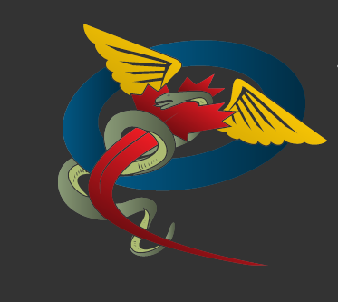
1. HS Support to RCAF Wings

Slide 4
What Health Support should you expect?
Airfield Response
Ambulance (usually civilian) within 30 minutes
Aviation Medical Officer by phone or on-site within 2 hrs
AFIC INFO PUB ASM 7000 29Jan22
Crisis and Urgent Care
Immediate assessment and help within 1 hour when clinic is open for walk-ins
Local ED for after hours
CFMAP – particularly if French/English barriers
DND Health, support and casualty services
Prioritized assessments
Notes:
While acknowledging the backlog of clinical activities, both dental and medical, as a result of the pandemic but an equally important need to support the recovery of HS staff over the next year, the following prioritization of health assessments is meant to empower clinics to focus on the most important clinical activities first while deprioritizing, which in some locations may mean temporarily ceasing, those lower on the list. The following is listed from most to least important:
a. Health assessments for new medical issues/urgent dental issues;
b. Operational dental fitness care for deploying personnel;
c. Health assessments for pre-existing medical issues and treatment of known dental issues;
d. Release medicals (to include VAC and SISIP paperwork for releasing personnel only);
e. Periodic Health Assessments ONLY for the following personnel (listed in order of priority):
i. OUTCAN postings;
ii. Medical selection for SOF and initial medicals for aircrew, divers, and submariners;
iii. Operational Aircrew i.e. those with a requirement to maintain flying currency and to include those awaiting posting into flying positions or in advance of flying courses (Note: this is an integral component of the DND/CAF Airworthiness Program under the Aeronautics Act);
iv. Operational Divers i.e. those with a requirement to maintain operational currency;
v. Operational Submariners i.e. those with a requirement to maintain operational currency; and
vi. International deployments.
f. Assessment and conversion of DFC 4* (unknown dental fitness) personnel to DFC 2;
g. Health assessments for administrative purposes, i.e. travel related medical advice, VAC and SISIP paperwork (for non-releasing members);
h. Periodic Health Assessments for all other personnel and reasons not mentioned above; and
i. Oral health care for DFC 2 personnel to address treatment that does not preclude operational dental fitness.
NOTE: With the exception of the individuals listed at para e., immediately above, who MUST have an updated PHA, for all other individuals and circumstances, including for Domestic Operations, the medical category remains valid from the date on which it was assigned until it is changed.

Slide 5
Not all Wings are created equal – and not all clinics are staffed to the same level
Majority of Wings have Primary Care and Mental Health resources in house.
Dundurn, Gander, Goose Bay, Moose Jaw, and Yellowknife are only formally assigned one ½ time civilian physician.
We rely heavily on specialists care through community consults and virtual care.
Notes:
Reliance on civilian health care providers is a double edged sword:
Allows for easy contracting and “purchasing” of resources but only when they are available. Health care inflation in Canada has averaged 6-7% annually and CMP budget / PS pay rates, have not kept pace.

Slide 6
Mental Health Programs offered by CFHS
Programs | Program Status | Program Description
R2MR | Up to Date / Fluid | Resiliency and performance education and skills development program tailored to meet needs of target audience internal and external to the CAF.
CF Member Assistance Program | Up to Date | Confidential, voluntary, short-term counselling to assist with resolving many of today’s stresses at home and in the work place.
Addictions | To be Reviewed | Comprehensive program of care for those suffering from Alcohol Use, Substance Use and Behavioural Disorders- to be reviewed and updated in coming year.
General Mental Health (28d) | Up to Date | MH care program for myriad of MH disorders including, but not limited to, depression, anxiety, PTSD, bipolar disorders. Follows interdisciplinary care model including MH and primary care providers.
Pycho-social Services (14d) | Up to Date | Psychosocial Services Program with walk-in and referral services for immediate support for those suffering from various work/home stresses. Initial triage and care with further referral as needed.
Operational Trauma and Stress Support Centres | Up to Date | Operational Trauma and Stress Support Centres specializing in mental health disorders related to CAF operations. Reciprocal relationship with VAC's Operational Stress Injury Clinics.
Enhanced Post Deployment Screening | Under Review | Enhanced Post-Deployment Screening Program: to screen for possible psychological trauma in those members returning from high risk deployments. Generally for overseas deployments > 60 days.
Suicide Prevention | Restructuring | Education, screening, clinical care and post-suicide review as CFHS contribution to the Suicide Prevention Action Plan. Annual Suicide Mortality Report produced by Research & Analysis Section in collaboration with D MH suicide prevention experts.
Notes:
This table lists the MH programs currently offered by CFHS. Not all programs are available at all clinics.
CFHS has established targets for MH care.

Slide 7
Suicide in the CAF (Statistics)
From 2018-2022 there were 66 CAF Reg Force male suicide deaths
Mean age 35
Higher rate among those separated, divorced or widowed.
No difference by Env Command
Suicide rate in the CAF unchanged 1995-2022 at 20-25 deaths / 100k
Similar rate as the Canadian Population
No difference based on deployment
Reg Force males in combat arms higher rates (31 / 100k) from 2002-2022
Multi-factorial casual pathway
Biologic, psychologic, interpersonal and socio-economic
Watch for failing relationships, family / friend suicide (or death), personal issues, excessive debt, work / legal problems.
2023 Report on Suicide Mortality in the Canadian Armed Forces (1995 to 2022) - Canada.ca
Notes:
Several work and life stressors were assessed among Regular Force males and females who died by suicide, stressors that include failing relationship(s), friend/family suicide, family/friend death, family and/or personal illness, excessive debt, work problems or legal problems. At the time of death, all (100%) Regular Force males that died by suicide in 2022 were reported to have had at least one of these work and/or life stressors and a majority (83.3%) had two or more concomitant stressors prior to their death
Mental Health Diagnoses among the Regular Force Males that Died by Suicide in 2022 and the Regular Force Females that Died by Suicide over 2018 –
1. The mental disorders that were identified among the Regular Force males at the time of their suicide death in 2022 included
a) depressive disorders (25.0%),
b) anxiety disorders (16.7%),
c) post-traumatic stress disorder (PTSD) (8.3%)
d) and other (non-PTSD) trauma and stress-related disorders (25.0%).
2. A documented addiction or substance use disorder was reported in 8.3% of these suicide deaths and 16.7% had a traumatic brain injury in the past.
3. A moderate fraction (25.0%) had at least two active mental health problems at the time of death (i.e., a combination that could include: depressive disorders, trauma and stress-related disorders, anxiety disorders, addictions or substance-use disorders, traumatic brain injury or personality disorders).
4. Additionally, there was documented evidence of prior suicidal ideation and/or prior suicide attempts among 66.7% of the Regular Force male suicides in 2022.
5. In comparison, the mental disorders that were identified among the Regular Force females at the time of their suicide death in 2018 – 2022 included depressive disorders (33.3%), anxiety disorders (33.3%), PTSD (16.7%) and other (non-PTSD) trauma and stress-related disorders (16.7%). A documented addiction or substance use disorder was reported in 33.3% of these suicide deaths and 33.3% had been identified with a personality disorder. It was common (66.7%) for these members to have at least two active mental health problems at the time of death. Additionally, there was documented evidence of prior suicidal ideation and/or prior suicide attempts among 50.0% of the Regular Force female suicides during 2018 – 2022.

Slide 8
The future of suicide prevention
Population health monitoring
Tracking of suicide attempts and other sentinel events
The access paradox
Virtual care
Dependency
Transition
New phenomenon
Post pandemic state
Cumulative stressors
Moral injury
Resilience training
Effectiveness beyond stigma reduction
Leadership and ownership
Compassion
Inclusiveness
Engagement

Slide 9
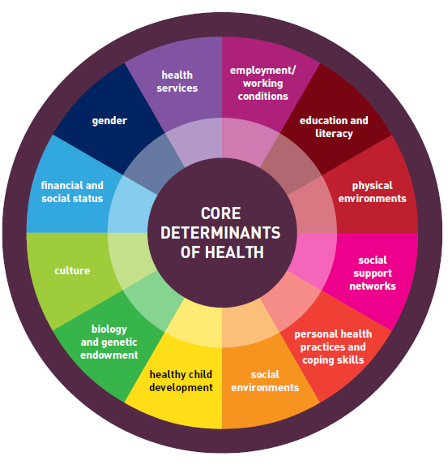
2. Health in All initiative

Slide 10
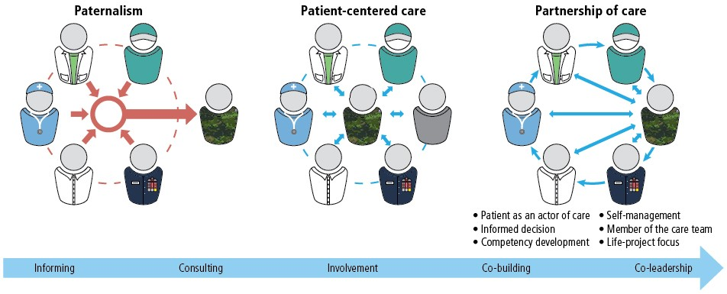
Person Partnered Care – from paternalistic
The Chain of Command plays a critical part in facilitating an appropriate Return to Work or Release Transition Plan along with the following stakeholders:
The CAF Member | The Primary Health Care Provider | The Parent Unit Chain of Command
The TC RTD Coordinator | The Unit RTD Representative | The Employing Unit Supervisor/Chain of Command
The Nurse Case Manager | The Member’s Spouse/Partner and Family | The TC Services Manager

Slide 11
Health in All can help identify barriers to Health
Health is about much more than just delivery of health services
Health in All Policies is an emerging concept that is necessary to adopt to improve how we design and create policy
Military-specific examples
Desire to increase diversity, change to retention policy and CRA
Financial incentives for disability
Dependent care travel allowance that does not reimburse cost of R&Q and only applies to isolated posts
HHT/DIT only after receipt of posting message and sale of current home
Notes:
The following lists the locations of Isolated Postings and Isolated Units:
• Gander
• Suffield
• Cold Lake

Slide 12
3. Administrative Review - Case
39 yo Sgt Intox (MSEOP) first presented for help for his alcohol use in Aug 2017 after his COC and peers expressed concerns over his consumption.
Diagnosed with alcohol use disorder 14 Sep 17
Attended inpatient treatment 13 Sept – 1 Nov 2017.
Upon discharge he relapsed.
PMedHx:
History of childhood trauma with PTSD (not service related)
Depression
Personality traits (narcissistic, borderline and antisocial).
Treatment has been difficult because of continuous substance use.
Pte Intox’s COC calls the BSurg shortly after Pte Intox’s relapse. They are at a loss as to what to do, they are very concerned for the member’s wellbeing as he is frequently found unconscious and intoxicated. They want him detained and monitored 24/7, however member is refusing to go back to detox.
What information/advice can you provide the COC?

Slide 13
AR/MEL
DGMC - Administrative Review Medical
Staff process
Evaluates the requirement and,
Develops a recommendation for administrative career action,
When the conduct, performance or medical situation of a CAF member calls into question the viability of continued service
Authorities
CO if Low Risk MELS
DMCA for Item 2 and 3B releases
CDS if MELS secondary to HISB

Slide 14
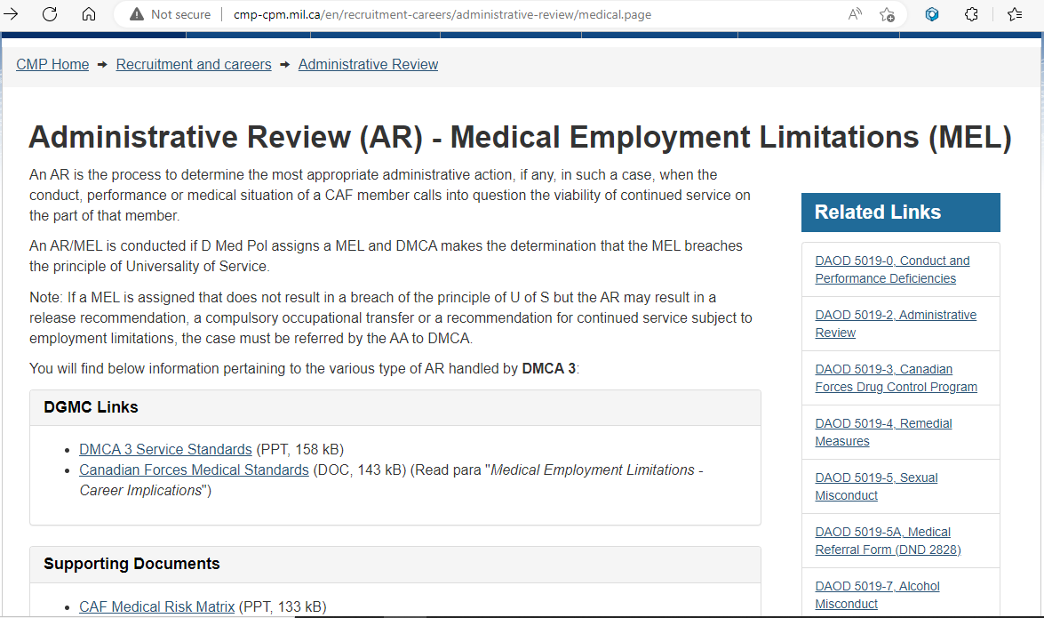

Slide 15
Process Chart: Change of Medical Category and
Medical Employment Limitations
(2017 Version)
RELEASE
RELEASE
DMCA
CF HLTH SVCS CENTRE
NO
YES
PHA 1 and 2
No change in med cat
TCat (CF 2088)
PCat (CFHIS chit)
+/- ASCS/CDM decision
B/WSurg or delegate
2nd signature
D MED POL
HIGH Risk
for UoS
Conducts Admin Review
(AR/MEL)
Advisory Message
Disclosure message
Meets UoS¹?
Meets MOSID
standards²?
Pcat or Tcat >18 months
Employable and Service requirement in rank and MOSID?
Member
Ill or
injured
Assigns Med
Cat & MELs
(TCat or PCat)
UoS NO
MOSID NO
Complex
Care?
DND
4345
TCat or
LOW Risk for UoS
NO
TCat <18 months
CF 2088
DND 4345
UoS ¹ YES
MOSID ² YES
IITP
Up to 3 yrs transition until RELEASE
UoS¹ YES
MOSID² NO
Abbreviations
AR/MEL: Admin review of MELs
ASCS: Aeromedical Standards & Clinical
Services
CDM: Consultant Dive Medicine
CFHIS: Canadian Forces Health Information
System
DMCA: Director Military Careers Administration
ITP: Integrated Transition Plan
MEL: Medical Employment Limitation
MOSID: Military Occupational Structure ID
PCAT: Permanent Category
TCAT: Temporary Category
PHA: Periodic Health Assessment
UoS: Universality of Service
UNIT CO
Compulsory Occupational Transfer
Retain without restrictions
Fit full duties in new MOSID
- Reviews MELs
- Discusses with Mbr
- CO & Mbr sign CF 2088
Forms:
CFHIS Chit
First document to Inform Unit CO of
MELs assigned by clinician that are
pending approval by B/W Surg or
DMedPol.
CF 2088
TCat and MELs are approved by B/W
Surg and ready for CO’s review and
decision.
DND 4345
TCat or PCat changes by D Med Pol
that require DMCA or CO decision.
Notes:
1. DAOD 5023-1, Minimum Operational Standards Related to Universality of Service
2. CFP 154 Annex D MO SID Task Statements.
Notes:
Unit:
File returned to originating medical clinic
2634 files in 2018
Sent to the members’ CO for adjudication
Options for CO’s are generally:
Retain without Restrictions
Retain with Restrictions
Any concerns regarding a
“disconnect” should be
addressed with B/W Surg
and/or DMCA
DMCA:
2551 files in 2018 – 1804 led to release.
Retain Without Restriction
Retention With Restrictions
for up to 3 years, non-renewable, for the purpose of preparing for transition to civilian life
Compulsory Occupational Transfer
3a/3b Release

Slide 16
Not all release decisions are medical
Release Item | Category | Reasons for Release QR&O 15.01
1 | Misconduct | a. Sentenced to Dismissal.
 |  | b. Service Misconduct.
 |  | c. Illegally Absent.
 |  | d. Fraudulent Statement on Enrolment.
2 | Unsatisfactory Service | a. Unsatisfactory Conduct.
 |  | b. Unsatisfactory Performance.
3 | Medical | a. On medical grounds, being disabled and unfit to perform duties as a member of the Service.
 |  | b. On medical grounds, being disabled and unfit to perform his duties in his present trade or employment, and not otherwise advantageously employable under existing service policy.
4 | Voluntary | a. On Request – When Entitled to an Immediate Annuity.
 |  | b. On Completion of a Fixed Period of Service.
 |  | c. On Request – Other Causes.
5 | Service Completed | a. Retirement Age.
 |  | b. Reduction in Strength.
 |  | c. Completed Service for Which Required.
 |  | d. Not Advantageously Employable.
 |  | e. Irregular Enrolment.
 |  | f. Unsuitable for Further Service.

Slide 17
Sgt Intox (2/3).
Information to Chain of Command
Patient’s right to refuse treatment;
Member has a chronic medical condition at high risk (80%) for relapse in the first year. In the event of a relapse the member will be unable to perform military duties;
CF H Svcs will provide appropriate care and develop a treatment plan that uses both internal and external care providers.
The CoC should proceed with any appropriate administrative or disciplinary review. However, they should consider the mitigating factor of a chronic medical condition when determining outcome.
What is required to recommend an administrative review?

Slide 18
Sgt Intox (3/3)
When a unit is made aware of a misconduct by a CAF member, the CO is required to follow the table on procedural fairness as set out in DAOD 5019-2:
(DMCA Aide-Memoire)
conduct an initial evaluation;
consult with the local JAG representative to determine the required action in accordance with this DAOD, other relevant DAODs and QR&O article 101.09;
consider relieving the CAF member from the performance of military duty in accordance with QR&O article 101.09;
contact the military police if the initial evaluation of the incident indicates a requirement for a police investigation;
administer, if appropriate, a remedial measure in accordance with paragraph 8.5 of DAOD 5019-7 if an AR is not conducted; and
refer the member to a CAF medical care provider in accordance with CFAO 34-56, Mental Disorders, using form DND 4006-E.

Slide 19
Recent CANFORGENs you should be aware of:
034/24 Changes to CAF LTD Plan
Eff 1 Apr 24: Members medically released with health problems not resulting primarily from service will now only receive med, psychosocial and vocational rehab through SISIP LTD.
144/23 Clarification of Medical Categories
Medical category is valid until it is changes
CJOC still requires confirmation of medical fitness to deploy
JFACC orders usually waive requirement for HCP to verify medical category for individuals with G2O2

Slide 20
4. CAF MEDICAL CATEGORY SYSTEM
http://cmp-cpm.mil.ca/en/health/policies-direction/medical-standards/index.page
Series of numerical codes
Represent key elements of mbr’s occupational fitness for military duties.
Most important ones are the Geographic and Occupational (G and O).
Complemented by the Medical Employment Limitations (MELs) when factors
change on for a TCAT or PCAT or a period of convalescence.
PROFILE - PROFIL | YOB | V | CV | H | G | O | A
PRESENT ACTUEL
RECOMMENDED RECOMMANDE

Slide 21
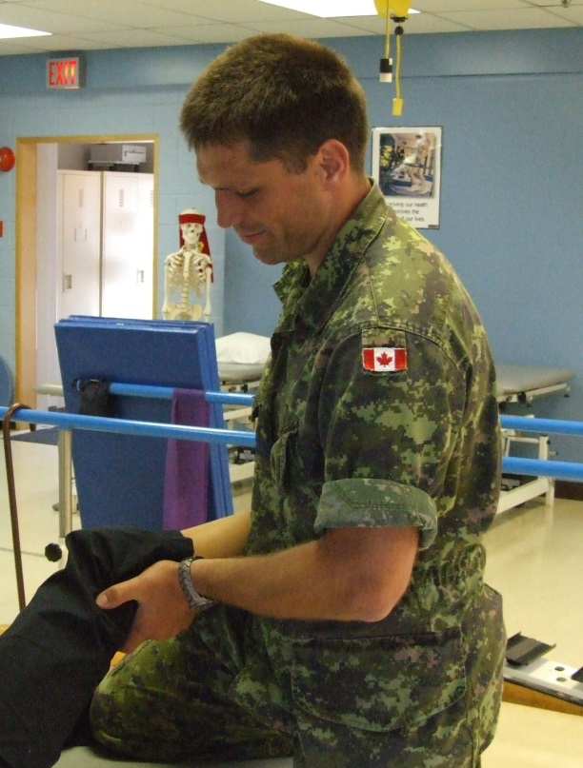
GEOGRAPHIC FACTOR
Requirement for geographic proximity to a specific level of medical care.
Address the level of medical expertise required on a planned basis and how often it is required.
For conditions where there is a risk of crises/exacerbations;
What is the risk (quantify if possible)?
What is the required medical response and
how soon should it be available ?
What will the member’s status be in the interim?

Slide 22
GEOGRAPHIC FACTOR
G1 – No longer in use
G2 – “No limitations”
Standard healthy individual
No planned care requirement; or
Mild, stable, chronic condition optimized through the use of medication (e.g.; hypothyroid, dyslipidemia)
G3 – “Requires periodic medical follow-up no more often than every 6 months”
Planned care permits 6 month tours
Manageable impact of stopping meds or other form of treatment, no acute issues likely
Annual specialist follow-up for low-risk medical conditions
who may require a specific medical evaluation before being sent on a tasking;
G4 – “Requires regular physician follow-up”
OR requires medications/lab work/other clinical services
OR runs a risk of acute onset problem requiring physician services (generally with diagnostic support) to prevent or mitigate a bad outcome
Between q3-6/12
More frequent than q2/12
G5 – “Requires regular specialist follow-up”
Similar to G4 but requires more specialized services, secondary/tertiary level care, often multiple care providers on an ongoing or urgent basis
G6 – Essentially requires institutional level care/ongoing medical support
Always accompanied by O6.
Notes:
G1 previously: “no limitations. The individuals health allows him or her to be fully employed anywhere in the world with minimal risk of becoming ineffective as a result of climate, living conditions, or the unavailability of even minimal medical care
G2 previously: “the individual has a minor medical condition, not requiring regular medical support and which does not preclude employment in any climatic or environmental conditions.
G3: the individual requires medical care (not necessarily a physicians) about every 3 months. The individual is still considered fit for operating in the field, at sea and in isolated locations.

Slide 23
OCCUPATIONAL FACTOR
O1 – Not in use anymore
O2 – Fit all generic and MOSID tasks without limitation
O3 – Requires some specific limitations, but fit more than clerical duties
(Most common)
“Fit PT but may be limited in type, duration, intensity, and frequency”
“Should avoid running on a daily basis”
O4 – Clerical/light duties only; or, unfit the stress of an
operational environment. unfit CMTFE
O5 – Sedentary duties only; or work hours or environment limited
O6 – Unable to do any work in any environment

Slide 24
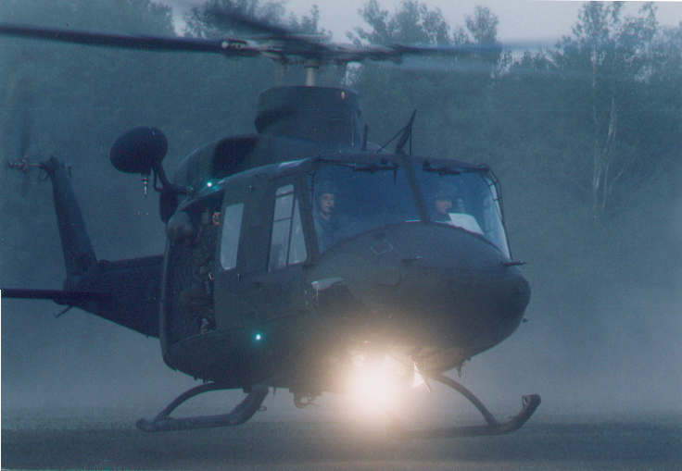
AIR FACTOR
A1 – Pilot
A2 – Other aircrew essential to safe aircraft ops
A3 – Any aircrew with restrictions
A4 – Other aircrew not essential to safe flight ops
A5 – Non-aircrew fit to fly as passenger
A6 – Non-aircrew unfit to fly as passenger
A7 – Aircrew unfit flying duties

Slide 25
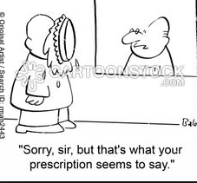
I don’t like / agree with / understand these MELS!
CO have no authority to overrule or disregard recommended medical care. This includes, treatment, diagnosis, hospitalization, PMED, MELS and Sick Leave
CO encouraged to clarify medical care with medical staff NOT the individual member
CANFORGEN 128/03 CDS DIRECTION RE MEDICAL CARE AND MELS
Notes:
3. COMMANDING OFFICERS ARE REMINDED THAT THEY HAVE NO AUTHORITY TO OVERRULE OR DISREGARD WHAT MEDICAL STAFF RECOMMEND AS MEDICAL CARE FOR CF MEMBERS UNDER THEIR COMMAND. THIS INCLUDES BUT IS NOT LIMITED TO MEDICAL AND SURGICAL TREATMENT, DIAGNOSTIC AND INVESTIGATIONAL PROCEDURES, HOSPITALIZATION, PREVENTIVE MEDICINE PROCEDURES, MEDICAL EMPLOYMENT LIMITATIONS AND SICK LEAVE
4. COMMANDING OFFICERS ARE ENCOURAGED TO CLARIFY ISSUES AROUND MEDICAL EMPLOYMENT LIMITATIONS WITH THE APPROPRIATE SUPPORTING MEDICAL STAFF. HOWEVER, COMMANDING OFFICERS ARE REMINDED THAT CLARIFICATION OR RESOLUTION OF ANY ISSUE RELATED TO THE MEDICAL DECISIONS TAKEN BY MEDICAL STAFF SHALL BE BETWEEN THE CHAIN OF COMMAND AND THE APPROPRIATE MEDICAL AUTHORITY, AND NOT BETWEEN THE CHAIN OF COMMAND AND THE INDIVIDUAL MEMBER

Slide 26
Questions

