Slide 1
AJAG Prairie
Maj Laura Hodgson
CWO Will Kuseler

Slide 2
Agenda
Who we are and what we do – call us!
Bill C-77, changes to the MJS
Incident occurs:
Disciplinary vs Administrative?
Scenario
Questions/Comments

Slide 3
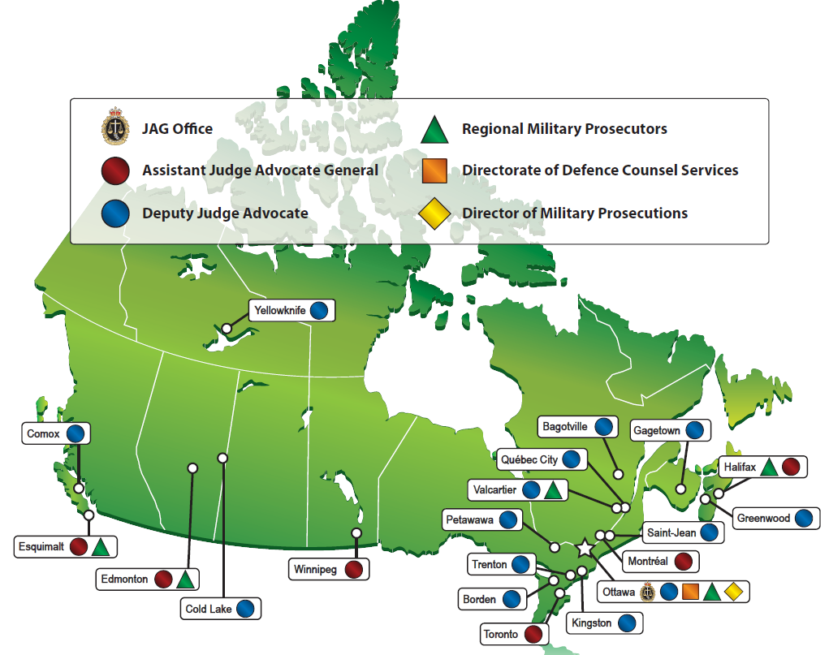

Offices

Slide 4
MJS 101 – Post Bill C-77
Service Offence | Service Infraction
Court Martial Only - DMP unlikely to prefer charges where they assess SH sanctions are adequate. E.g., AWOL, NDA 129 (Conduct to the Prejudice of Good order and Discipline); Drunkenness, etc. Beyond a Reasonable Doubt Sentences (Absolute Discharge – Detention) No limitation period (was 1 year for ST) Declaration of Victim’s Rights | Summary Hearing – unit level only E.g., Tardiness, Conduct adversely impact moral, efficiency/discipline of CAF, Offences related to Information, offences related to alcohol and drugs. No quarrelling. Balance of Probabilities Sanctions: minor sanctions – reduction in rank 6 month limitation (from time of incident – SH) DVR by policy, must seek legal advice if affected person (pre invest, pre-charge, pre-hearing).

Slide 5
Service Infractions
120.02 – INFRACTIONS IN RELATION TO PROPERTY AND INFORMATION
A person commits a service infraction who
(a) takes or uses, for other than authorized purposes, non-public property, public property, materiel or government-issued property or damages that property or materiel;
(b) without permission or legal justification, takes property that belongs to another person;
(c) accesses, possesses, uses or communicates information for a purpose unrelated to the performance of their duties; or
(d) fails to disclose actual, apparent or potential conflicts between their duties and private interests.

Slide 6
Service Infractions Cont’d
120.03 – INFRACTIONS IN RELATION TO MILITARY SERVICE
A person commits a service infraction who
(a) handles a weapon, explosive substance or ammunition in a dangerous manner;
(b) discharges a firearm without authorization;
(c) behaves in a manner that could reasonably undermine the authority of a superior officer;
(d) fails or while on duty is unfit to effectively perform their duties or carry out responsibilities;
(e) in relation to military service, furnishes false or misleading information or engages in deceitful conduct;
(f) without reasonable excuse, fails to attend or is tardy to their place of duty;
(g) dresses in a manner or adopts an appearance or demeanour that is inconsistent with Canadian Forces requirements;
(h) fails to maintain personal equipment or assigned quarters in accordance with Canadian Forces requirements; or
(i) otherwise behaves in a manner that adversely affects the discipline, efficiency or morale of the Canadian Forces.

Slide 7
Service Infractions Cont’d
120.04 – INFRACTIONS IN RELATION TO DRUGS AND ALCOHOL
A person commits a service infraction who
(a) while on duty, is impaired by a drug or alcohol;
(b) uses a drug contrary to article 20.04 (Prohibition); or
(c) introduces, possesses or consumes an intoxicant contrary to article 19.04 (Intoxicants).

Slide 8
Incident Occurs – MJS Considerations
Who should investigate? MP Vs Unit
Unit Investigations:
Gather all available evidence, including exculpatory, can be used for SI charges or RM.
Charge Layer: Reasonable belief SI occurred, public interest.
Strength of evidence; reluctant civilian witnesses;
Summary Hearing:
Balance of Probabilities;
Oral and written reasons, must be clear to an objective 3rd party why a particular decision was made.
Decisions can be reviewed, Judicial Review:
Procedural Fairness?
Was the decision reasonable?

Slide 9
Remedial Measures – DAOD 5019-4
"Clear and Convincing Evidence on a BOP that a CAF member has demonstrated 1. Conduct Deficiency/applicable standard of conduct; 2. Performance Deficiency - over reasonable period of time applicable standard of performance not met (para 5.1)
Considered personal information;
On Review:
Is the decision reasonable?
Does it reference a “CAF Standard”,
Detailed description of applicable evidence? Is it clear why the standard was breached?
Was procedural Fairness applied?
Did the person have time to submit representations?
Were the representations considered? (see para 6.4 DAOD 5019-4).

Slide 10
Scenario
At the unit lunch table, Cpl A gets into a verbal dispute with Cpl B, which escalates into shouting, swearing, name calling.
There are 5 people at the table, one of the people, Cpl C reports the incident through the CoC.

Slide 11
Scenario Cont’d
UDI
Evidence from all 4 pers is consistent, suggests Cpl A is the instigator, comments were inappropriate.
Cpl A and B normally get along, yesterday, Cpl B had done something similar to Cpl A.
Cpl A personal circumstances deteriorated the night before;
All individuals at table agree that Cpl Cs report is blown out of proportion, including Cpl B. Cpl C is adamant that a SH proceed.
Other examples?

