Slide 1
Change of Circumstances
Brief
VICE CHIEF OF THE DEFENCE STAFF
Canadian Forces Military Police Group
Commander Air Force Military Police Group
LCol Wuskynyk
3 September 2024
Prepared by Maj Barnes

Slide 2
Outline
VICE CHIEF OF THE DEFENCE STAFF
Introduction
Change in Personal Circumstances
Changes Noticed by Leaders
Decision & Reporting Process
Denial of Access
Change of Circumstances Form (DND 4151)
Questions

Slide 3

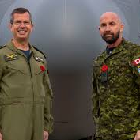
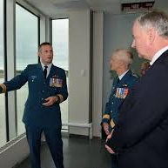

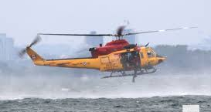
Introduction
Notes:
We all know that security is everyone’s concern and responsibility. This has never been as important is it is in today’s interconnected world.
Today’s brief will go through what you as senior leaders need to know about the Change of Circumstances process.

Slide 4
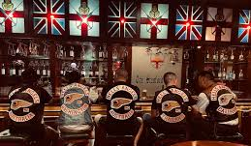



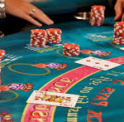
Changes in Personal Circumstances
Notes:
All individuals must report to their supervisors, changes in their personal circumstances. This includes but is not restricted to:
a. change in criminal record status (e.g. criminal conviction, suspension of a criminal record, other judicial prohibitions);
b. involvement with law enforcement (e.g. suspect in a criminal investigation, arrest);
c. association with criminals;
d. significant change in financial situation (e.g. bankruptcy, unexpected wealth); and
e. those who work in Security and Intelligence (S&I) organizations may be required to report additional changes in their personal or legal status, including a change in marital or spousal status.

Slide 5



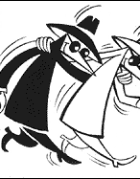
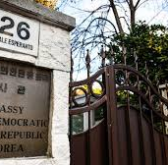
Changes in Personal Circumstances
“Exposed”
Notes:
Individuals must also report to their manager or supervisor when THEY ARE EXPOSED TO SITUATIONS that could constitute a security concern such as, but not limited to:
a. they are contacted by people who appear to be, or who identify themselves as members of criminal organizations, radical groups, foreign intelligence organizations, or extremists;
b. any persons who display a persistent or an unusual interest in their work; or
c. they are directly invited (i.e. not through DND or CAF channels) to social or official events of foreign governments or groups known or reasonably suspected to conduct espionage against Canada or her allies.

Slide 6
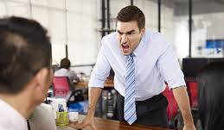


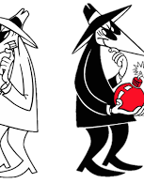
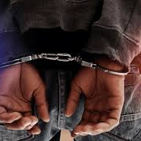

Changes Noticed by
Leaders
Notes:
Leaders are responsible to notice when there are changes in their personnel that constitute a security concern, raising concerns about their ability to be access sensitive information and materials.
This list is not all inclusive and does not limit the chain of command to just this list.
any indication or suspicion that an individual is engaged in acts of espionage, subversion or sabotage;
an unauthorized or unreported association with nationals of, or travel to, regions or countries considered to be a high-risk for espionage;
a change in criminal record status (e.g. criminal conviction, suspension of a criminal record, other judicial prohibitions);
involvement with law enforcement (e.g. suspect in a criminal investigation, arrest);
association with criminals;
a change in domestic status, divorce or separation, which appears to be creating an unusually stressful situation;
drug or alcohol misuse;
sudden or marked changes in financial situation or expenditures (e.g. bankruptcy, unexpected wealth);
expressions of support for extremist views, actions or incidents, particularly when violence is advocated;
unexplained hostile behaviour or communication, or any indication of mental instability;
unexplained frequent absences;
indications of fraudulent activity;
disregard for safeguarding of sensitive information or assets (e.g. violations, breaches of security); or
persistent or unusual interest in, or attempts to gain access to, sensitive information, assets, resources or Defence facilities to which an individual has no work-related need to access.

Slide 7


Decision Making & Reporting
VICE CHIEF OF THE DEFENCE STAFF
Monitor Concern
No Concern
Change of Circumstances Report
CCR’s are sent to the PSSO at ++DPSIM CCR - DSPGI RCS@VCDS DGDS@Ottawa-Hull
Notes:
Changes to personal circumstances self reported or noticed by leadership could constitute a security concern and thus affect eligibility for holding a reliability status or security clearance.
Leaders must assess these security concerns and determine if there is no actual concern, if they should monitor the situation, if they should conduct a SI, initiate a Change of Circumstances report, and/or when there is belief that a criminal act has occurred contact the MP. If you are contacting the MP on this subject you should be probably initiating a Change of Circumstances as well.
COs, directors, and formation commanders may not revoke or suspend a clearance. They can however, initiate a Change of Circumstances Report and may also deny access to sensitive materials, locations, and information, barring the individual from actively working with or around sensitive materials (discussed a little later in more detail).
PSSO → Personnel Security Screening Office
The DND 4145 Change of Circumstances report is a very simple form, that when completed goes to the PSSO via email: ++DPSIM CCR - DSPGI RCS@VCDS DGDS@Ottawa-Hull

Slide 8

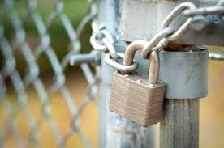

Denial of Access
VICE CHIEF OF THE DEFENCE STAFF
Notes:
Upon uncovering adverse information that raises a reasonable security concern on an individual`s ability to safeguard information, assets, resources and facilities, a CO or director must determine if the individual must be denied access to any DND and CAF sensitive information, assets, resources and facilities, pending a review of the circumstances identified. The CO or director must state any restrictions to be adhered to by the individual on the Change of Circumstance Report (DND 4151).
Denial of access is a precautionary interim step, and must not be construed as a suspension, denial or revocation of a reliability status or security clearance
COs and directors may reinstate the individual's access as deemed appropriate, when the risk level is identified as low and after consultation with PSSO.
OPTIONAL:
When the PSSO receives information regarding an individual holding authorization to access SCI, which raises a reasonable security concern of their ability to safeguard information, assets, resources and facilities, and the individual has been denied access, the PSSO must notify the National Special Centre (NSC) Secretariat. Upon completion of the review where no security concerns remain, the PSSO will advise NSC Secretariat accordingly.
Note: In specific instances, the PSSO, under the authority of the DGDS, will direct that an individual is denied access until a full review of the concerns has been completed. Access to Sensitive Compartmented Information

Slide 9
Scenarios
Scenario 1
Major Smith sends you an email last night to inform you that he was arrested for driving while under the influence. Major Smith is in charge of a company of aircraft maintainers.
Scenario 2
Your unit MWO informs you that he has been receiving a number of phone calls from collection agencies regarding Cpl Bloggins. Cpl Bloggins is part of a small base IT maintenance section.
Major Smith is convicted of a first offence, and sentenced to a $3,000 fine and required to use Interlock Breathalyzer for 2 years.
During an inventory check, the IT section is missing a large number of new laptops and expensive parts that they cannot account for.
Notes:
Prepared facts to aid in discussion.
Both Maj Smith and Cpl Bloggins hold TOP SECRET Clearances.
Maj Smith has had no other incidents with law enforcement.
Part of Cpl Bloggins duties includes being the primary COMSEC custodian for the Base, including CF-18’s, and J2.
When the MP interview Cpl Bloggins it is discovered that he has become addicted to Oxytocin after an injury on deployment and is selling IT equipment to pay for his addiction.

Slide 10
Scenarios
Scenario 1
Major Smith has no previous criminal infractions and no history of service infractions.
Scenario 2
Subsequent MP investigation reveals that Cpl Bloggins has been selling numerous laptops on Facebook and Kijiji.
During the MP interview it was discovered that Cpl Bloggins is an addict and was selling the equipment to pay for his addiction..
When discussing the issue with Major Smith he admits to the poor decision to drive after drinking. There were no other outstanding issues involved.
You are informed that Cpl Bloggins is also the COMSEC custodian for the base, which also includes CF-18s, and the J2 unit.
Notes:
Prepared facts to aid in discussion.
Both Maj Smith and Cpl Bloggins hold TOP SECRET Clearances.
Maj Smith has had no other incidents with law enforcement.
Part of Cpl Bloggins duties includes being the primary COMSEC custodian for the Base, including CF-18’s, and J2.
When the MP interview Cpl Bloggins it is discovered that he has become addicted to Oxytocin after an injury on deployment and is selling IT equipment to pay for his addiction.

Slide 11
Scenarios
Scenario 1
Should a Change of Circumstances be initiated?
Scenario 2
Should a Change of Circumstances be initiated?
Why or why not?
Why or why not?
Notes:
Prepared facts to aid in discussion.
Both Maj Smith and Cpl Bloggins hold TOP SECRET Clearances.
Maj Smith has had no other incidents with law enforcement.
Part of Cpl Bloggins duties includes being the primary COMSEC custodian for the Base, including CF-18’s, and J2.
When the MP interview Cpl Bloggins it is discovered that he has become addicted to Oxytocin after an injury on deployment and is selling IT equipment to pay for his addiction.

Slide 12
Notes
VICE CHIEF OF THE DEFENCE STAFF
National Defence Security Orders and Directives (NDSOD) 4 , Standard 4B Individual Security Program National Defence Security Orders and Directives (NDSOD) (mil.ca)
  Annex G: Change of Circumstance Report
DND 5141, Change of Circumstances Report (CCR), is found in the CAF Forms Catalogue in both French and English

Slide 13
Change of Circumstances Received by PSSO
CCR Received by PSSO
2020 | 2021 | 2022 | 2023 | 2024
45 | 76 | 133 | 119 | 102
2016 | 2017 | 2018 | 2019
84 | 97 | 47 | 59
Notes:
These are basic numbers of CCRs received by PSSO. Not all contain adverse information, but their office does not track this specifically.

Slide 14

Questions
Discussions

