Slide 1
Chief Professional Conduct and Culture RUCTop 11 Sep 2024
Security Classification: UnCLASSIFIED

Slide 2
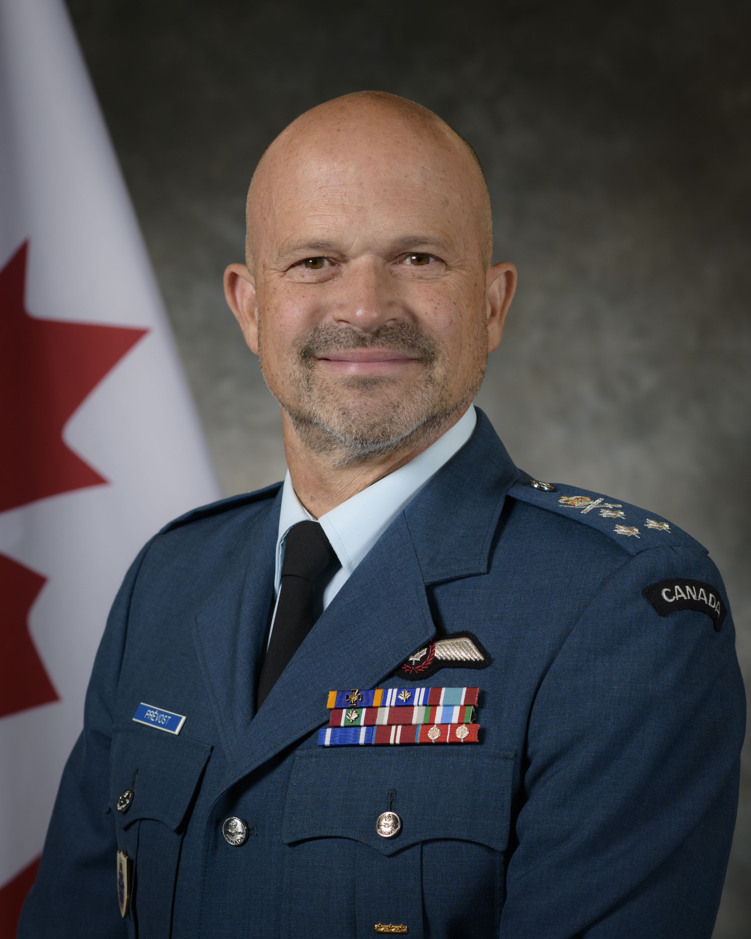
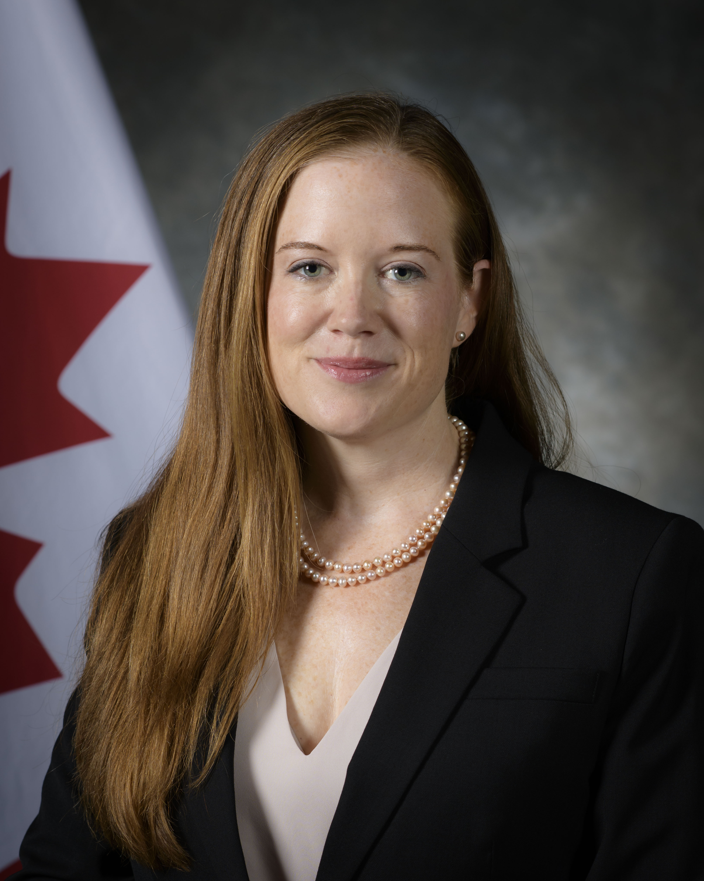
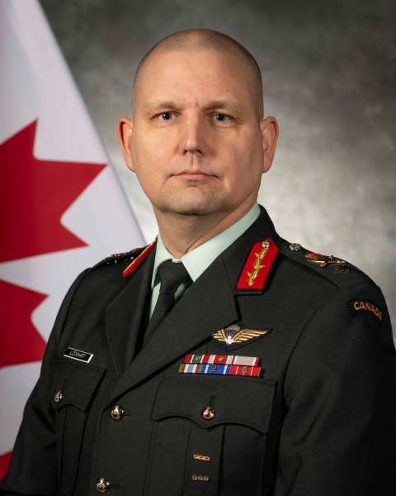
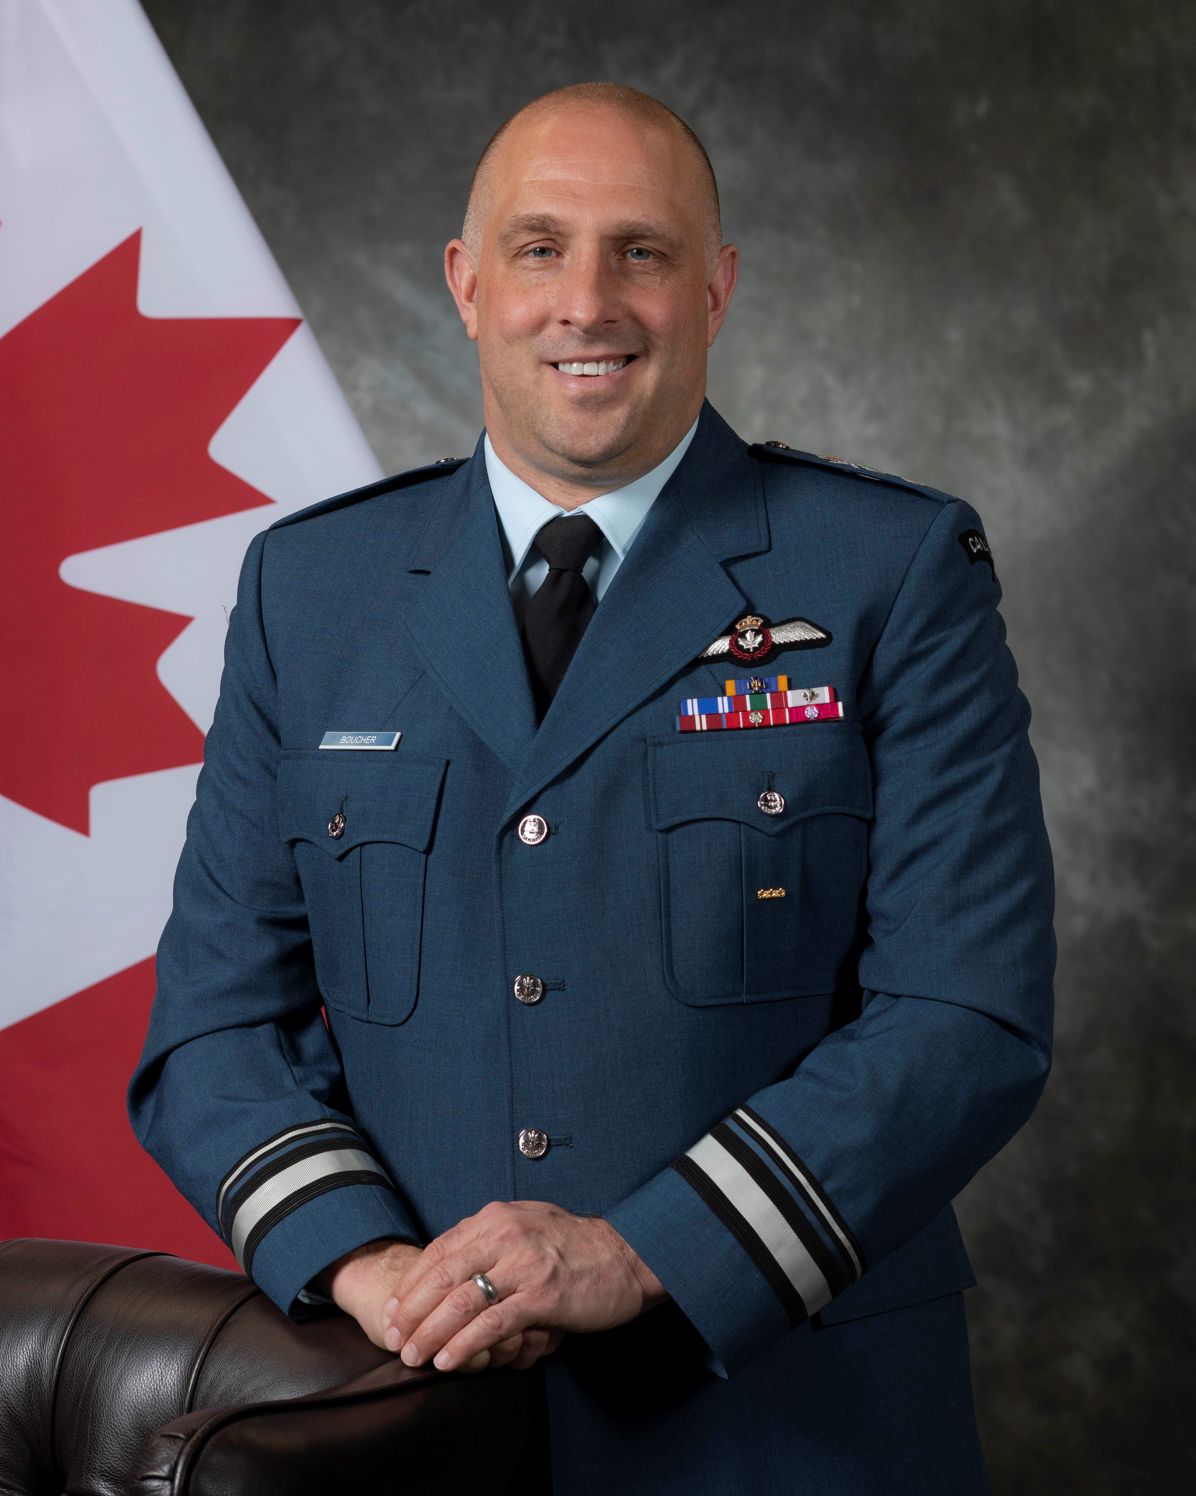
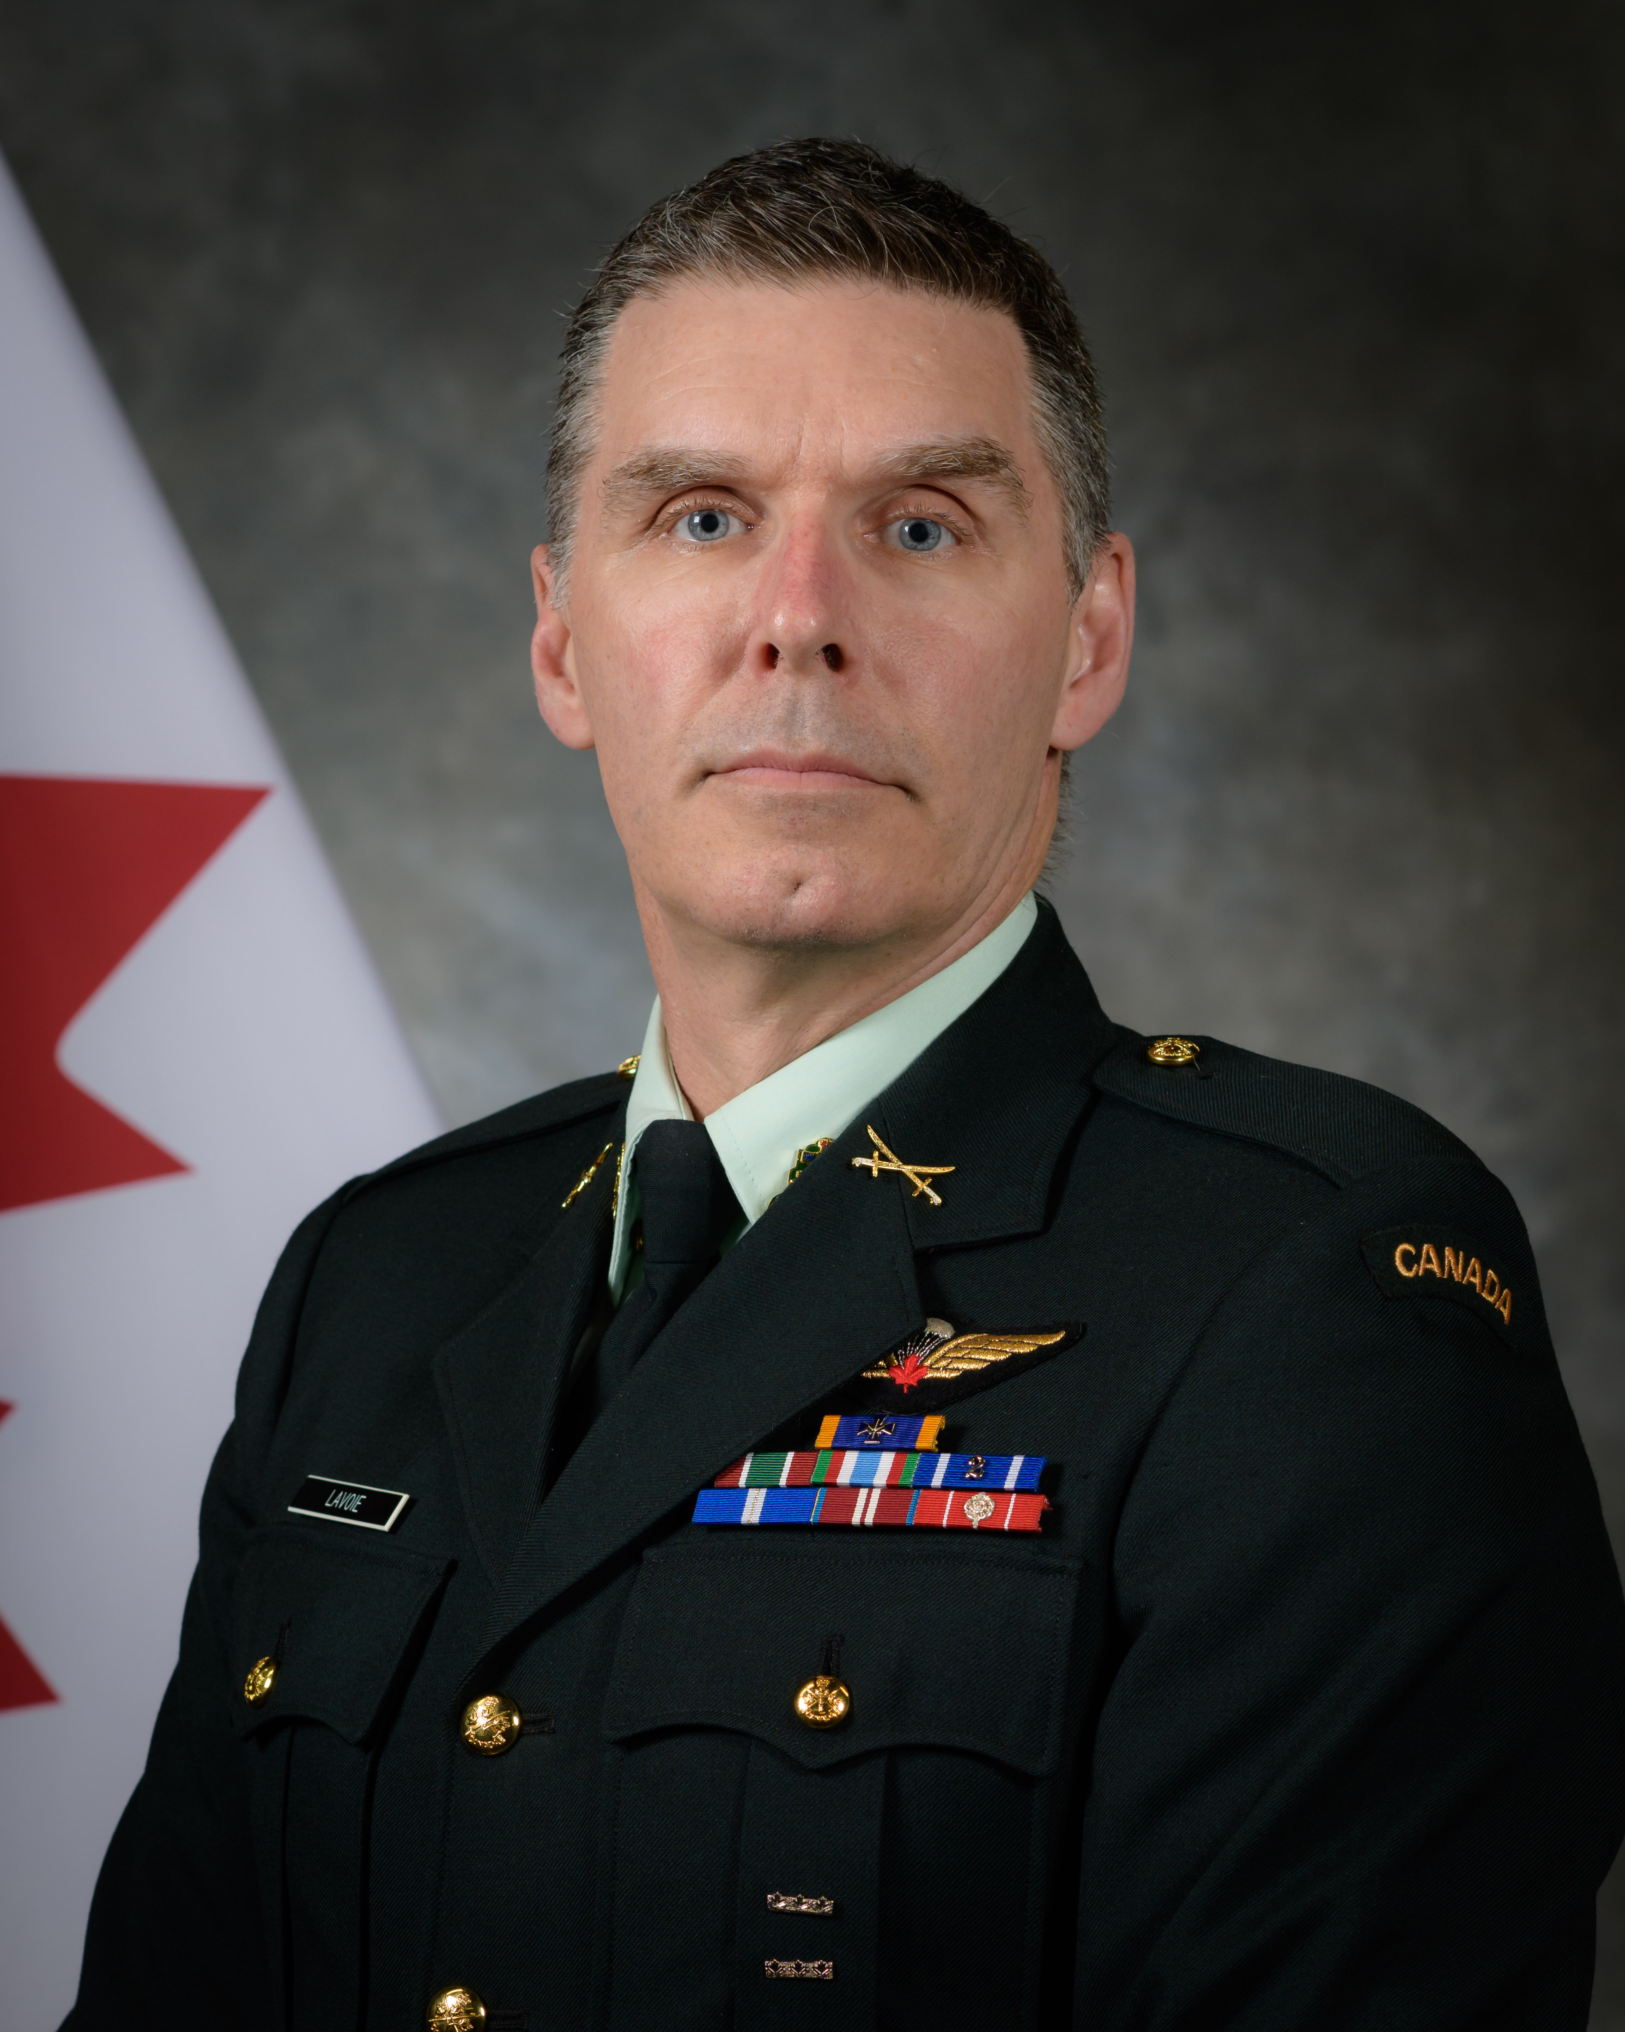
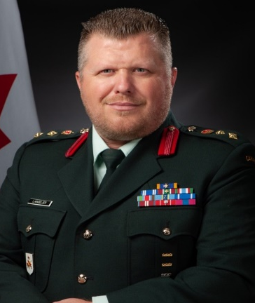

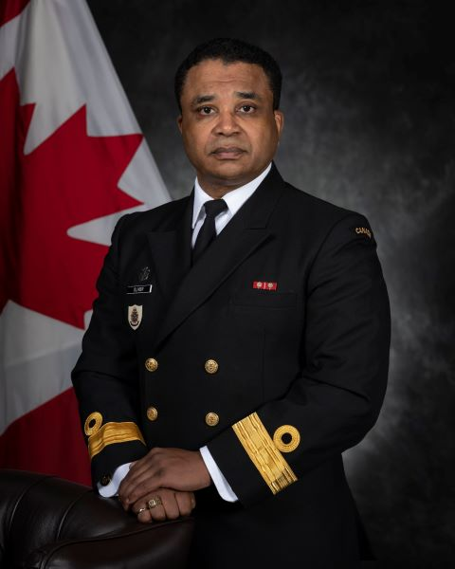
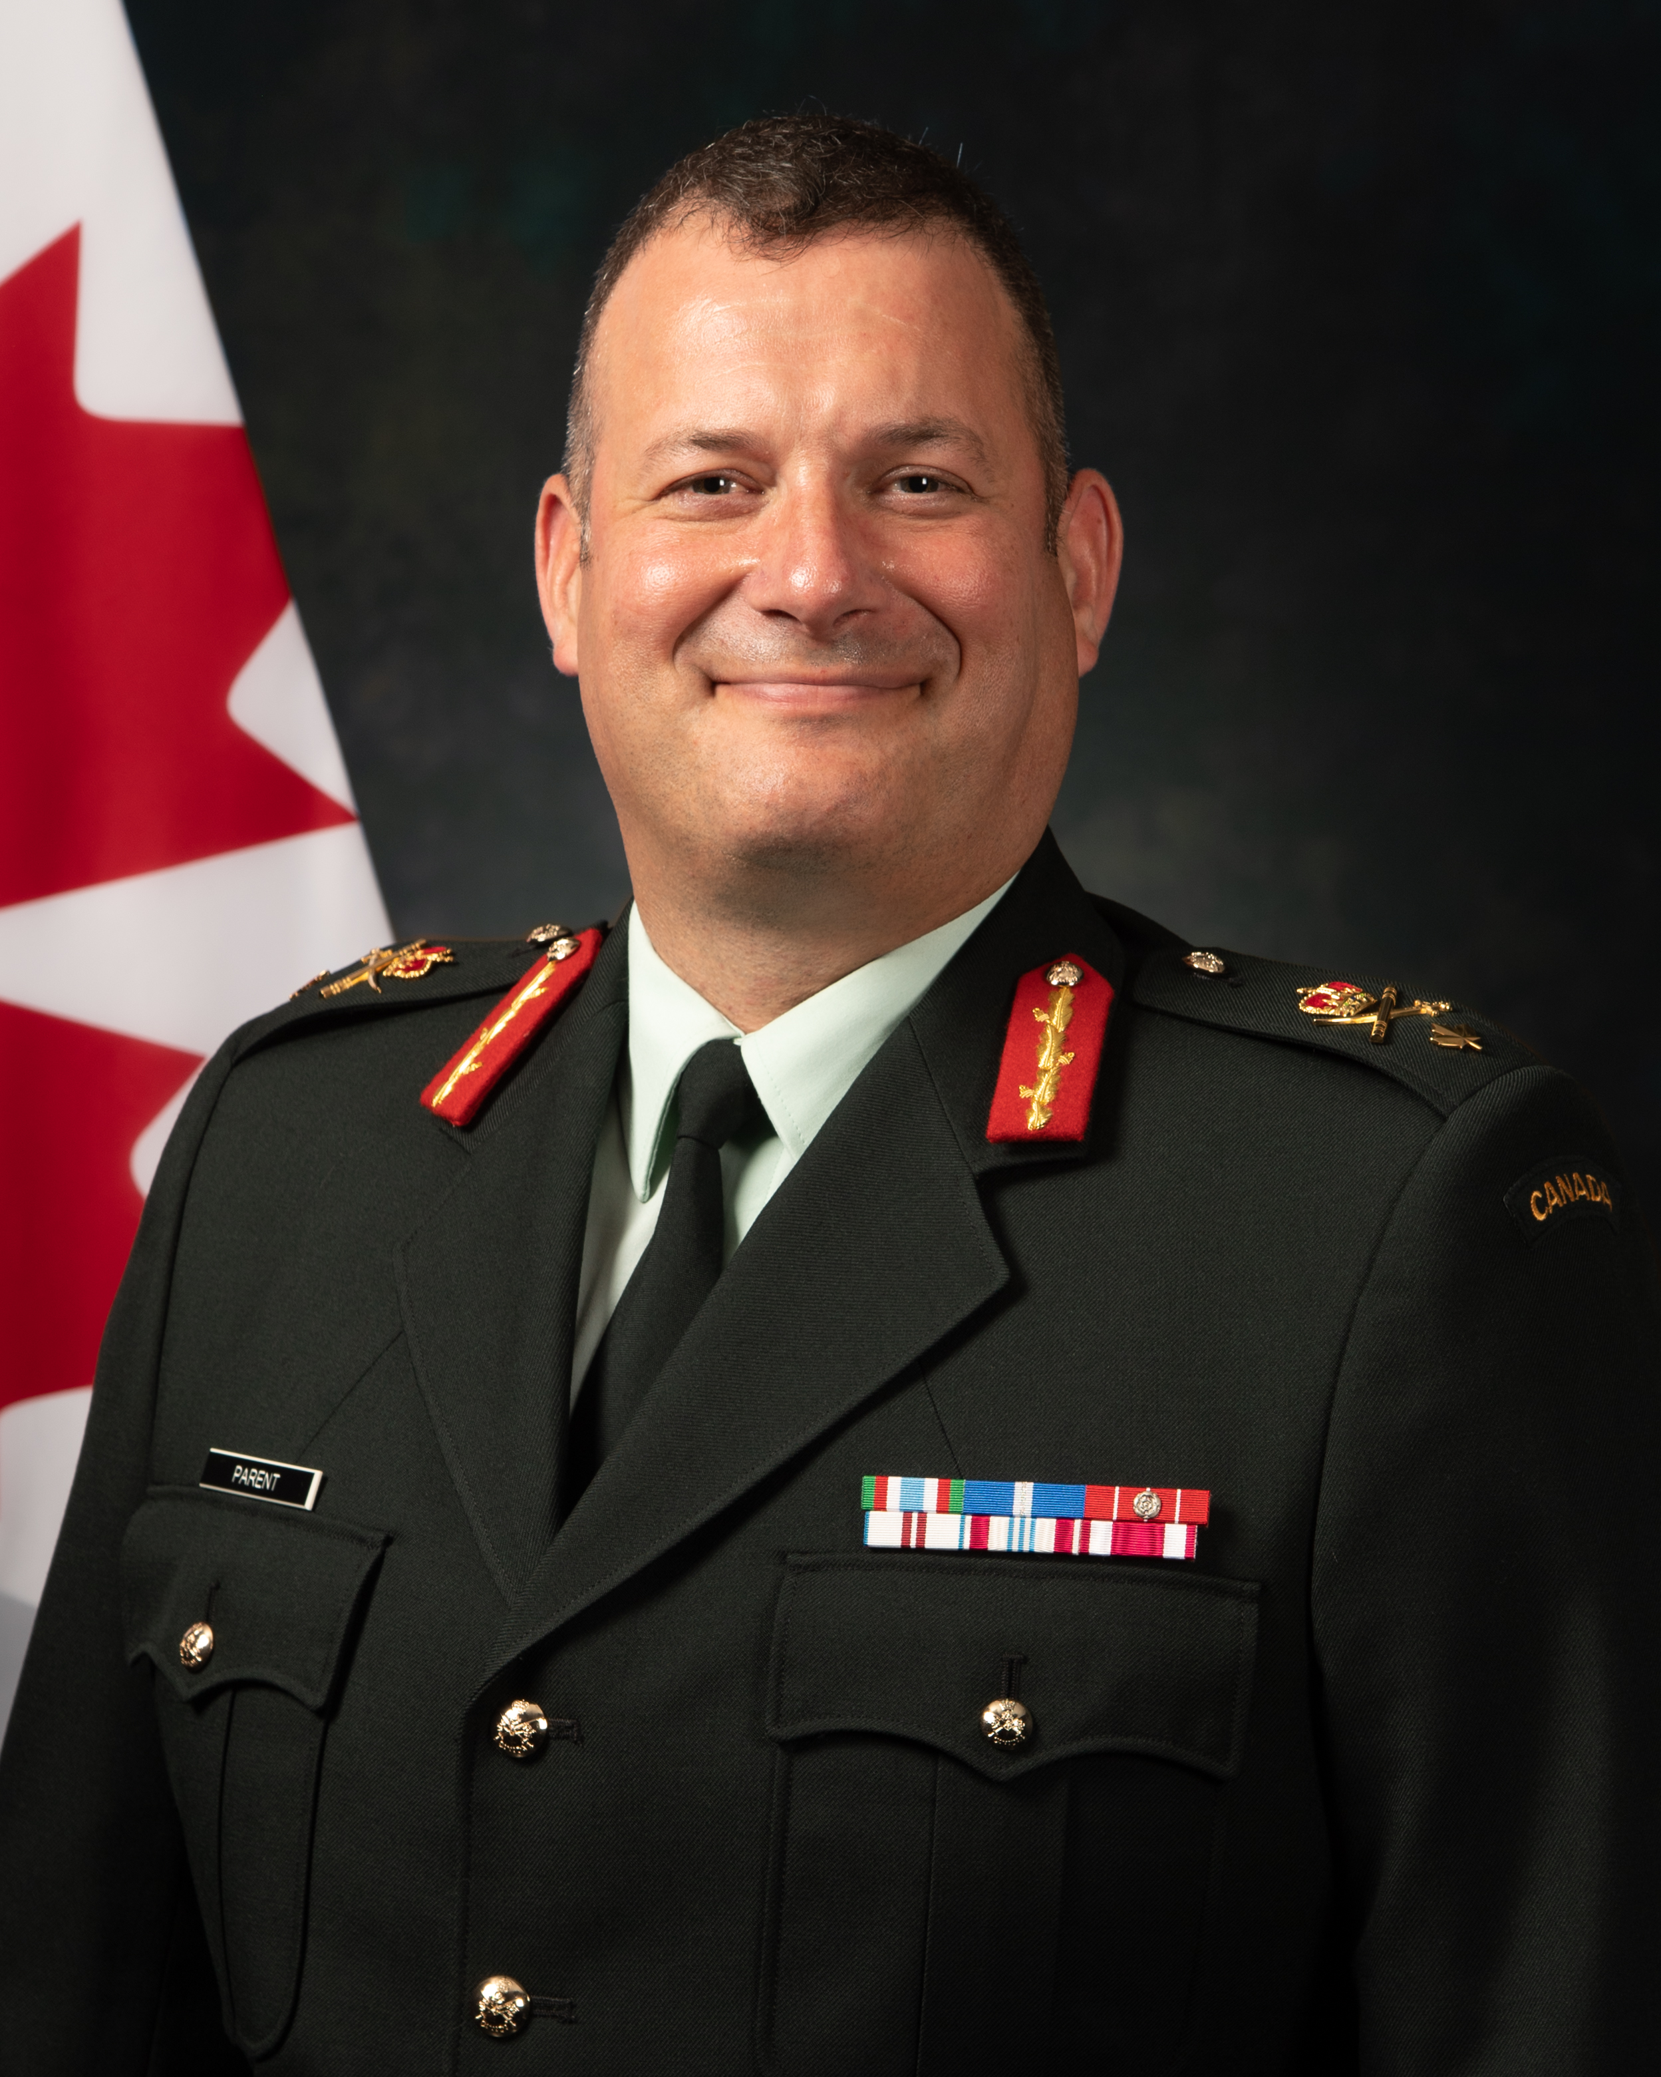
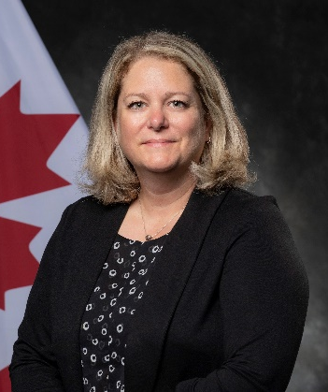
ABOUT CPCC – Senior Leadership
LGen Paul Prévost
Chief of Professional Conduct and Culture
Wendy Luciani
Assistant Chief of Professional Conduct and Culture
MGen Jeannot Boucher
Chief of Staff
CWO Frédérick Lavoie
Command Chief Warrant Officer
BGen Paul Lockhart
Deputy Chief of Staff
BGen Jason Langelier
Director General External Review Implementation Secretariat
Lara Rooke
Director General Policy, Engagement and Research
BGen Marc Parent
Director General Professional Conduct and Development
Genevieve Lord
Director General Conflict Solutions and Services
Rear Admiral Jacques Olivier
Director General Culture

Slide 3












CHIEF, PROFESSIONAL CONDUCT & CULTURE
We will strengthen operational readiness and effectiveness by building an inclusive Defence Team culture where all members feel safe, respected, and empowered to bring their best selves to serve.
THEMES
TRANSPARENCY & ACCOUNTABILITY
The Conduct & Culture Data Centre (CCDC) facilitates information sharing, monitoring, and measuring; and enhances transparency and accountability.
Top Priorities
Transform grievance and complaints process, enable independence of military justice actors, support for victims of other forms of misconduct, evolve of anti-racism, accessibility and other policies.
DIVERSITY, EQUITY, & INCLUSION
IDENTITY
Strategy
LEADERSHIP
TRUST & LEADERSHIP
17,000 CONSULTATIONS
The Culture Evolution Strategy
(CES) will integrate culture considerations into regular business cycle and everyday routines.
OUTCOMES
PROFESSIONAL CONDUCT
SERVICE
Plan of Action
Comprehensive Implementation Plan
(CIP) will bring coherence to our response to multiple external reviews and recommendations.
DEFENCE TEAM EXPERIENCE
TEAMWORK

Slide 4


Culture Evolution Strategy (CES)
CHIEF PROFESSIONAL CONDUCT AND CULTURE
Strategic Engagement Plan | CULTURE EVOLUTION STRATEGY (CES)
Modernization
Capabilities
Defence Policy Update
Digitalization
Business Transformation
Vision
The Four Culture Themes
Together - Stronger:
Diversity of Service, Unity of Purpose
We will build a Defence Team where each member,
across the organization, and lived experience,
is valued for their knowledge, skills,
and is enabled to achieve their full potential in order to make their maximum contribution
to operational readiness and effectiveness.
Leadership
Recruitment
Retention
Force Design
21st Century
Military
Diversity, Equity, Inclusion
Professional Conduct
Military Justice Modernization
Identity
Culture Themes
Teamwork
Reconstitution
Culture Evolution
Service
The Defence Team Culture Evolution Strategy (CES), establishes the way forward for building a Defence Team where each member is valued and enabled to achieve their full potential and contribute to operational readiness and effectiveness.
The strategy takes a holistic approach to evolving and aligning broad-based culture change,
The CES provides detailed guidance and enhanced support to Defence Organizations in building aligned and people-focused culture plans and implementing consistent practices from the top-level organizations down to small teams.
The strategy takes an evergreen approach to culture,
The CES is set for early distribution to L1 planning teams in September 2023,
Implementing organizations will be expected to have their first culture plans in place in the winter/ spring of 2024 and implementation underway by June, 2024.
Leadership
Strategic objectives
Leadership is centered on character, emphasizing humanity, team well-being and accountability and adapts style and approach as needed to the working context.
Teamwork
A more diverse and inclusive Defence Team.
Teamwork is a key factor in operational readiness and effectiveness. We will develop high-functioning teams through equity, inclusion, and diversity.
1
Service
Diversity, inclusion, and equity will contribute to increasing our ability to anticipate, learn and adapt. They are strengths that make teams more resilient, innovative, and creative and better reflect the diversity and expectations of Canadians.
We embrace a concept of service that includes protecting the well-being of each team-member in order to maintain peak readiness and effectiveness. We recognize that our best selves are required to best serve.
Identity
2
Build strong and enriched teams.
We will ensure that our collective identity is reflective of the wide variety of roles demanded by a 21st Century military context and is firmly centered around character.
We will take a mosaic approach to building teams, where individual identity and team identity are mutually reinforcing. Connecting as human beings, leveraging diversity, engaging all voices, and encouraging courageous conversations will lead to high-performing teams built on trust, loyalty, and authenticity.
Big five enabling activities
3
Increase operational readiness and effectiveness.
Organizational Culture Plans and Culture Philosophy​
Institutionalization of GBA Plus ​
Conduct & Culture Support Structure​
Culture Conversations & Psychological Safety​
Unit-level programs and tools
Creating a psychologically safe work environment where people can thrive and not fear or feel threatened makes us better prepared and able to understand, decide and act on the challenges of the evolving modern Defence environment.
Notes:
The Defence Team Culture Evolution Strategy (CES), establishes the way forward for building a Defence Team where each member is valued and enabled to achieve their full potential and contribute to operational readiness and effectiveness.
The strategy takes a holistic approach to evolving and aligning broad-based culture change, focusing on establishing an environment that facilitates the alignment of both institutional systems and individual conduct with our stated values and ethics, supporting ongoing efforts across Defence to transform systems and address conduct.
The CES provides detailed guidance and enhanced support to Defence Organizations in building aligned and people-focused culture plans and implementing consistent practices from the top-level organizations down to small teams. It sets out a number of baseline enabling practices including the expanded integration of GBA Plus.
The strategy takes an evergreen approach to culture, constantly incorporating new inputs and insights, and establishing an annual cycle to review and refresh organizational culture plans to respond to the evolving state of culture. Through the integration of GBA Plus, it also provides an approach for the coordination and analysis of new initiatives, policies, programs and practices with desired culture outcomes.
The CES is set for early distribution to L1 planning teams in September 2023, with formal tasking to be issued with CPCC Functional Planning Guidance in fall 2023.
Implementing organizations will be expected to have their first culture plans in place in the spring of 2024 and implementation underway by June, 2024.

Slide 5





Culture Measurement Themes & MeTRICs
CONDUCT AND CULTURE DATA CENTRE
Outlined below are the prioritized measures for each of the 4 culture themes. Each metric includes a sample KPI, providing insight into the types of culture-related information that the data centre is seeking to capture.
Diversity, Equity & Inclusion
Defence Team Experience
Professional Conduct
Trust & Values
Diversity & Representation
(i.e. demographics)
Employee & Member Satisfaction
Hateful Conduct
(including, but not limited to, harassment, discrimination, and racism)
Lived Values & Value Alignment
E.g., gender representation (e.g., annual increase in representation of women).
E.g., attrition (e.g., attrition rate for the regular force).
E.g., discrimination (e.g., # of founded discrimination complaints / investigations.
E.g., value alignment and consistency (e.g., agree values communicated by DND/CAF do not match what is actually practiced).
Equity & Inclusion
Work-Life Balance
E.g., accessibility (e.g., # of duty to accommodate requests).
E.g., burnout (e.g., % agree they need more hours in the day to do all that is expected).
Sexual Misconduct
Accountability
E.g., incidents (e.g., # of days between incident occurrence and reporting).
E.g., appropriate discipline (e.g., % of CAF members who agree personnel will be disciplined if they behave unethically).
Information Sources
Initial capability will provide access to approx. 160 key measures and indicators
Key L1 Partners: HR-Civ, CMP (DGMPRA), CPCC, ADM (PA), SMSRC, ADM (IM), and ADM (DIA)
Defence Team Research Products
Existing Frameworks (e.g. Path to Dignity and Respect)
Open Source
Ethical & Respectful Leadership Behaviour
Dignity & Respect
E.g., ethical conduct (e.g., # of instances of unethical decisions).
E.g., role modeling behaviour (e.g., % of members who agree senior leadership sets a good example of ethical behaviour).
Version 1.0

Slide 6
CCMS Locations
Alert
Regions
West – North
West – North
Edmonton (Yellowknife, Wainwright)
Det Calgary
Esquimalt (Comox)
Winnipeg (Shilo, Dundurn, Moose Jaw)
Cold Lake
Central
CCMS site
East
services provided
Whitehorse
Yellowknife
Cold Lake
Goose Bay
Edmonton
Comox
Wainwright
Gander
Esquimalt
Vancouver
Calgary
Regina
St. John’s
Victoria
Suffield
Dundurn
Valcartier
Moose Jaw
Winnipeg
Bagotville
Rimouski
Shilo
Quebec
Moncton
Sydney
Thunder Bay
Longue Pointe
Gagetown
Halifax
Sudbury
Petawawa
Montreal
Sherbrooke
Shearwater
Central
Kingston (Brockville, Cornwall)
Petawawa (North Bay)
Borden (Meaford)
Trenton
Toronto (London, Windsor)
NCR/ International Sp
North Bay
St. Jean
Greenwood
Borden
Ottawa
East
Valcartier
Montreal / St-Jean
Bagotville
Halifax (St-Johns, Yarmouth
Gagetown (NB, PEI)
Greenwood (Gander, Goose Bay)
Kingston
Meaford
Trenton
London
Toronto
Hamilton

Slide 7

Synchronized and integrated services to maximize effectiveness and influence culture evolution (feedback loop)
Resources and interventions are timely and efficient to minimize harm at the individual and team levels
Clear and responsive service standards with focus on reducing delays
Support shift to preventative rather than reactive
Leadership Support Team (LST)
CFGA* - Grievances
CCMS* 16 Centers across Canada
Defence Team Coaching Program (DTCP)
CAF Human Rights (DER)
WHVP*
* CCMS – Conflict and Complaint Management Services
* CFGA – Canadian Forces Grievance Authority
* WHVP – Workplace Harassment and Violence Prevention
CAF Harassment
Restorative Services (RS)

Slide 8
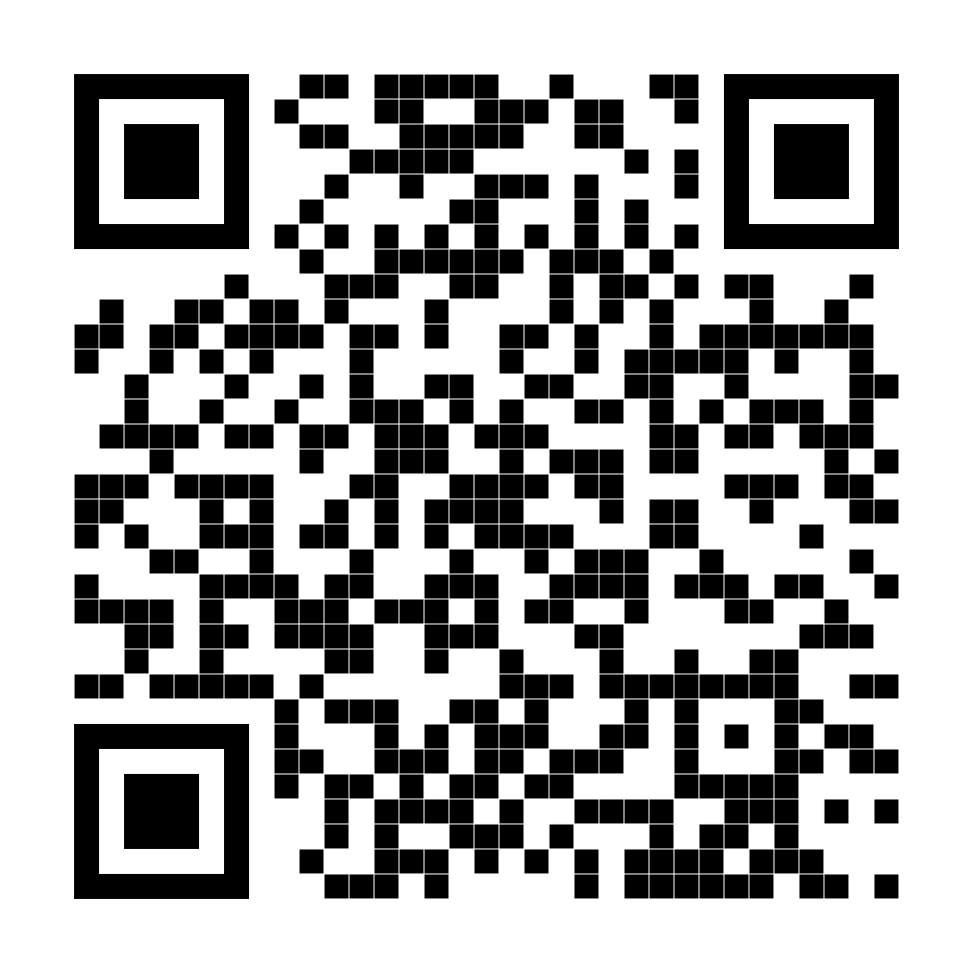
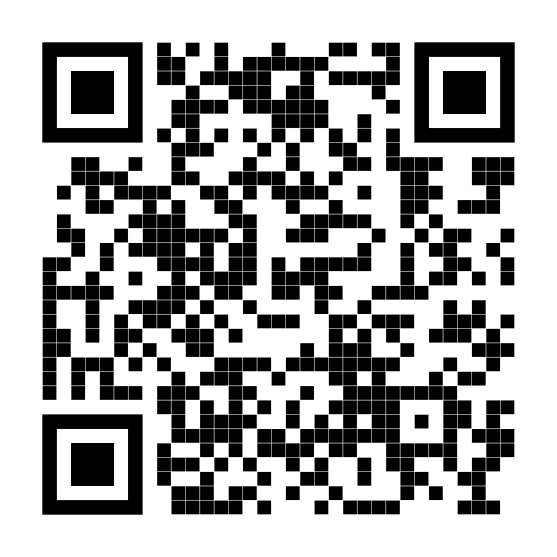
Contactez-nous
Contact Us

Slide 9










DGPCD L3 Lines of Business
CHIEF, PROFESSIONAL CONDUCT AND CULTURE • CHEF, CONDUITE PROFESSIONNELLE ET CULTURE
DIRECTOR GENERAL PROFESSIONAL CONDUCT AND DEVELOPMENT • DIRECTEUR GÉNÉRAL CONDUITE ET DÉVELOPPEMENT PROFESSIONNELS
Restorative Engagement Liaison
Support Heyder-Beattie Restorative Engagement program (2021-26). Recruit Defence Representatives (DR); capture lessons learned; facilitate DR Alumni Community.
Professional Conduct Data Systems and Complaints Process Transformation
Develop, coord and maintain prof conduct incident tracking sys and modernize case management sys to provide reliable data-centric info and decision-support to DND.
Defence Ethics
Services Available to Defence Team
Training and Education Programs
GBA+ for Defence and Leaders
Culture Evolution Coordinator
Victim Liaison Officer
Various course facilitators
Professional conduct scenarios and vignettes for unit level discussions
Restorative Engagement Defence Representatives and Alumni Program
Reintegration to Unit/Workforce Guide
SM and HC Spectrum Guidance
SMITS and HCITS admin and Trend Analysis
SMSRC Military Liaison to CoC and members
VLO Management
Professional Conduct Advice to develop L2/3/4 Culture Programs
Éthique de la Défense
Defence Ethics Program
Foster the practice of ethics in the workplace and in operations such that DND employees and CAF members perform their duties to the highest ethical standards.
SMSRC Military Liaison
Contributes to the effectiveness of the SMSRC response and sp svcs by offering info and guidance to CAF mbrs affected by SM and assisting CoC with the application of SM policies.
.
Prof Conduct and Culture Trg and Educ (T&E)
Contribute to DT Culture Evolution by supporting stakeholder programs and leadership in the development & delivery of education programs, tools, and resources to positively impact organizational change.
Notes:
Defence Ethics Program
Cornerstone of everything we do
Enables discussion at all levels to incorporate ethical thinking into daily work habits
Heyder-Beattie Restorative Engagement Liaison
Coordinates, trains and manages the defence representatives participating in the restorative engagement process
Professional Conduct Data Systems / Complaint Process Transformation
Provides system administration and monitoring of existing Hateful Conduct Incident Tracking System (HCITS) and Sexual Misconduct Incident Tracking System (SMITS)
Leads the initiative to transform the complaints process into a single system for improved tracking and analysis
SMSRC Military Liaison
Provides a military point of contact to support members and chains of command to navigate the resources available
Provides military advice to civilian SMSRC staff
Professional Conduct and Culture Training and Education
develop, deliver and oversee institutional training and education as it relates to professional conduct and culture
Provide subject matter expertise to other training authorities to incorporate professional conduct and culture into existing training products
9

Slide 10
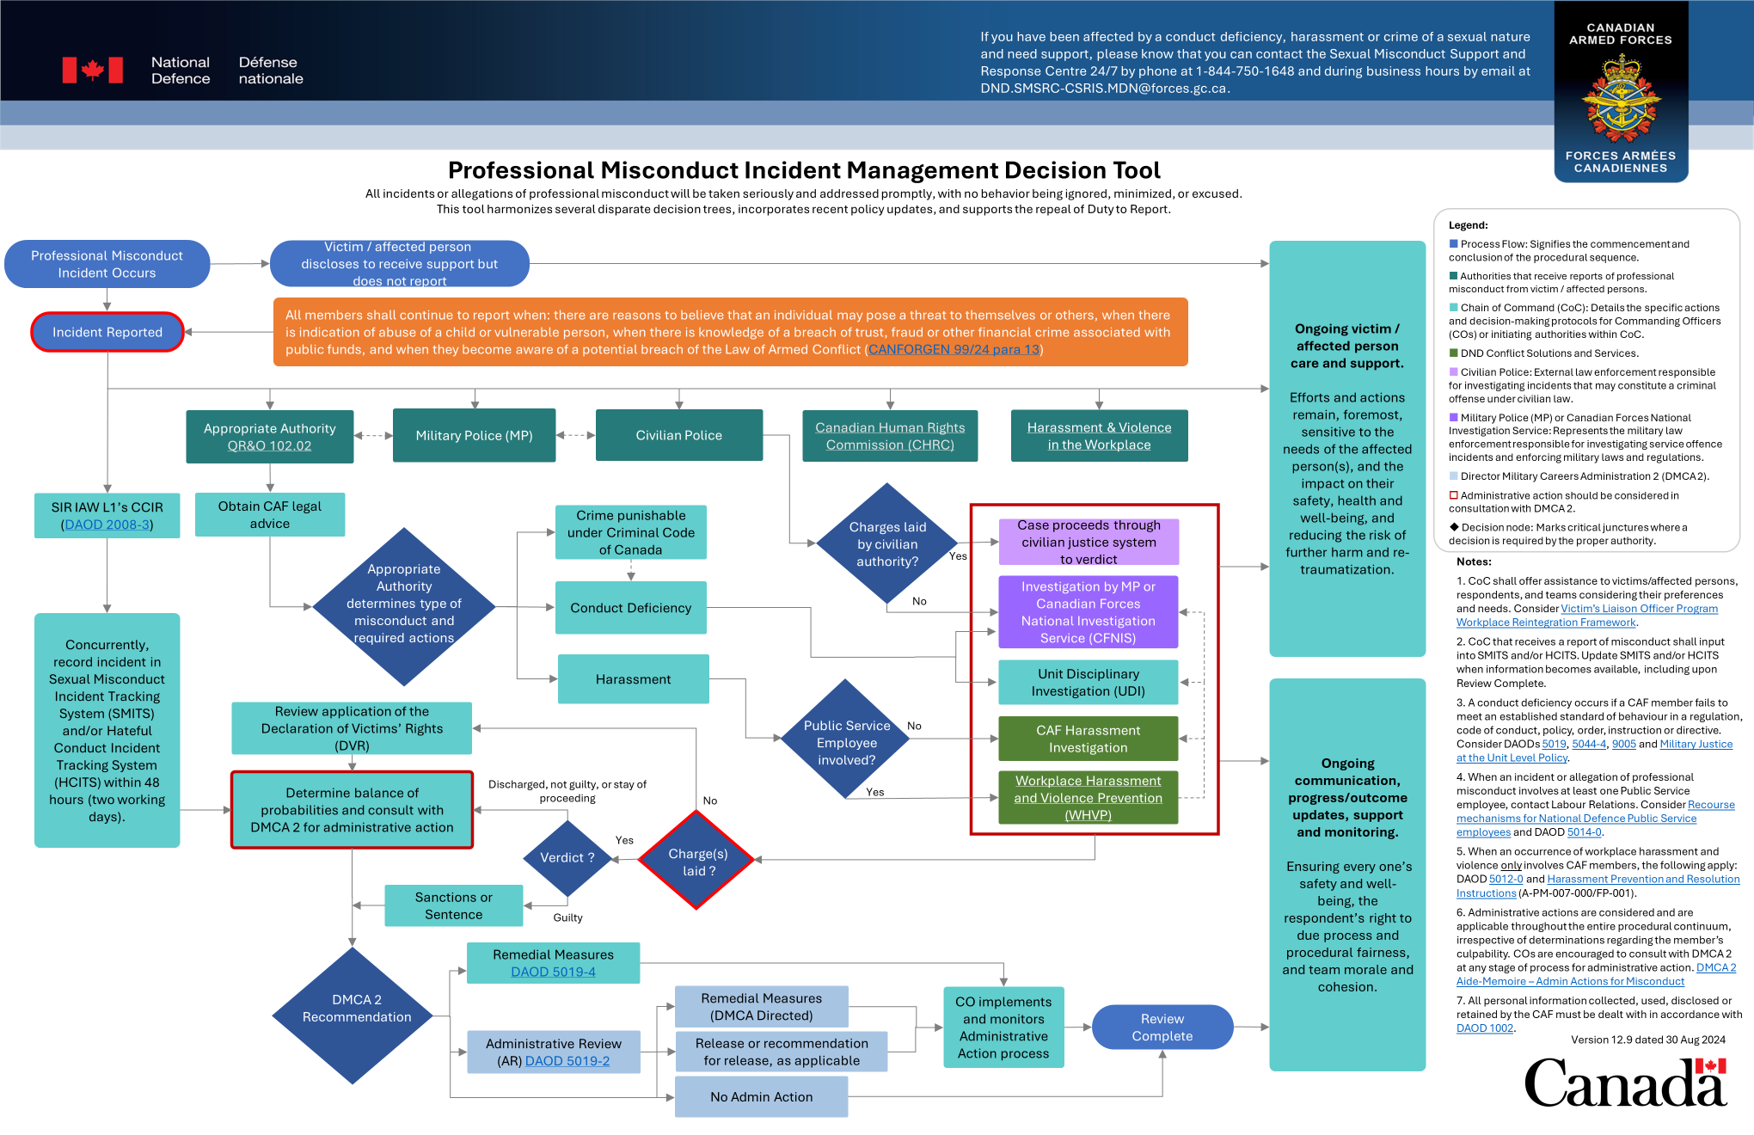
Notes:
The new Professional Misconduct Incident Management Decision Tool consolidates previous decision trees and incorporates recent policy updates including repeal of DtR and IECR 1. It enhances transparency, consistency, due process, and procedural fairness, providing a comprehensive guide for misconduct management.
The target audience is Commanding Officers, to determine the avenue to take to address the issue, but the tool has links and references for the entire defence team, including victims or affected persons and respondents. Links include source documents like DOAD’s and QR&Os, and also include other complimentary tools like the Workplace Reintegration Framework.
The Tool incorporates feedback from internal and external experts including DMCA 2, SMSRC, MPs/CFNIS, legal advisors, HR Civ, and affected persons.
Recently, a handful of Command Teams that are currently in command at the Unit level have provided valuable feedback.
I will now present a brief fictional scenario to demonstrate how the tool works.
Additonal consultation info:
Initial review conducted by KPMG​
Iterative consultation process with key stakeholders:​
DMCA 2​
SMSRC​
MPs/CFNIS​
LEGAD ​
Intersectional Advisor​
Across CPCC L2s, including in-depth engagements with:​
Workplace Harassment and Violence Prevention/DGCSS​
SMITS/HCITS Team Leads​
Duty to Report Repeal Policy Lead/DGEPR​
SMSRC Military LOs​
Advice Cell

Slide 11





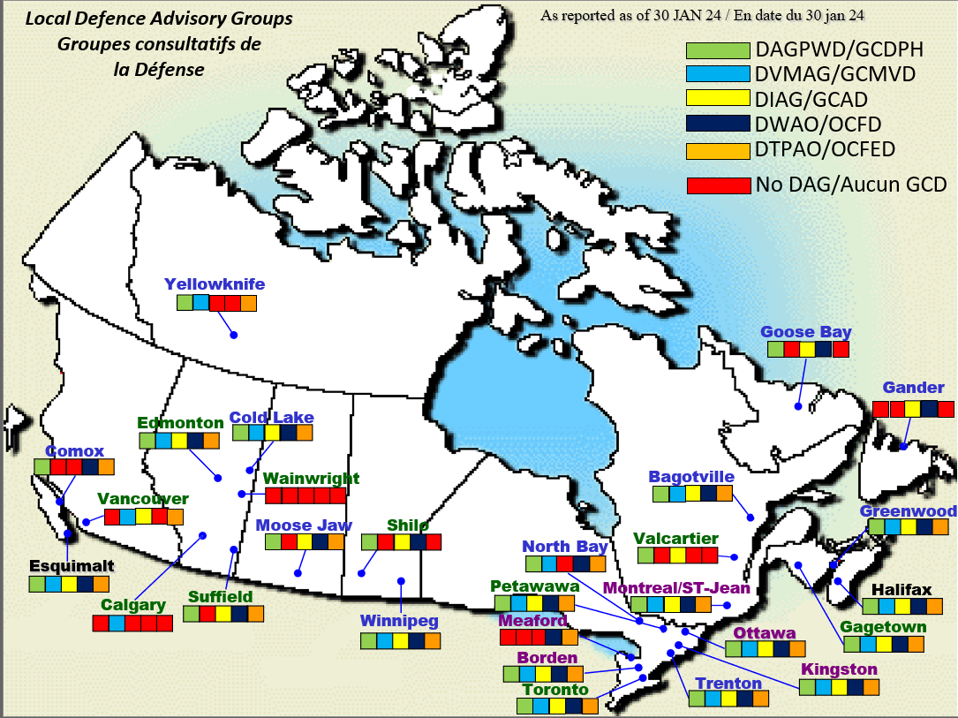
DEFENCE ADVISORY GROUPS (DAGs)
The EE Act (EEA) requires that every employer consult with its employees’ representatives by inviting those representatives to provide their views on the implementation of EE in the workplace and on the communication to its employees of matters relating to EE.
The five established DAGs are as follows:
Defence Indigenous Advisory Group (DIAG);
Defence Visible Minority Advisory Group (DVMAG);
Defence Women's Advisory Group (DWAO);
Defence Advisory Group for Persons with Disabilities (DAGPWD); and
Defence Team Pride Advisory Organization (DTPAO).
DAGs are available to provide advice and grass roots insight to DND and CAF leadership on issues relevant to their respective designated group on the implementation of EE. Their role may affect or assist with:
policy development on issues related to recruitment, retention, promotion and training;
employment equity initiatives; and
identification of systemic barriers.
11
Notes:
Progress:
Annual Reporting on SSE 10: Promote Diversity and Inclusion as Core Institutional Values
Challenges identified with ability to report and measure success/challenges of 2016 CAF Diversity Strategy
In response to a required update to the CAF Diversity Strategy, the CAF Inclusion Framework was created
The Framework will be integrated, along with actions and measures, into the new CAF HR Strategy (in progress)
Submitted annual update of SSE 10 to VCDS Fall 2021
In reference to the Golden Circle, the Inclusion Framework focuses on the WHY
Next Steps:
Using the Inclusion Framework to shape the new CAF HR Strat (led by DGMP Strat)
CAF HR Strategy is expected to be released in 2022
Risks:
Person who holds Diversity and Inclusion file is doubled-hatted
Key references: 2016 Diversity Strategy

Slide 12
Questions?

Slide 13
Training and education Link – added by RUCTOP CD
https://www.canada.ca/en/department-national-defence/services/conduct-and-culture/training-and-education.html

