Slide 1
RUCTOP 2024
LCol Chris Chmelyk
CWO Laurie Moore

Slide 2
CAF TG Mission:
In coordination with our valued partners, CAF TG will deliver personalized, professional, and standardized casualty support and transition services to CAF members and their families to enable seamless transition and enhanced well-being with special attention provided to ill and injured personnel, their families and the families of the deceased.

Slide 3
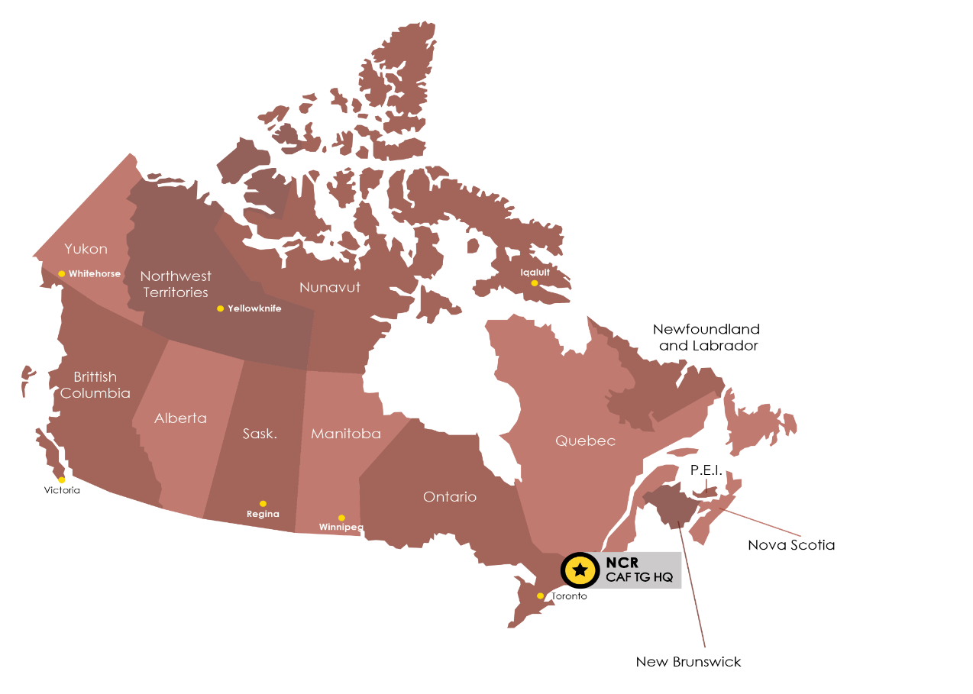
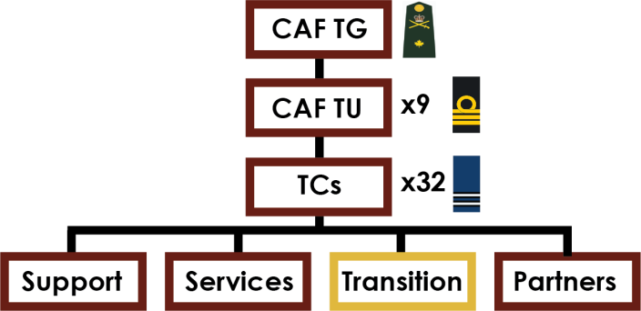






CAF TG
CAF TG: Canadian Armed Forces Transition Group CAF TU: Canadian Armed Forces Transition Unit TC: Transition Centre
CAF TU AB/North
TC Edmonton
TC Calgary
TC Wainwright
TC Cold Lake
VAC operates 38 Area Offices across the country and is working at 24 Transition Centres, on or near CAF bases, where VAC is generally co-located with CAF colleagues
CAF TU SK/MB
TC Winnipeg
TC Shilo
TC Moose Jaw
CAF TU E ON
TC Petawawa
TC Kingston
TC Trenton
TC North Bay
Edmonton
CAF TU NB/PE
TC Gagetown
TC Moncton
TC Charlottetown
Calgary
CF TU QC
TC Valcartier
TC Bagotville
TC Montréal
TC Saint-Jean
CAF TU BC
TC Esquimalt
TC Vancouver
TC Chilliwack
TC Comox
CAF TU S ON
TC Toronto
TC London
TC Borden
TC Meaford
CAF TU NCR
- TC Ottawa
CAF TU NS/NL
TC Halifax
TC Saint John’s
TC Greenwood
TC Gander
TC Sydney

Slide 4
Transition Centre Services
Support platoons
Members posted to TCs
Transition Services
My Transition (formerly SCAN) training
Transition counselling
Releases **
Integrated Services
CBI 211 benefits
CSM (including DA training)
Return to work (RTD training)
OSI Social Support
Members posted to TCs
TC Partners
VAC
MFRC
Soldier On

Slide 5
TU Command Teams
BC
Cdr Crossman / CPO1 Stevens
AB / North
LCol Han / CWO Crane
MB / SK
LCol Chmelyk / CWO Moore
Southern ON
LCol Lang / CWO Parris
Eastern ON
LCol Lidington / CWO Russell
NCR
LCol Manley / MWO McGoldrick
QC
LCol Theriault / CWO Cloutier
NB / PE
LCol James / CWO Leck
NS / NL
LCol Watson / CPO1 Landry

Slide 6
Contacts
For more information on the CAF TG and the transition services and support offered by both the CAF and VAC, please visit: https://www.canada.ca/military-transition or contact us at 1800-883-6094.
Additional transition-related contacts include:
VAC General Inquiries: 1-866-522-2122 (English), 1-866-522-2022 (Français)
VAC Assistance Service: 1-800-268-7708 for mental health support (24 hours a day, 365 days a year)
Family Information Line: 1-800-866-4546 (North America)
Manulife/SISIP Services:
CAF Long Term Disability (LTD): 1-800-565-0701
CAF Vocational Rehabilitation Program (VRP):1-800-565-6463
SISIP Financial: 1-800-267-6681

Slide 7

Domains of Well-Being
Domains of Well-Being are inter-dependent areas of consideration that
form the foundation of criteria for a successful transition. The seven domains defined by CAF and VAC are:
Health. Functioning well physically, mentally, socially, and spiritually.
Finances. Achieving financial security.
Housing and Physical Environment. Living in safe, adequate and affordable housing.
Social Integration. Maintaining mutually supportive relationships and being engaged in the community.
Purpose/Employment or Other Meaningful Activity. Engaged in activities one finds beneficial and meaningful.
Life Skills and Preparedness. The ability to adapt, manage and cope within civilian life.
Culture and Social Environment. Being understood and valued by Canadians.

Slide 8
Transition Centre Myths
Members on MELs / TCATs / PCATs should be posted to a TC;
Only members posted to TCs can access services;
Return to Work (RTW)
is solely a TC responsibility (unit, Wing RTD coordinators);
participation in RTW program is a member’s choice;
members can pursue educational upgrading as their RTW placement.
Members with MELs stating “appointments only” are not required to meet with their CoC or adhere to dress & deportment policies; and
Members on MELs will not be placed on administrative or disciplinary measures; and
All ill and injured members are entitled to a 3B release.

Slide 9
Useful Links
Canadian Armed Forces Transition Centres
Military Career Transition Portal
My Transition Guide
Soldier On

