Slide 1
RCAF Unit Command Team Orientation Program (RUCTOP)
LCol Maryse Therrien, D Mil C 4 13 Sept 24

Slide 2
Intent
To provide a brief overview of DMILC and to discuss Career Management issues.

Slide 3
Agenda
Introduction
Who we are
What We Do
Responsibilities
CM Cycle
Guiding principles
Challenges
Questions

Slide 4
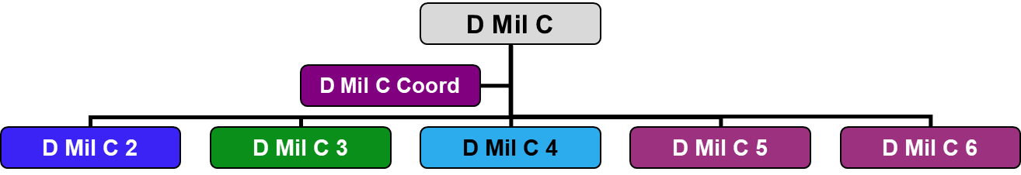
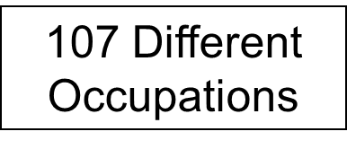
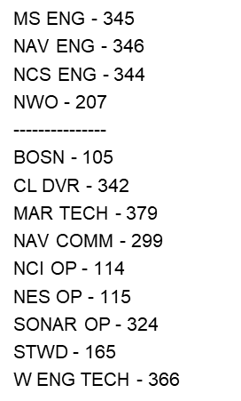
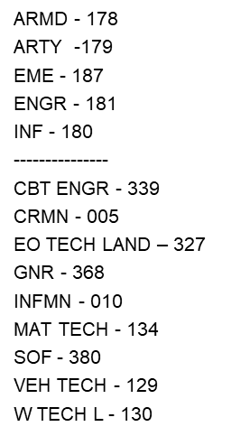
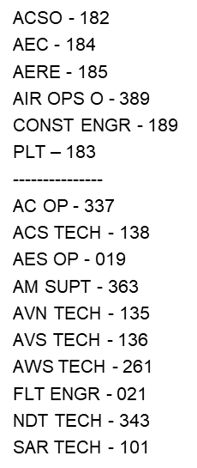
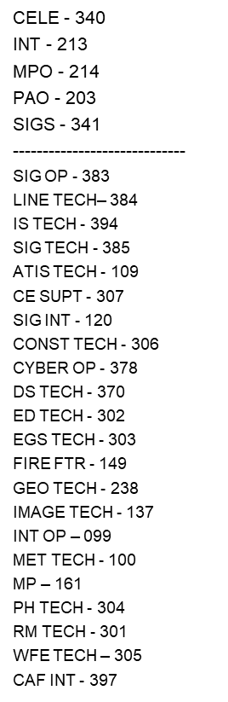
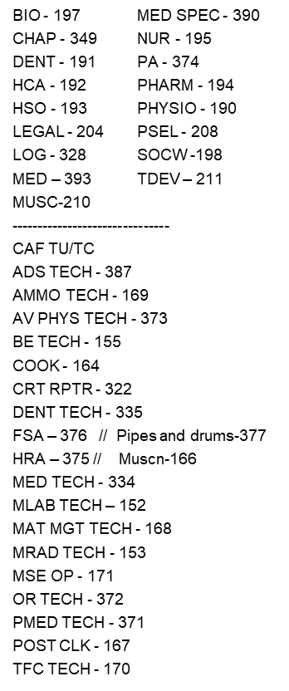
Who we are

Slide 5
Career Manager’s Responsibilities
Promotions
Postings
Staff files for administrative action (i.e., release, medical, compassionate postings, etc.) using Electronic Administrative Reviews (eARs)
Interview and counsel Officers and NCMs
Prepare files for Selection/Succession Boards
Submit nominations for career courses
Maintain Evaluation Reports, Information Systems and database files

Slide 6
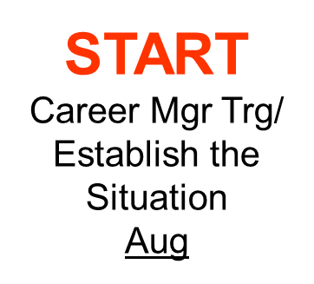
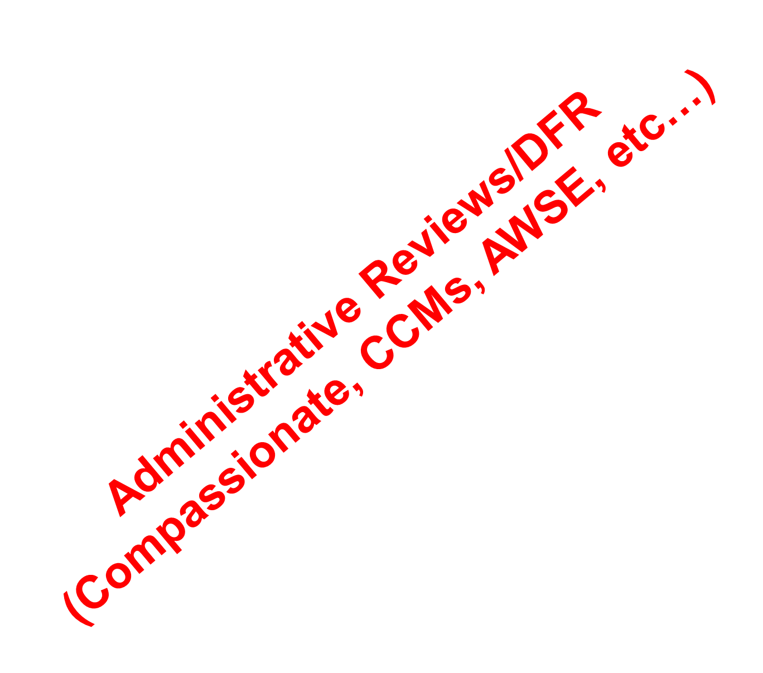
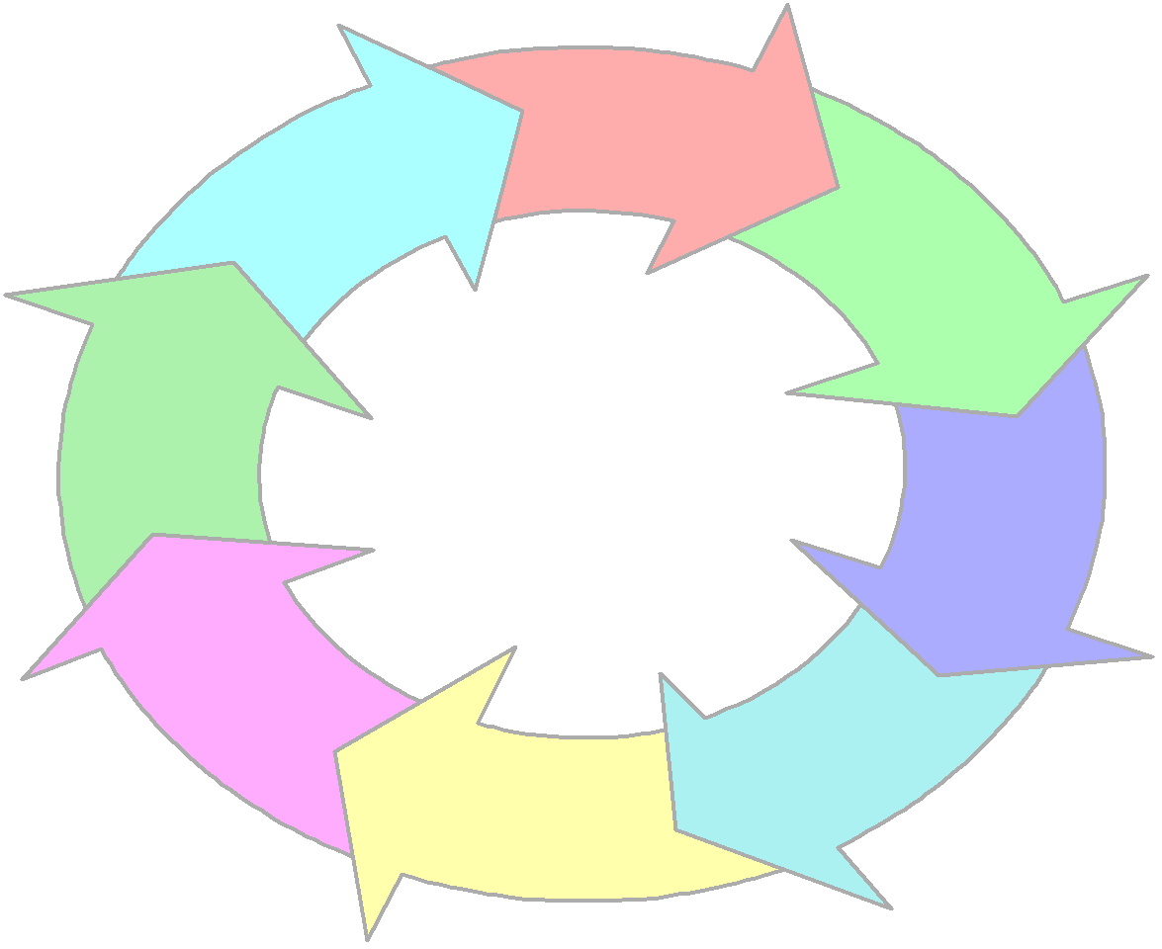
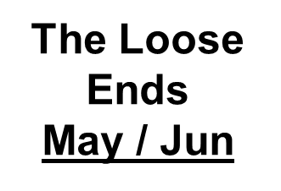



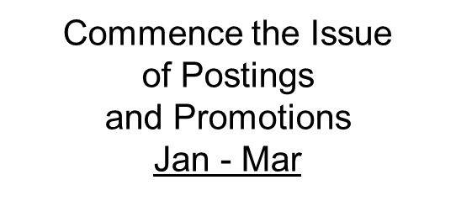
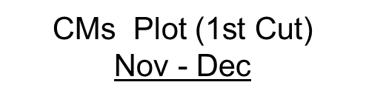
Career Manager Cycle
CM Interviews
Plot Refining
Jan-Feb

Slide 7
Career Manager Guiding Principles
Fairness Treat all individual and organizational issues in an objective, impartial and equitable manner
Transparency We must be committed to articulate the rationale and the process that led to a decision
Consistency Similar interpretation and applications of rules, policies, etc
Flexibility Willingness to reconsider a decision based on new information *
Responsiveness Committed to addressing client issues in a timely, considerate, and approachable manner (Client: Anyone we assist in reaching their goals)
Innovation Analyzing the current processes and where necessary implement improved ways of doing the business
Integrity Behave in accordance with our guiding principles
* Note : Not flex of policy but rather flex of application and willingness to consider new info

Slide 8
CM Guiding Principles Cont
Right Person
Right Qualifications
Right Place
Right Time

Slide 9
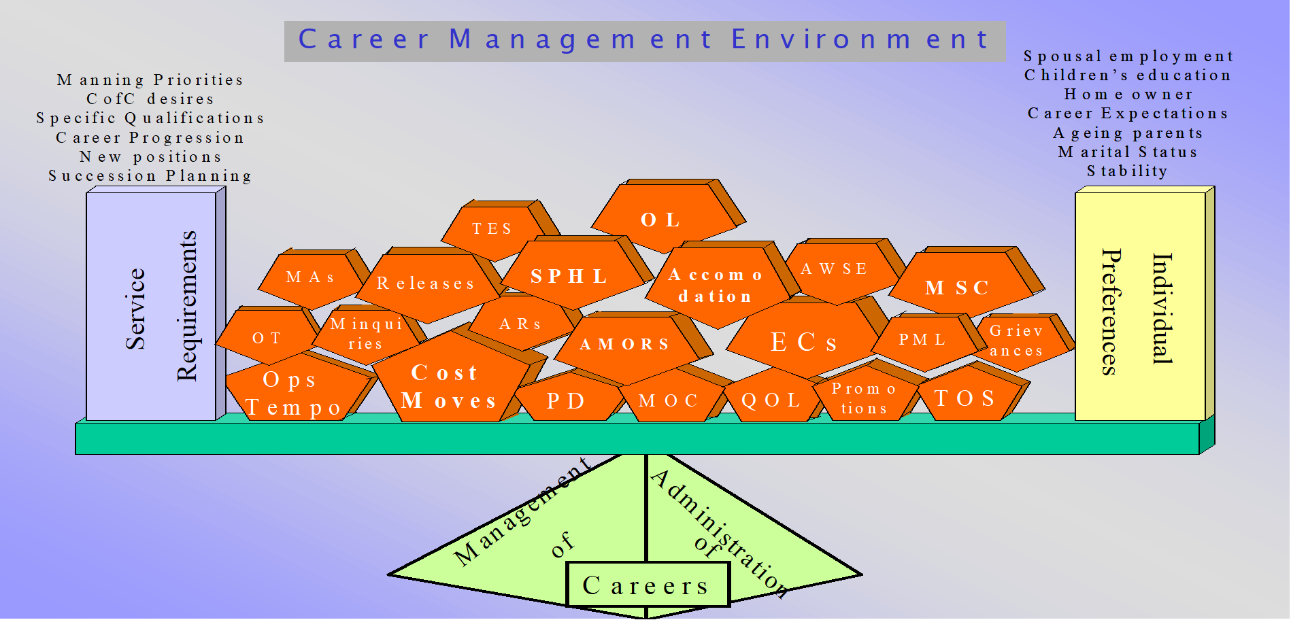


CM Pressures; Balancing Act…

Slide 10
Critical Career Management Challenges
Staffing Pressures
The CAF is short approx. 11,000 personnel on Trained Effective Strength (TES) and the situation is not improving
Current staffing demands (INCAN & OUTCAN) may outstrip the CAF’s ability to FG. The demands continue to be greater at ranks / trades that are already “Red/Yellow”
Command Teams must Manage Vacancies
Notes:
DND/CAF is facing a net growth without a coordinated offset plan
Units that have to be manned to 100% (e.g. CFRG, CFLRS, TG and Priority 1 (OUTCAN) require resources making them unavailable for other priorities
OUTCAN posts are bound by rigorous screening (i.e. harder to fill in some cases)
Qualified personnel (TES) is the limiting factor in the short term
TES Shortfall combined with LWOP (MATA/PATA) and non-accountable positions leaves ~10,000 (~20%) vacancies within CAF establishment, mostly at middle-management ranks (Maj-LCol and Sgt-MWO). As an example, we’re currently short ~600 Majs, ~600 WO
Current challenge requires a longer term fix as it takes 3-7 years to generate the qualified/experienced cadre
NEW AWSE Policy is still be reviewed by all L1s we are not sure when it will be issued. if COs deems position should be filled by AWSE member, a request to and approval from DGMC is required for AWSE prior to assigning all duties and responsibilities to the individual. COs must consider cascading effect as you AWSE from lower Ranks there will be no backfill creating a more hollow Unit.
Note last year brief 7,200 short on TES

Slide 11
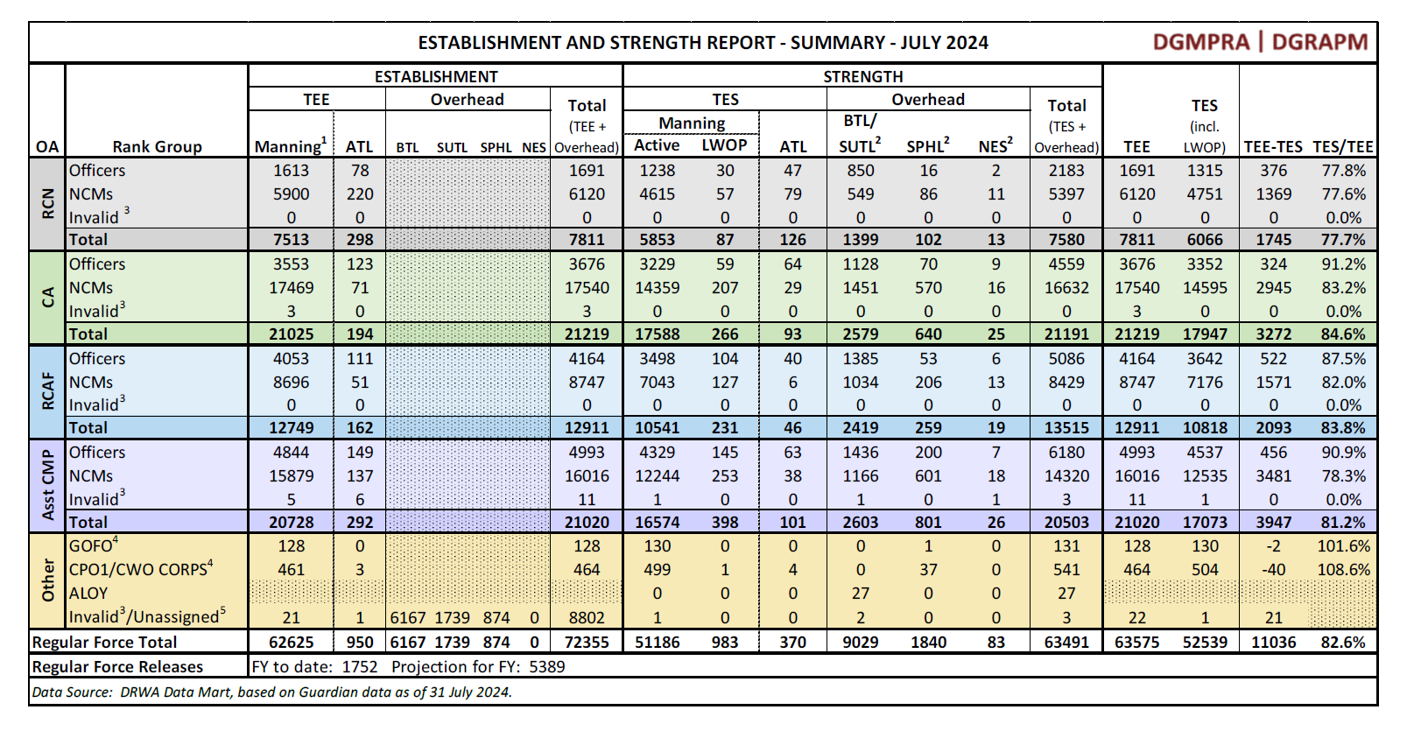
CAF Manning as of Jul 2024
Notes:
Currently the CAF is

Slide 12
CO’s Responsibilities, how to help DGMC
Recommendation for release
Support or not
CCM/Compassionate Status
Impact, new DAOD
Promotion concurrence or not

Slide 13
DGMC Retention Initiatives
AWA
STARTED IN 2022
CF MIL PERS INSTR 01-17
TO DATE APROX 110 APPLICATIONS
AWSE
CURRENTLY CANFORGEN 040/20
NEW CANFORGEN IS BEING REVIEWED
CS / CP / CCM
ONGOING POLICY REVIEW
CLARIFICATION OF POLICIES AND PROCEDURES
De Compressed APS 23

Slide 14
Final Points
Timely Decisions
the more we know, the better
the sooner we know, the better
Standards and precedents of CAF-wide decisions
Balancing the
the needs of the CAF
best employment of the member’s skills and experience
requests of the individuals
The Admin Review process ensures fairness and transparency, peer review and consistency

Slide 15
Questions / Discussion
Possible DMCA Career Decisions
Retention without restriction
Remedial Measure (including 2nd Counselling and Probation (C&P))
Retention with employment limitations
Compulsory Military Occupational Transfer
Release
An offer of TOS
DMCA KEY CONCEPTS / TAKE AWAY
Balance of probability
Comd Team’s key role in CAF Pers Mgt
Impact on CULTURE
Impact on the INSTITUTION
DMCA Procedural Fairness
Notification
Disclosure
Waiver
Representations
Decision
Dissemination of decision
DMilC Take Away
Timely Decisions
Standards and precedents of CAF-wide decisions
Balancing:
the needs of the CAF
best employment of the mbr’s skills and experience
requests of the individuals
The Admin Review process ensures fairness and
transparency, peer review and consistency

Slide 16
Key Points of Contact
Col C. Tetreault D MIL C 613-901-8086
Maj M. Lee D MIL C Coord 613-901-8154
Cdr R. Hodgson (C2 - RCN) 613-901-8119
LCol P. Pappins (C3 - CA) 613-901-8111
LCol M. Therrien (C4 - RCAF) 613-901-8141
LCol O. Montplaisir (C5 - Cbt Spt) 613-901-8135
LCol A. Lavoie (C6 - Cbt Svc Spt) 613-901-8129

Slide 17



